Slide 1
Mid Year PBM Change
Rob Oyer - Risk Manager, Lake County Schools
Joshua Rubich - Area Senior Vice President, Gallagher
©2024 ARTHUR J. GALLAGHER & CO.

Slide 2
Agenda
1
About Lake Schools
Rx Claims Over the Years
Chosen Vendor
5
9
Results and Savings Drivers
2
Pop Quiz Time
6
Ozempic and Mounjaro Claims
10
Example Clinical Determinations
3
PBM Business Model
What Drove the Increase
7
11
Post –Mortem and Summary
4
Need For A Different Solution
8
Chosen Path
12

Slide 3
About Lake Schools
4,700
Enrolled Employees
Four Onsite Clinics
Self Funded with two TPA:
Florida Blue and HPI
Insurance Committee with Members from Administration and Two Unions
$50M+
Healthcare Budget

Slide 4
Pop Quiz
₈%
According to a recent study, for patients in their deductible phase, what % of the time was paying cash cheaper than if the patient has used their insurance and gotten the price “negotiated” under their insurance (PBM)*?
19%
41% 79%
* Patel et. al., Annals of Internal Medicine, September 5, 2023, https://doi.org/10.7326/M23-0644

Slide 5
Pop Quiz
₈%
According to a recent study, for patients in their deductible phase, what % of the time was paying cash cheaper than if the patient has used their insurance and gotten the price “negotiated” under their insurance (PBM)*?
19%
41% 79%
* Patel et. al., Annals of Internal Medicine, September 5, 2023, https://doi.org/10.7326/M23-0644

Slide 6
The PBM Business Model Defies Common-Sense
Discount Guarantees
Inflationary mechanism that is tied to higher profits for industry vs. lower costs for buyers
Ex. Generics cost less outside, Mark Cuban Cost Plus
Formulary/Rebate Guarantees
Pay to play drug monopoly creation vs. lowest cost outcome
Ex. Nexium vs. Omeprazole, Humira vs. Yusimry
Owning Supply
Sold as lower costs for buyer instead of the truth of higher cost lock-in to higher prices

Slide 7
Need for a Different Solution
Actions Taken Thus Far
Plan Design Changes
Implementation of Onsite Clinics
Pharmacy RFP and Market Check
Surgical Center of Excellence
Independent TPA with high performing network
What We Wanted
Full transparency in data
Ability to change formulary or adjust drug mix without needing multiple approvals from the PBM
Lower total cost of care – thinking beyond discounts and rebates
What Was the Data Telling Us
36% of GLP-1 utilization didn’t have a diabetes claim in the past 12 months – Concerned about PA process
Rebates were increasing but not enough to offset the top line cost
Gross claims almost doubled in cost since 2018/2019

Slide 8
Rx Claims Over The Years
Gross claims have almost doubled since 2018/2019 with net claims increasing by 40%

Slide 9
Ozempic and Mounjaro Costs Over the Years
2021-2024
$1.6m in increased spend in two years on two medications.

Slide 10
What Drove the Increase?
Volume – Additional 400 members on these medications in the 2023/2024 plan year
Prior Authorization Process – Lack of process and validation – 442 GLP utilizers in 2023. 161 of these utilizers did not have a diabetes claim filed in 2022

Slide 11
Chosen Path
Engaged multiple PBA’s (not PBMS) for proposals
      Key difference in that the ONLY revenue generating source from these firms is their admin fee.
Conducted interviews pre-proposal to understand key differentiators, service model and overall approach
RFP encompassed the following:
      Claims repricing
      Member Disruption
      Questionnaire
    Presentation given to Insurance Committee for board recommendation
    Effective Date:
      Pharmacy change effective on January 1, 2025 (Lake School’s benefits renewal is 9/1/2026)
      January 1 chosen to achieve savings early and for member ease (deductibles and max oop reset Jan 1)

Slide 12
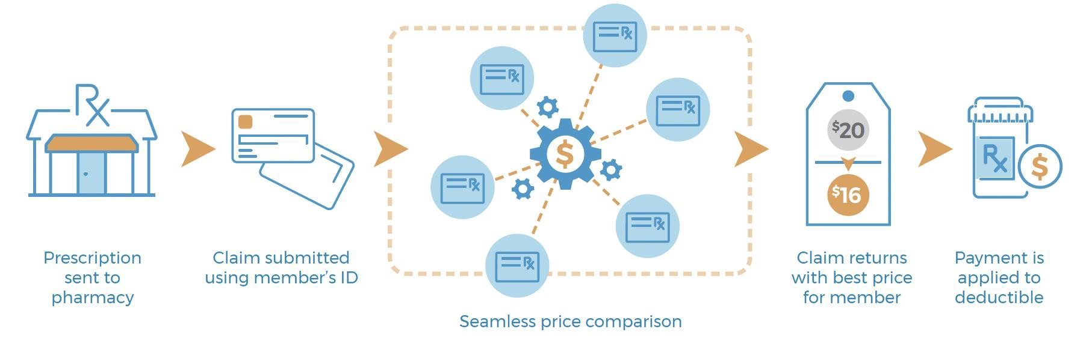
Chosen Vendor - VIVIO
VIVIO How it Works - Retail
Checks Network + Cash Prices on the backend so a member doesn’t have to

Slide 13






Chosen Vendor - VIVIO
VIVIO How it Works – High-Cost Therapies
VS
PRIOR AUTH
FORMULARY
CARE GAP
THERAPY
PLAN
RIGHT DRUG
OUTCOMES
DATA
TRADITIONAL PBM &SPECIALTY PBMS
Ineffective therapies cost more
VIVIO PRECISION CARE
Better therapies cost less
VIVIO Collaborates with physicians to get patients on the right therapy rather than excluding or denying drugs using a Formulary

Slide 14
Results
Claims are lower than they were in the 2022/2023 time period!

Slide 15
Savings Drivers
Therapy Plan
Full clinical notes required for all specialty medications and GLP’s
Biosimilar Strategy
January – All Humira claims moved to Yusimry - $30k in savings per drug (net of rebates)
July – All Stelara claims moving to Biosimilar
1
2

Slide 16
Savings Drivers
GLP-1 Appeals in Focus
Upheld | Upheld | Overturned | Total
1st level appeal | 59 | 1 | 60
2nd level appeal | 35 | 3 | 38
External appeal | 21 | 7 | 28

Slide 17
Example Clinical Determinations

Slide 18
Implementation Post-Mortem
Wins:
Vast majority of employees had no issues at the pharmacy counter
Savings are being delivered
Lake Schools has full control of the plan – no more “Mother May I’s”
Set Backs:
Service Provider did not effectively manage the therapy plan process with many employees, i.e. interaction between doctor, member and service provider
Lack of training with service provider staff led to poor interactions with members
New provider set up required manual accumulator at first
GLP-1s are VERY valued. Members felt as though they were specifically being targeted
Insights:
Onsite clinic provider was the single largest culprit in nondiabetic requests for GLP-1s
Mid year vendor change caused confusion with employes – You can’t over communicate!

Slide 19
Summary
1
3
Bigger isn’t always better
Communicate, Communicate, Communicate
2
4
Creating aligned incentives can drive savings and value
You are not bound by the same old solutions

Slide 20
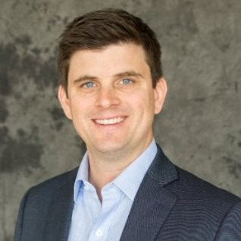
Thank you
Joshua Rubich, Area Senior Vice President
(P) 407-468-4383
(E) Joshua_Rubich@ajg.com

