Slide 1

Revealing Healthcare Fiduciary Liability:
Protecting Public Employers from Hidden Risks
Notes:
There is a growing legal scrutiny on employers and their fiduciary duties within their healthcare plans.

Slide 2

The Risk They Didn’t Know They Owned
More than 60% of employers are unaware they are legally liable for healthcare plan mismanagement—even when outsourced.
Notes:
In Lewandowski v. Johnson & Johnson, the plaintiffs alleged that J&J breached its fiduciary responsibilities under ERISA by mismanaging the prescription drug benefit program, costing employees millions of dollars in the form of higher payments for prescription drugs, higher premiums, deductibles, coinsurance and copays and lower wages and limited wage growth. In addition, the plaintiffs alleged J&J failed to furnish requested plan documents as required by ERISA.
On January 24, 2025, the U.S. District Court of New Jersey dismissed claims made in a class action lawsuit
Ability to furnish plan documents is still under review. If found in breach they will be responsible for a fine of up to $110/day for every day over 30 days from the request that it took to provide these documents.
With respect to the dismissed claims, the court is providing the plaintiff with leave to amend the complaint to cure the failures identified by the court as to the issue of standing (they have 30 days to do so).
While J&J may feel that they are off the hook, the flags have been raised in relation to employer's responsibilities in their group health plans.
Most employers believe that they can execute a fiduciary agreement and transfer the responsibility to a third party - but that is not the case, even in fully insured plans.

Slide 3



How Exposed Are You?
Have you conducted a claim audit in the last 12 months?
Have you reviewed your TPA’s approval and denial logic?
When was the last time you had a legal review of plan documents?
Notes:
If you are unsure or said 'no' to any of these, you're not alone—and you're not protected.

Slide 4

What is Fiduciary Responsibility?
Employee Retirement Income Security Act (ERISA) requires that persons or entities who exercise discretionary control or authority over plan management or plan assets, anyone with discretionary authority or responsibility for the administration of a plan, or anyone who provides investment advice to a plan for compensation or has any authority or responsibility to do so are subject to fiduciary responsibilities.
Notes:
Most of us know this definition as it relates to our retirement plans, and many governmental entities will feel that either they are not subject to them due to the exclusion of governmental entities or due to having a fully insured plan employer plan or even because at some point during their plan administration they have executed a document advising that a third party has the responsibilities of plan fiduciary.
But plan fiduciaries include, for example, plan trustees, plan administrators, and members of a plan's decision committee.
Anyone exercising discretion over plan management. As the employer you are the decision point for which TPA you use, if you use a PBM, if you are self-funded or fully insured, and thus do not miss the opportunity to protect yourself in the ways that you can.

Slide 5

Who Can Be Defined as Fiduciaries?
  Fully Insured Carrier/ASO (Florida Blue, Aetna, Cigna, United Healthcare)
  Third Party Administrator (Veracity, 90 Degree, Luminare Health, Personify Health, etc)
  Pharmacy Benefit Manager (Express Scripts, CVS, Capital Rx, Optum Rx, Evernorth, etc)
  Broker / Consultant (FBMC, Aon, Gallagher, Lockton, Mercer, Baldwin Group etc)
  Premium Third Party Administrator (FBMC, GIS, Optavise, Winston, etc)
  HR / Benefits / Risk Managers
  CFO
  Superintendent / Board

Slide 6




Three Key Areas of Fiduciary Risk
Clinical
Financial
Documentation
Notes:
today we are going to focus on 3 key buckets of importance with relation to fiduciary duty and ways to mitigate or protect not only your employees, and employer, but yourself in the event that you are the one responsible for making many of these decisions.
1. Clinical - Medical Necessity & Care Oversight
2. Financial - Billing & Payment Accuracy, Appropriateness of Fees, Transparency of Compensation
3. Documentation - remember we say, document, document, document, so this is a focus on Legal Compliance & Transparency, Availability, and Tracking of things like plan documents, committee meeting minutes, etc.

Slide 7


Owens & Minor vs Anthem BCBS of VA
Owens & Minor claimed Anthem had failed to uphold their fiduciary responsibilities as the Third Party Administrator.
  Overpayment of Claims
  Receipt of Kickbacks
  Retention of Rebates Due to the Plan
  Restricted Access to Data for Plan Evaluation
Notes:
Owens & Minor, acting in their fiduciary duty, held their TPA Anthem BCBS of VA responsible for their fiduciary responsibilities under their employer sponsored health plan.
It ultimately settled out of court, but one of the key components is that in the evaluation Owens & Minor identified that there was gross overpayment of claims, some that did not meet clinical appropriateness of treatment on behalf of employees.

Slide 8





Mitigating Clinical Risks
Partner Spotlight
Conduct regular audits of claims
Josh Spivak
(610) 213-4030
Implement independent medical reviews
josh@highlighthealth.com
Leverage population health management tools
Partner with experts in cost containment and claim reviews

Slide 9





Mitigating Financial Risks
Partner Spotlight
Pre-payment Claim Auditing
Michael Miele, FSA, MAAA
(201) 679-5164
mike@cap-rx.com
Transparency in Pricing
AI-driven Fraud Detection Tools
Notes:
The number of examples of financially related lawsuits has grown exponentially over the past year following the Johnson and Johnson lawsuit.
One of the more recent examples is for none other than JP Morgan. Someone whom you would expect to be so educated on fiduciary responsibility that they would be immune to lawsuit, but a recent suit filed in March 2025 related to overcharging of prescription drugs follows a long line of similar suits against employers, carriers, TPAs, and PBMs.
in June a motion to dismiss has been filed, but the outcome is still pending.
When we move into the financial bucket, there are many components of finance in a health plan. Including reserve funding and the use of those funds which are ultimately a co-mingling of employer and employee dollars.
I mentioned Josh and his team at Highlight, and I would be remiss to not mention that they also offer the pre-payment claim auditing.
Transparency in pricing is in all areas of the plan, brokers should be providing the annual compensation disclosures under the 2021 CAA requirements, check your PBM for spread pricing or hidden compensation through per script fees to brokers or other third parties
and lastly using AI driven fraud detection tools, check what tools your TPA is using for fraud detection and ask for reporting, if you are fully insured this is a great place to request how much auto-substantiation is being done as that can open you up to potential financial exposure.

Slide 10



Document, Document, Document
Plan Documents
Meeting Minutes
Audit Findings
Up-to-date plan documents and summary plan documents easily accessible and provided in accordance with regulatory timelines.
Creating benefit committees and documenting the discussions and outcomes of regularly scheduled meetings conducted with consultants, plan administrators, and carriers.
Engage vendors for performance audits and then have those findings documented and stored with the meeting minutes so they can be accessed easily.

Slide 11
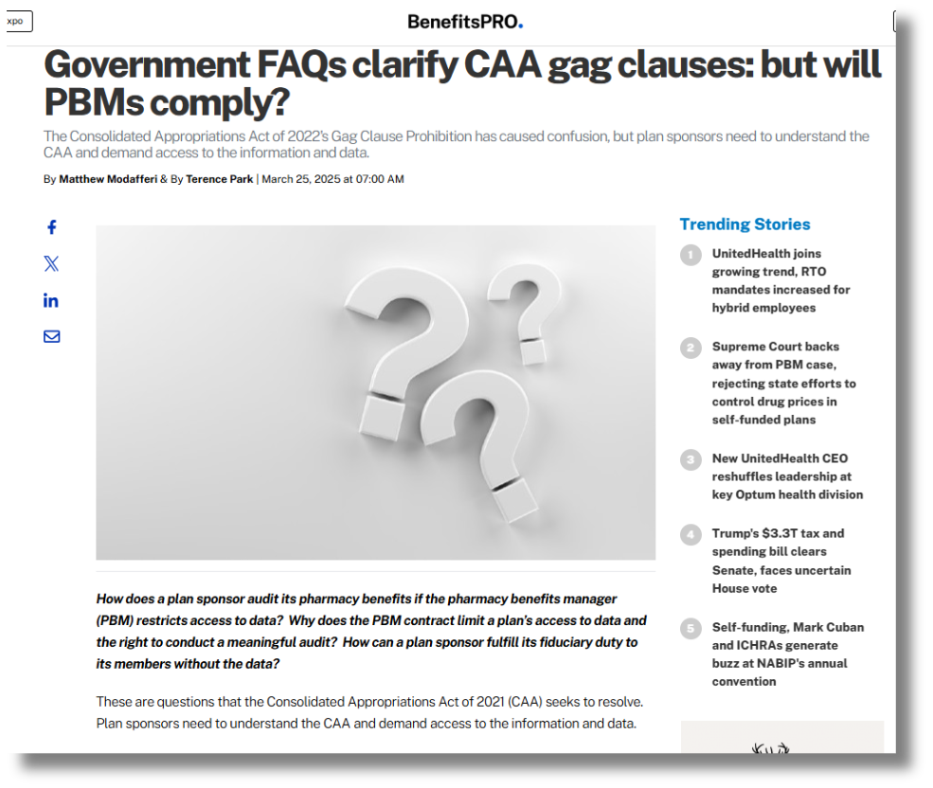
Consolidated Appropriations Act (CAA) 2021 -
Prohibition of Gag Clauses
Specifically, the CAA prohibits clauses that restrict:
  Sharing of cost and quality information: Plans cannot be prevented from disclosing provider-specific cost or quality information to members, plan sponsors, or referring providers.
  Access to de-identified claims data: Plans cannot be restricted from electronically accessing de-identified claims data for plan participants.
  Sharing information with business associates: Plans cannot be restricted from sharing data with business associates, as long as it's done in accordance with HIPAA regulations.

Slide 12




Mitigating Documentation Risks
Document Checklist & Storage Plan
Periodic Legal Review
Partner
Spotlights
Jeff Hogan
Patrick Williams, AIF
(860) 424-2600
(612) 860-0937
jeff@homahealth.us
patrick@fiduciaryinabox.com

Slide 13




Take Action Today - Don’t Wait!
Locate Current Documents
Identify Plan Fiduciaries
Engage Partners for Advising/Oversight
Set a Schedule for Future Audits
Collect current plan documents and create a centralized storage location for internal access of documents upon request.
Remember fiduciaries will come in many forms, identify who acts as a fiduciary in the plan and what areas they are responsible for and document it.
Now that you know where your documents are and who all is responsible, you can engage with partners to help ensure continued success.
This responsibility will continue to evolve, establish a schedule so you don’t forget to conduct periodic risk assessments and modifications.

Slide 14


Vickie Whaley, REBC
Managing Principal
(850) 933-1841
vwhaley@fbmc.com

