Slide 1




Current Trends & Innovative Solutions in Workers’ Compensation

Slide 2
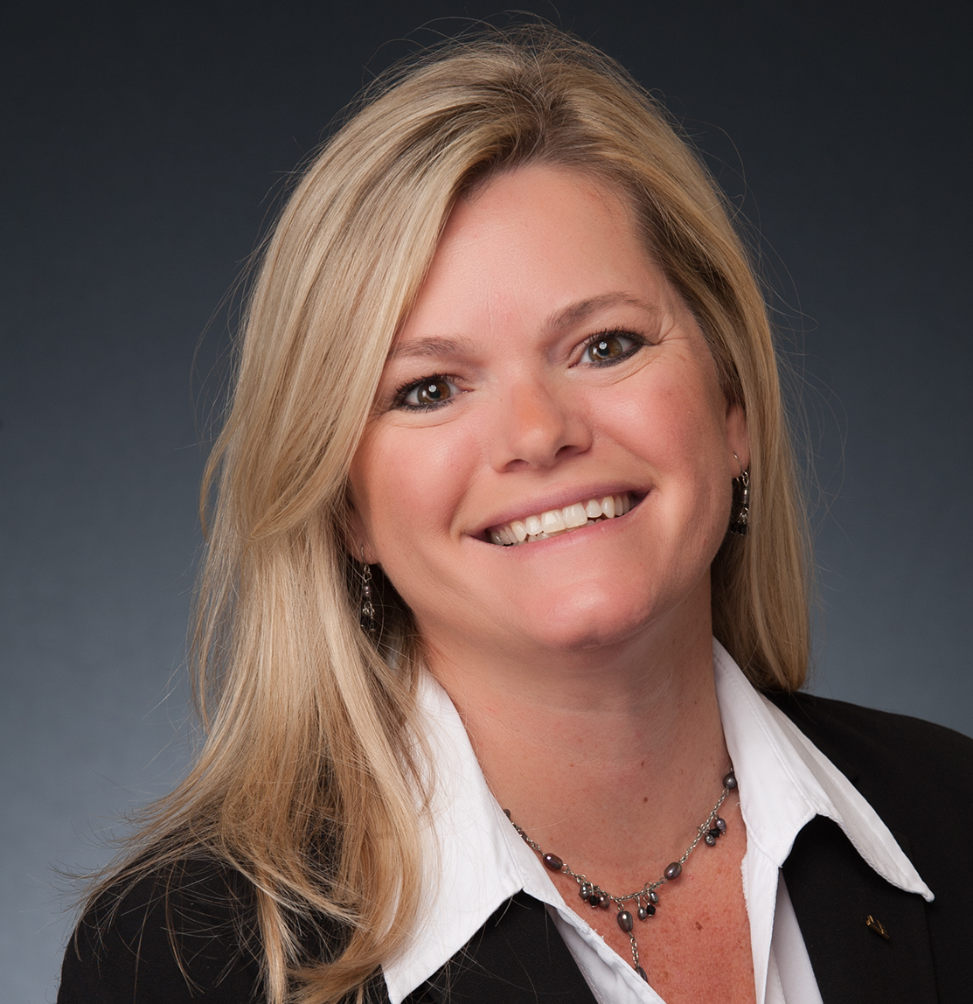
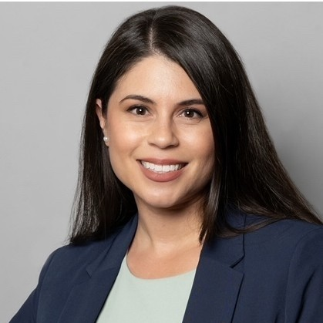

Today’s Presenters
Alice Wells
Senior Vice President, WC TPA
Davies
Eunice Gutierrez
Asst Vice President
AmeriSys
Greg Nichols
PT President
SPNet

Slide 3

What We’ll Cover Today
NCCI Trends
Florida Division of Workers’ Compensation
Innovation and Technology
  Care Coordination
  Care Engagement
Notes:
Story we want to get across
Impact FS changes “the why it occurred”
Positive impact
Negative: MD FS increase
Impact to Educational Risk
Davies : Mitigation strategy to offset changes

Slide 4
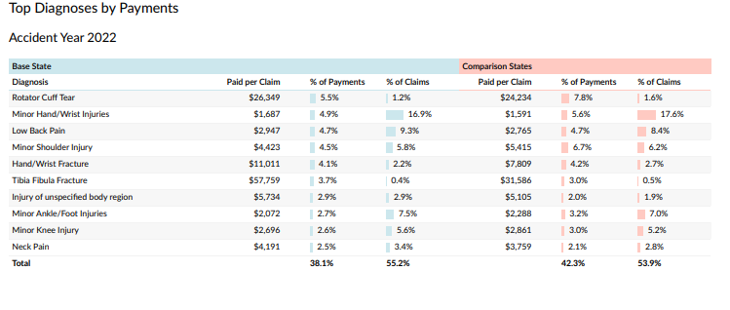
NCCI Trends

Slide 5
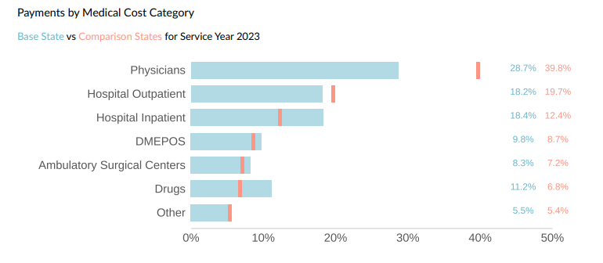
NCCI Trends

Slide 6
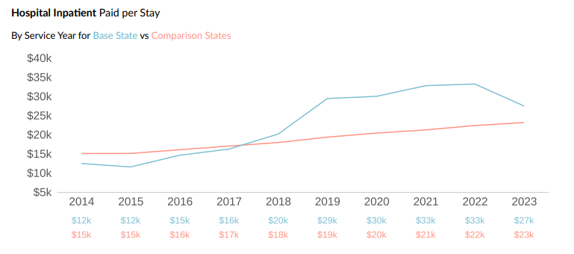
NCCI Trends: Hospital Inpatient Services

Slide 7
FL Division of Workers’ Compensation
Hospital Reimbursement Manual
Fee Schedule Update
Effective
May 25, 2023
Revised 2020 version of the Hospital Reimbursement Manual
Termination of reimbursement at Stop Loss
References a 3-tier per diem methodology for inpatient stays
Tier 1: Non-Surgical Stays
Reimbursing $7K Daily Per Diem Rate
Tier 2: Surgical Stay (Operating Room and Anesthesia Services)
Reimbursing $11K Daily Per Diem Rate
Tier 3: Intensive and Critical Care Services
Reimbursing $13K Daily Per Diem Rate

Slide 8
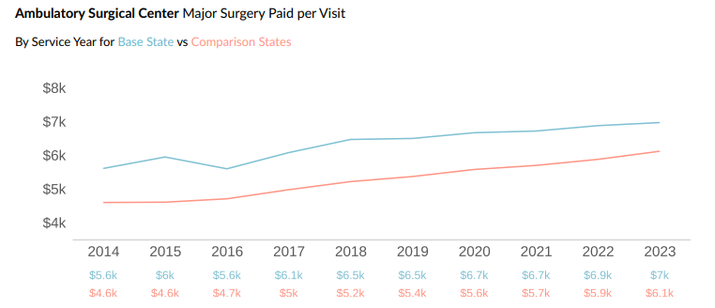
NCCI Trends: Ambulatory Surgery Centers
Notes:
Story we want to get across
Impact FS changes “the why it occurred”
Positive impact
Negative: MD FS increase
Impact to Educational Risk
Davies : Mitigation strategy to offset changes

Slide 9
FL Division of Workers’ Compensation
Ambulatory Surgery Center (ASC) Reimbursement Manual
Fee Schedule Update
Effective
July 1, 2023
INCREASE IN MAXIMUM REIMBURSEMENT ALLOWANCES (mra’S) FOR ALL CPT CODES
Addition of MRA’s for about 1,000 previously unlisted cpt codes
No longer paid at a percentage of Billed Charges

Slide 10
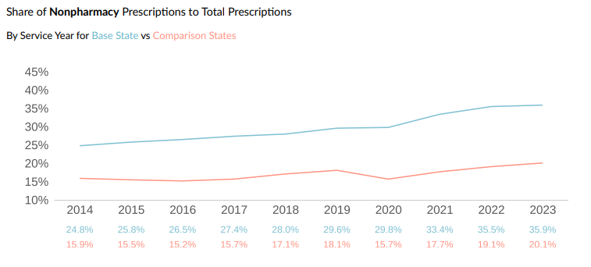
NCCI Trends: Physician Dispensing

Slide 11
FL Division of Workers’ Compensation
Healthcare Provider Reimbursement Manual – Physician Dispensing
Fee Schedule Update
Effective
July 1, 2023
INCREASE IN provider reimbursements across the board

Slide 12
FL Division of Workers’ Compensation
Healthcare Provider Reimbursement Manual – Physician Dispensing
Fee Schedule Update
69L-7.740(1)(c); F.A.C
Medication is treatment. When physicians (including oral surgeons), physician assistants, ARNPs, and any other recognized practitioners registered to dispense medications pursuant to Section 465.0276, F.S., submit a medical bill for reimbursement of dispensed medication, the insurer, claim administrator, or entity acting on behalf of the insurer may disallow payment for dispensed medication if the medication is not authorized prior to dispensing, pursuant to Section 440.13(3)(a), F.S., and is not medically necessary to treat the compensable injury. Dispensing such medications may not be denied, absent a contrary contractual provision, and reimbursement may not be disallowed or adjusted for the sole reason that the injured worker chooses to receive such medications from a practitioner registered to dispense medications under Chapter 465, F.S. Any response to a request for authorization must be communicated electronically or by telephone to the health care provider and must be documented in the claims administration system. Failure to timely respond to the written request for authorization shall be governed by Section 440.13(3)(d), F.S.
69L-7.730(2)(l); F.A.C. – b
Physicians (including oral surgeons), physician assistants, ARNPs, and any other recognized practitioners registered to dispense medications pursuant to Section 465.0276, F.S., may dispense medications to the injured worker. Medication is treatment and must be authorized prior to dispensing, pursuant to Section 440.13(3)(a), F.S., and must be medically necessary to treat the compensable injury. Dispensing such medication may not be denied, absent a contrary contractual provision, and reimbursement may not be disallowed or adjusted for the sole reason that the injured worker has chosen to receive such medication from a practitioner registered to dispense medications under Chapter 465, F.S. All requests for authorization of medications to be dispensed must specify drug name, dosage, and strength, must be documented in the injured worker’s file, and must be sent in a manner prescribed by the carrier pursuant to Section 440.13(3)(e), F.S. A

Slide 13
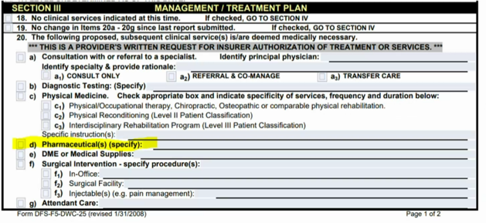
FL Division of Workers’ Compensation
Healthcare Provider Reimbursement Manual – Physician Dispensing
Provider must document physician dispensed medication specifically by drug name, dosage, and strength medication on DWC 25
DWC 25 is time sensitive – respond within 3 business days
Adjuster/Nurse Case Manager must provide notification to Provider’s office
If physician dispensed medication is not documented, potential bill denial
Collaborate with Pharmacy Benefit Manager

Slide 14

Senate Bill 362
Approved by Governor 6/14/24 – Chapter #2024-241
Effective January 1, 2025
Increasing the multipliers for both Non-Surgical & Surgical Services:
  Non-Surgical Services – from 110% to 175% of Medicare Allowable
  Surgical Services – from 140% to 210% of Medicare Allowable
***NCCI is projecting 6.9% increase for the industry
***2024 fee schedule already available on FL DWC website
https://secure.fldfs.com/wcapps/CPT/ProviderManMenuHCPFSM2024.asp

Slide 15

Specialty Provider Trends
By 2034, Association of American Medical Colleges projects the following shortages:
Approximately 30,200 for surgical specialties
Approximately 13,400 for medical specialties
35% of physician workforce will be of retirement age
By 2035, Florida Medical Association projects shortages:
Approximately 5,974 traditional primary care specialists
Approximately 1,519 emergency room physicians
Approximately 632 cardiologists
Approximately 209 orthopedic surgeons
Approximately 1,230 psychiatrists
Mental Health Shortage
CMS proposed expanding roles of Clinical Social Workers, Clinical Nurse Specialists, Nurse Practitioners, Physician Assistants

Slide 16
Advocacy
Early Identification & Intervention
Injured Employees
Identifying Psychosocial Barriers
Keeping the “Human Touch”
Medical Providers
Maintain Rapport
Deliver Education on Legislative Changes
Cost Containment
Collaboration between Claims and Clinical Teams
Holistic Approach
Return to Work
Quality of Care Treatment According to Best Practice Guidelines
Preferred Vendors & Providers

Slide 17

Care Coordination/Care Engagement
Future State of Healthcare Delivery

Slide 18




Innovation
Combining Technology with Data
Data Driven Decisions
AI Driven: Road Map
Fair Provider
Good Provider
Premier Provider
$34,749
$29,490
15.1%
7.3%
$27,327
Total Average Cost of Claim

Slide 19
Expansion of Care Direction
High
Surgical Center
Physical Medicine makes up 12-15% of Medical Spend
DME, T&T, and Dx makes up 6-12% of Medical Spend
73%+ of Medical Spend currently unmanaged by Insights Driven Care Direction
Physical Medicine
Medical Cost
Ortho
Dx
Primary Care
DME
T&T
Low
Impact (Outcomes)
High

Slide 20
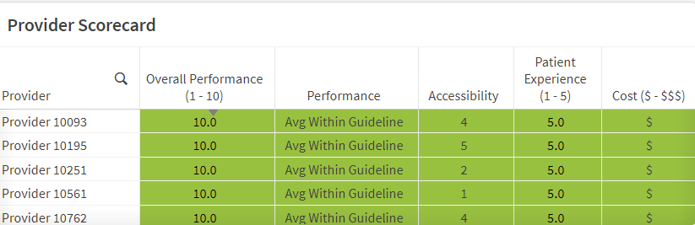
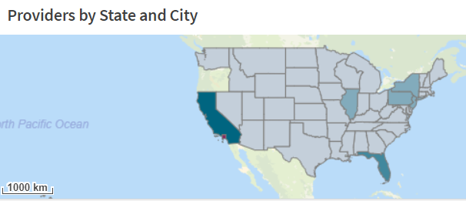
Care Direction SmartMatchTM
SmartMatch technologies use AI to determine the best Physical Medicine provider for each individual Injured Worker in the area in which they are treating.
Performance of Provider: Utilization Outcomes vs Expected Guideline
Accessibility of Provider: Ability to get the Injured Worker into Treatment within X Days from Referral
Cost of Provider
Patient Satisfaction: Patient Reported Outcomes Metrics, Provider Satisfaction Surveys

Slide 21
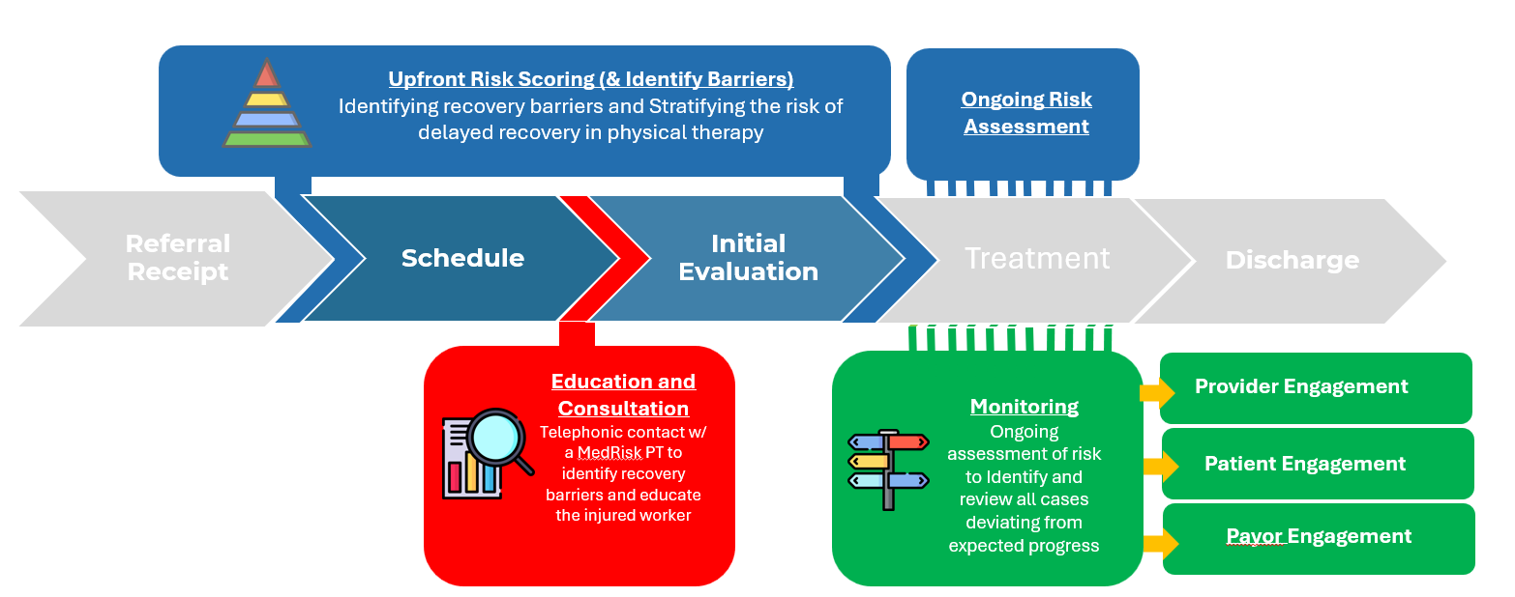
Care Engagement: Clinical Pathways

Slide 22
Claim Advocate_Clinical Services
Telephonic Case Management Services
Utilization Review, URAC Accredited
Bill Review, Cost Containment Services
Medical Directors and Physician Advisors
Field Case Management Services
Return-to-Work and Vocational Services

Slide 23
Thank You for Joining Us!
Questions for Today’s Presenters?
Alice Wells – alice.wells@us.davies-group.com
Eunice Gutierrez – eunice.gutierrez@amerisys-info.com
Greg Nichols – nicholsg@spnetclinicalsolutions.com Operations Manager
Questions for Today’s Presenters?

