Slide 1
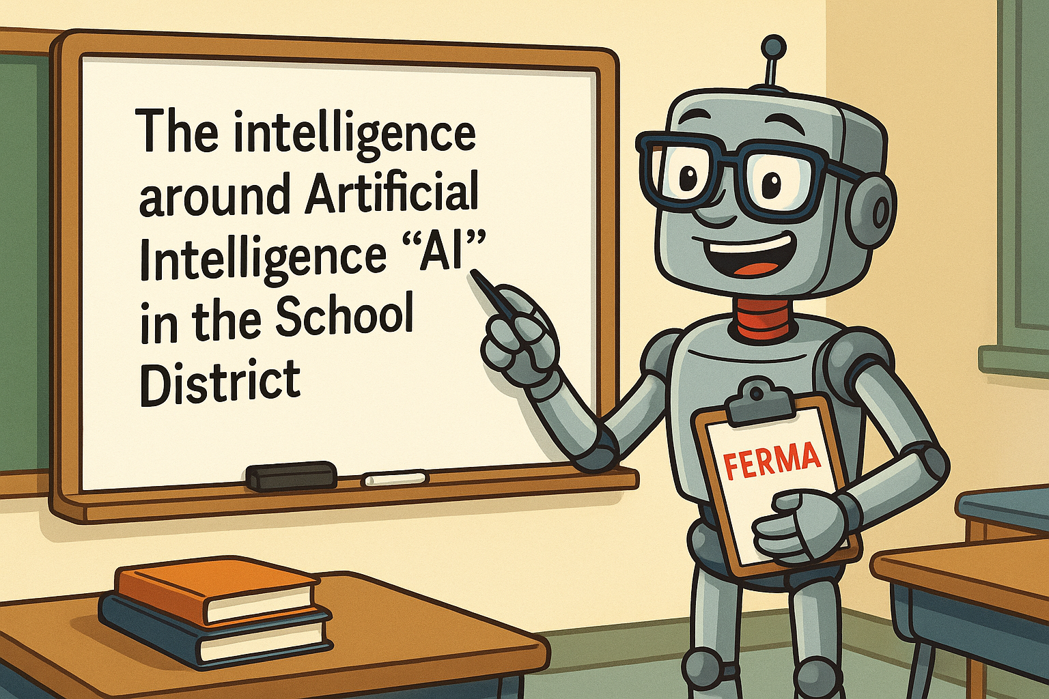


FERMA
2025
John M. Drye, Esq. & AI Barry Campus Benefits

Slide 2

John M. Drye, Esq.
General Counsel & Chief Risk Strategist – Campus Benefits
Home Office – Atlanta, GA
Work in all 50 US states & Abroad
PPACA , Healthcare Reform & Public School Employee Benefits
In 2013 - 2025, completed training sessions to over 625+ Public School System Risk Managers in the Southeast US.
Contact: Jdrye@CampusBenefits.com
What will we discuss today:
1. A Primer on “Artificial Intelligence”
2. Top Five Issues for K-12 School Districts
3. Understanding the AI School District Policy
4. What do I do next?
Presentation Disclaimer:
This Presentation is not intended to be exhaustive nor should any discussion or opinions be construed as legal advice. Listeners should contact school legal counsel for legal advice.
www.CampusBenefits.com

Slide 3

“The greatest liability in your district’s AI strategy… is not having one.”
– John M. Drye, Esq., FERMA 2025

Slide 4

PROMPT: Create a realistic AI character that can represent AI for my presentation and suggest slides to put him in. Give him a FERMA theme and place him in Sarasota, Florida.
Theme 1: “AI Barry” – The Overeager Robot Intern
Style: Cartoonish but expressive and consistent
Character Concept:
AI Barry is a well-meaning but often clueless robot trying to help in a school district. He carries a clipboard, and is always just a little behind on what humans really meant.
He attempts to "help" with grading, policies, and even legal advice — often making things worse in humorous ways.
Recurring gag: Barry misinterpreting things like "bias audits" or “parental consent” literally.
Use for: Slides 2 (disclaimer), 5 (AI in schools), 6 (legal risks), 13 (policy checklist), etc.

Slide 5
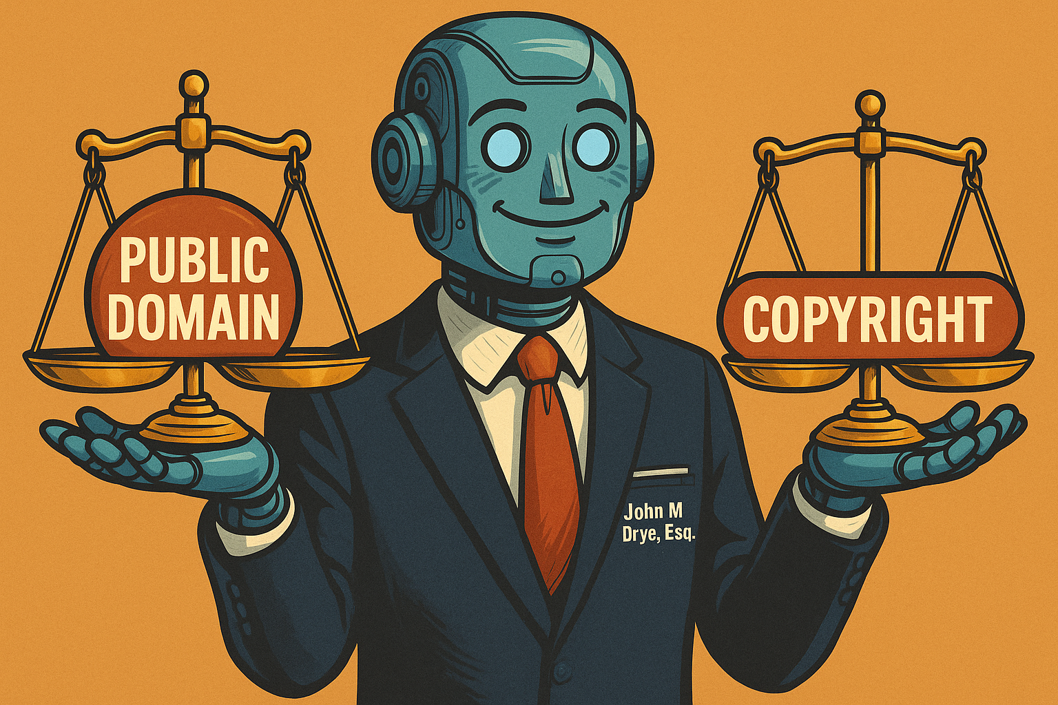
AI Images Are Usually Not Copyrighted
U.S. law requires human authorship for copyright.
                Basic AI outputs (e.g., DALL·E, Bing Image Creator)
                = typically public domain.
          2. OpenAI (DALL·E) Terms Let You Use Them Freely
          You own images you generate.
          Free to reuse, sell, merchandise, even on free plans.
          3. Add Human Creativity for Protection
          Significant edits or combining images into a new work may qualify for copyright.
          4. Watch Platform Licensing Terms
          Tools like Canva or Bing may restrict commercial use.
          Others (e.g., Stockimg.ai) offer full commercial licenses.
          5. Avoid Legal Pitfalls
          Don’t mimic logos, characters, or artist styles.
          You can still infringe on IP even if your image is "AI-generated".

Slide 6
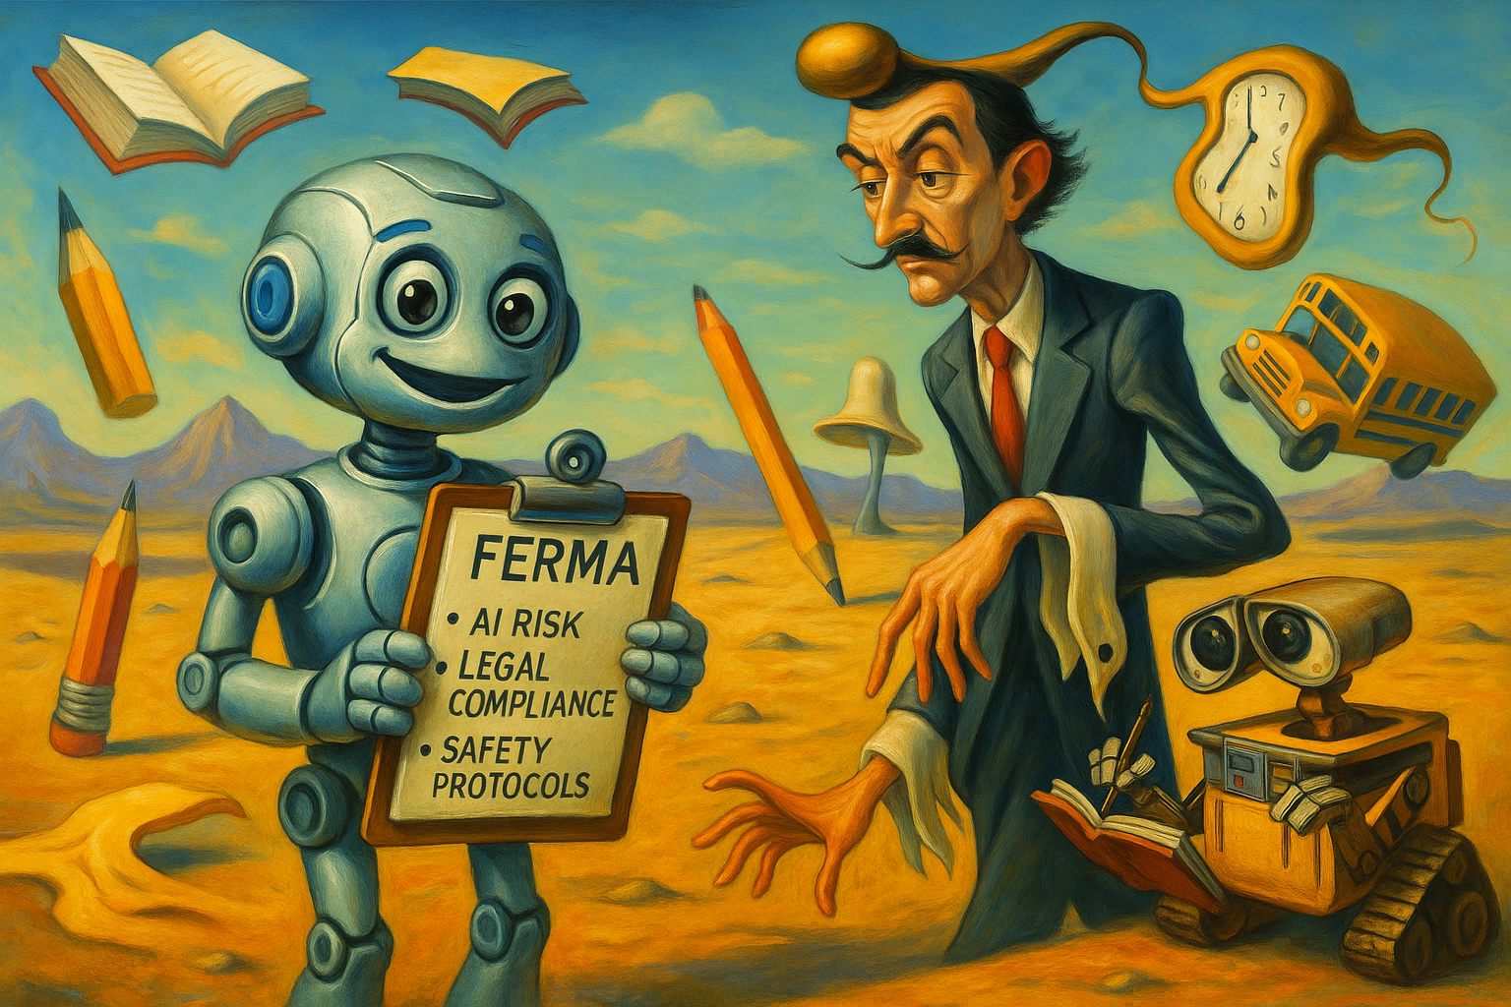
Salvador Dali + Wall-E = Open AI’s Dall-E “Text to image Creations”
“Dali” — a nod to Salvador Dalí, the famous surrealist painter known for imaginative, dreamlike artwork.
“WALL·E” — a child favorite robot from the Pixar movie, representing artificial intelligence and technology.

Slide 7
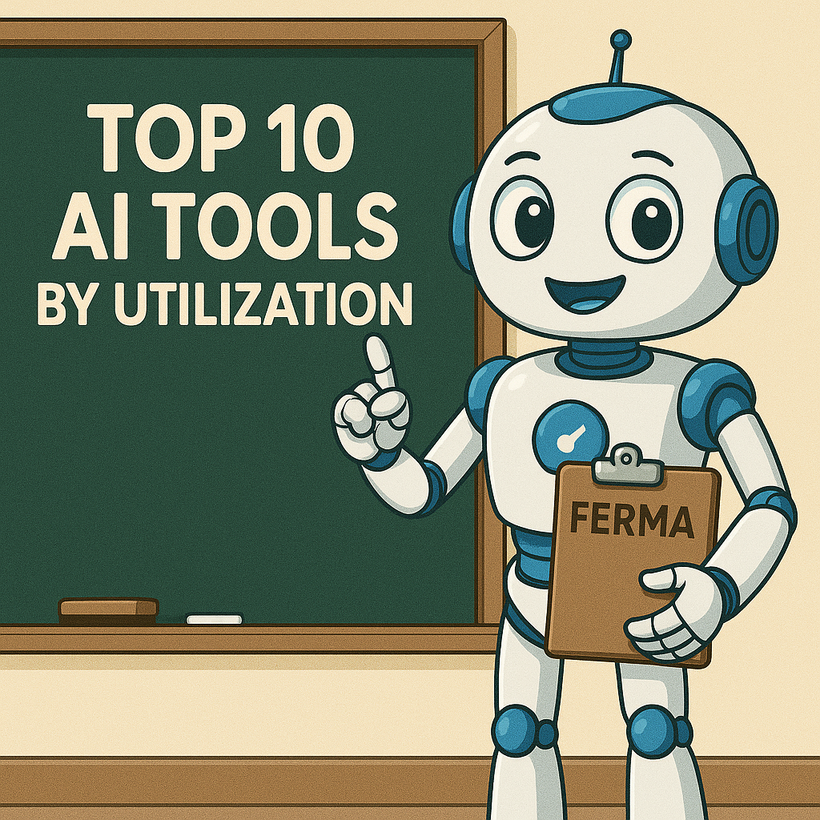
1. ChatGPT – With over 400 million weekly users, it remains the go-to multitool for writing, coding, summarizing, planning, and more
2. Canva Magic Studio – AI-powered design suite used by over 220 million people for presentations, graphics, and image creation
3. Fathom – Popular AI meeting assistant, used across 180k companies to transcribe and summarize calls
4. Claude / Anthropic – Advanced conversation-oriented LLMs widely adopted by professionals and enterprises .
5. Google Gemini – Google’s competitor to GPT, integrated into search, chat and coding workflows and ranked among leading AI assistants .
6. Midjourney / GPT‑4o – Leading AI image generators used for creative and educational visuals
7. Synthesia – AI video-generation tool enabling synthed avatars speaking in multiple languages
8. Prezi AI – Versatile slideshow and presentation generator with over 160 million users
9. Khanmigo (Khan Academy) – An AI tutor for K–12 learners, now available in thousands of classrooms
10. GitHub Copilot – AI coding assistant, topping developer surveys with 42% usage among engineers

Slide 8

AI EdTech Tools
ChatGPT – The leading AI tutor and writing assistant used by both students and teachers. It supports essay drafting, Q&A, and lesson planning.
Khanmigo (Khan Academy) – AI tutor tailored to K–12, widely used in math, science, and writing support.
Scite – Academic research assistant that checks citations and verifies sources, rising in popularity among high school students.
Perplexity – AI-powered Q&A/research tool gaining traction for homework help and comprehension.
Trinka – Advanced grammar and writing enhancement tool popular in academic settings.
Scholarcy – Summarizes academic articles and textbook chapters, aiding research and study planning.
Elicit – Research assistant that automates literature reviews and data extraction.
Notion AI – Built into Notion for note-taking, project planning, and writing support in classrooms.
Otter.ai – AI transcription and summary tool used to document lectures and meetings.
Gradescope – AI-augmented grading system used by educators for efficient, consistent scoring.
Runner Up Tools (Strong Adoption)
Wayground (formerly Quizizz)
Qanda
ClassDojo
Quizlet
Synap
Virti
Fishtree

Slide 9
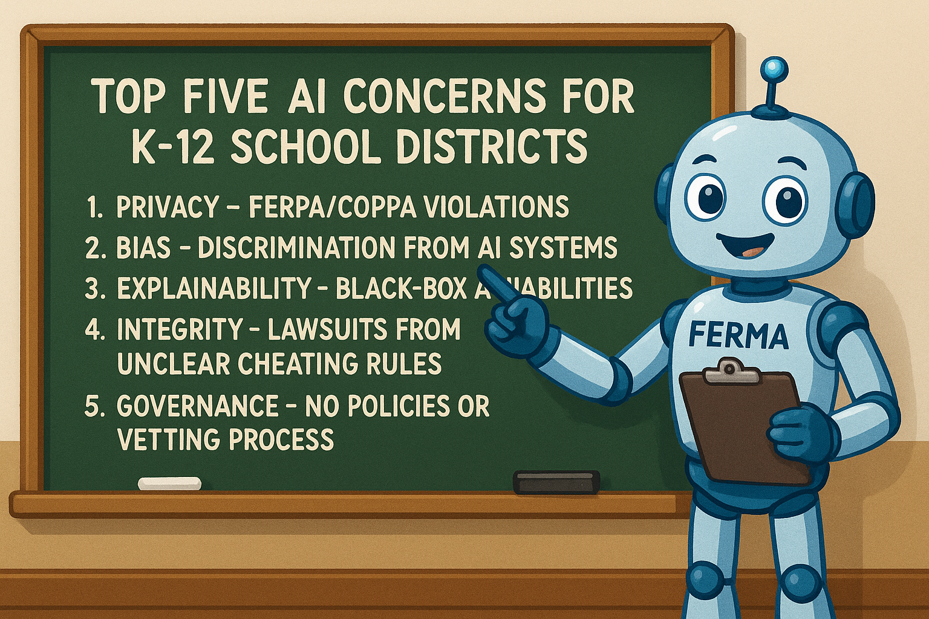

Slide 10
1. Student Data Privacy & Security (FERPA / COPPA Violations)
AI tools often process sensitive student information, which can trigger regulatory scrutiny or lawsuits.
FERPA exposure: Many AI platforms store or transmit "education records" (e.g., grades, behavior logs) to third parties without clear consent or contracts.
Third-party risk: Districts using edtech AI vendors without signed Data Privacy Agreements (DPAs) could unknowingly violate federal law.
Behavioral data creep: Predictive AI tools may collect mouse movements, attention tracking, or keystroke data—often crossing into COPPA-protected territory if students are under 13.
Common Mistakes by School Districts
Assuming every tool used in classrooms has already been vetted for COPPA.
Using free AI tools or chatbots without verifying age restrictions or reviewing privacy policies.
Allowing students under 13 to create accounts on tools like ChatGPT, YouTube, or Canva without district-wide consent systems.

Slide 11
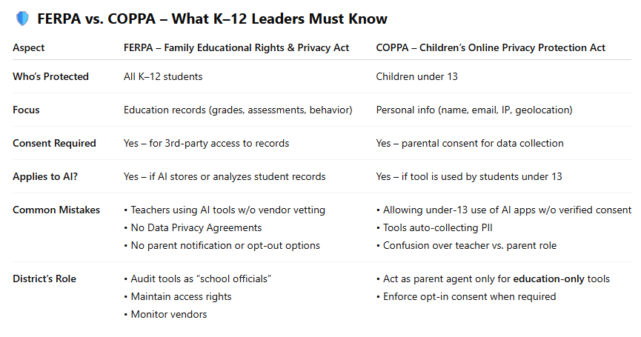
Bottom Line for Risk Managers
FERPA = Control of records
COPPA = Control of collection
You need policies, audits, and contracts for any AI touching student data

Slide 12
2. Algorithmic Bias & Discrimination
AI systems trained on biased data can result in inequitable treatment of students—especially in grading, discipline, or admissions.
Civil rights exposure: Disparate impact on students by race, disability, or economic status could trigger claims under Title VI or ADA.
No bias audits: Most school districts are not conducting third-party algorithmic audits before deployment—despite increasing calls from civil rights groups.
Opaque vendor tools: AI grading platforms may include biased assumptions (e.g., penalizing dialects in essays), and districts can't always inspect or modify them.
Why It Matters: Algorithmic Bias & Discrimination
Equity Risks:
AI may unfairly penalize students based on race, language, disability, or income—affecting grades, discipline, or placement.
Legal Exposure:
Disparate outcomes can trigger Title VI or ADA violations and civil rights complaints.
Opaque Tools:
Vendors rarely disclose how AI decisions are made; some tools embed biased assumptions.
No Bias Audits:
Most districts lack independent reviews of AI tools despite calls from equity advocates.

Slide 13
3. Transparency & Explainability
“Black-box” decisions—where even the developer can't fully explain how an AI tool reached a conclusion—raise legal red flags.
Florida SB 262 compliance: Requires “decision transparency” when AI is used for educational or disciplinary outcomes—yet few districts are documenting AI logic chains.
Disciplinary defensibility: If AI flags a student for misbehavior but no human can explain the logic, suspensions or interventions are legally vulnerable.
Litigation trend: Plaintiffs’ attorneys are beginning to request AI algorithms and logs in discovery—especially in disability or due process disputes.
Why It Matters: Transparency & Explainability
Black-Box Risk:
AI decisions without clear logic are legally questionable and undermine trust.
Policy Compliance:
Florida SB 262 requires districts to document how AI influences educational or disciplinary outcomes.
Legal Vulnerability:
If no one can explain how AI flagged a student, suspensions or actions may not hold up in court.

Slide 14
Florida SB 262 – Student Online Privacy & AI Protections
Also known as: Florida Digital Bill of Rights
Effective: July 1, 2024
Applies to: Schools, EdTech vendors, online platforms accessed by minors
Key Provisions
Limits data collection on platforms used by students under 18
Bans profiling, dark patterns, and geolocation tracking without safeguards
Prohibits sale of biometric/genetic data without consent
Requires opt-out options for voice, facial recognition, and targeted advertising
Empowers parents to control minors’ personal data
Enforced by FL Attorney General – fines up to $50,000 per violation (tripled for minors)
K–12 Risk Relevance
Strengthens parental control and opt-out rights
Expands AI-related privacy compliance requirements
Aligns with COPPA and Florida SB 662 (Student Online Personal Information Protection Act)
Urges vetting of all platforms/tools used by minors
Bottom Line: SB 262 aims to enhance online safety for students and children in Florida by limiting data collection and use and giving individuals more control over their personal information.

Slide 15
4. Academic Integrity & Cheating Liability
AI tools make cheating easier—but vague district policies create unclear rules and open liability.
Lawsuits from ambiguity: A student in Massachusetts sued after being punished for AI-aided writing—arguing the school had no clear policy banning it.
Inconsistent enforcement: Teachers and administrators often have different thresholds for what counts as “AI cheating,” exposing districts to claims of unequal treatment.
Overreliance on detectors: Many AI detectors (like GPTZero) are unreliable, creating false positives that lead to unjust academic discipline.
Why It Matters: Academic Integrity & Cheating
Legal Risk:
Lack of clear AI rules can lead to lawsuits over unfair discipline or unclear expectations.
Unequal Enforcement:
Inconsistent definitions of “AI cheating” open the door to bias or favoritism claims.
Faulty Detection:
AI detectors often misidentify students—triggering unjust punishment based on unreliable tools.

Slide 16
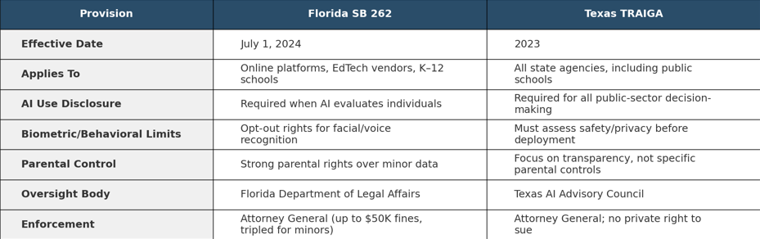
5. Governance Gaps & Lack of Oversight Frameworks
Without structured AI governance, risk managers are left reacting instead of planning.
No AI inventories: Many districts don’t even know which apps or tools use AI—let alone have approval protocols or vetting procedures.
Missing policies: It is estimated that fewer than 15% of districts have formal AI use policies, and almost none require human-in-the-loop review for high-risk decisions.
No oversight bodies: Unlike states like Texas (TRAIGA), most districts lack standing committees or designated officers responsible for AI governance. (Texas Regulatory and AI Governance Act.)

Slide 17
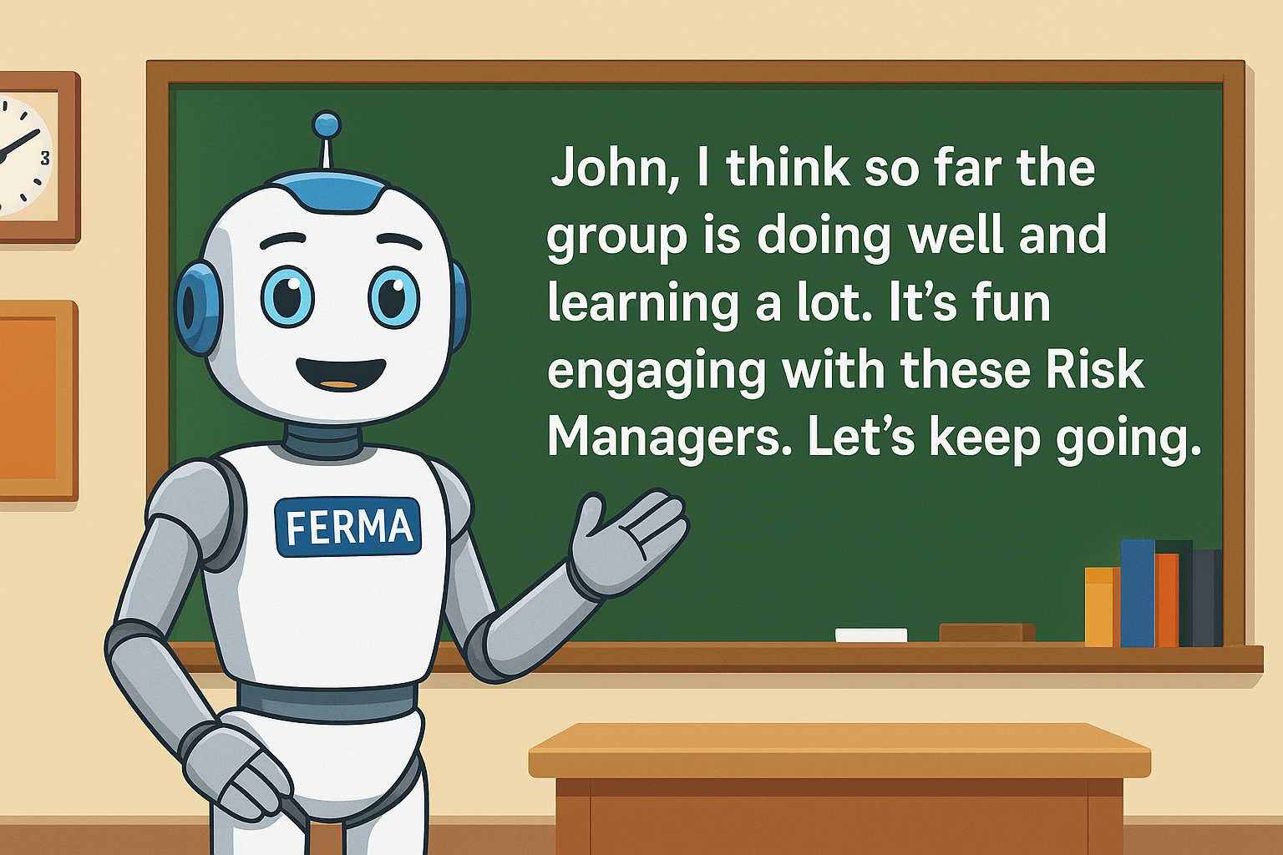

Slide 18
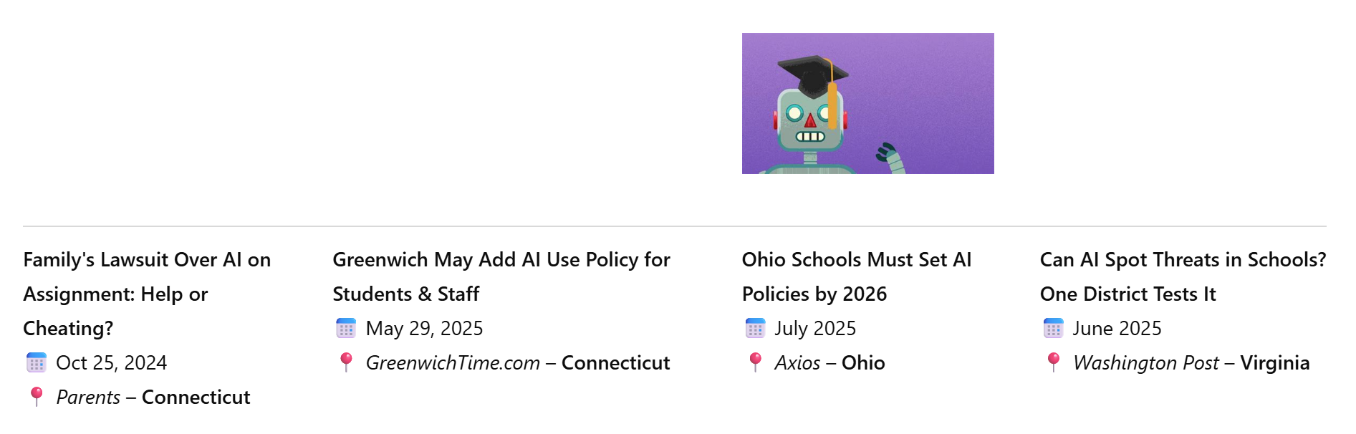
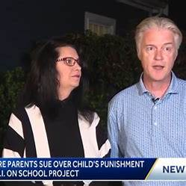
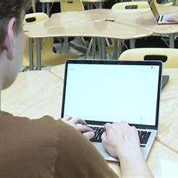

AI is front and center in k-12 School Districts across the country.
DO NOT wait to address your policy until (1) State Mandates or
(2) Local Lawsuits occur

Slide 19
“How to Develop an AI Policy for Your School District”
Key Components of an AI Policy
1. Purpose & Scope
  Define what qualifies as “AI” and who the policy applies to.
  State the district’s position: AI is a tool—not a replacement.
2. Acceptable Use Guidelines
  Clearly outline where, how, and when AI may be used by staff and students.
  Require adult supervision and approval for student use.
3. Prohibited Uses
  Ban AI for cheating, impersonation, or unauthorized surveillance.
  Address AI misuse in testing environments.
4. Privacy & Compliance
  Reinforce alignment with FERPA, COPPA, and state laws (e.g., Florida SB 262).
  Include guidance on protecting student data and prohibiting biometric profiling.
5. Oversight & Governance
  Appoint an AI oversight committee.
  Require periodic reviews and updates as tech evolves.
Why You Need a Policy
AI is already in classrooms—even if you didn’t approve it.
Without a policy, you risk FERPA/COPPA violations, integrity issues, and inconsistent enforcement.
Proactively sets expectations for safe, ethical, and educationally sound AI use.
It is not difficult to create one if you establish the right group and ask the right questions.

Slide 20
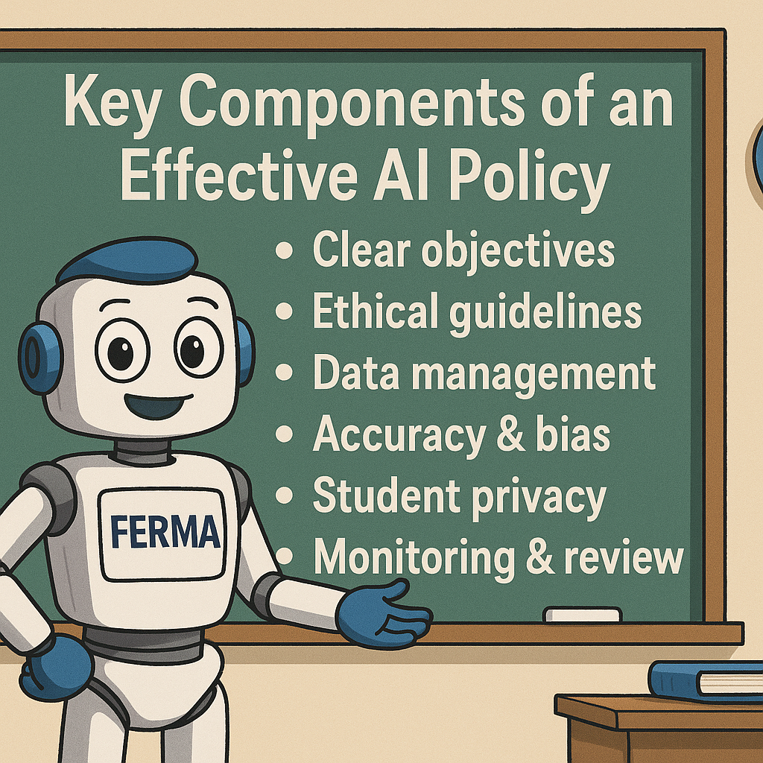
Common Pitfalls to Avoid
Failing to define AI clearly
Overlooking student privacy/data risks
No training plan for staff or policy enforcement mechanism
Action Steps for District Leaders
Conduct an AI inventory across classrooms and departments.
Review model policies (e.g., Sarasota County’s Policy 4.24).
Collaborate with legal, tech, curriculum, and risk management teams.
Pilot, refine, adopt.
Make this a living policy—not a one-and-done document.

Slide 21
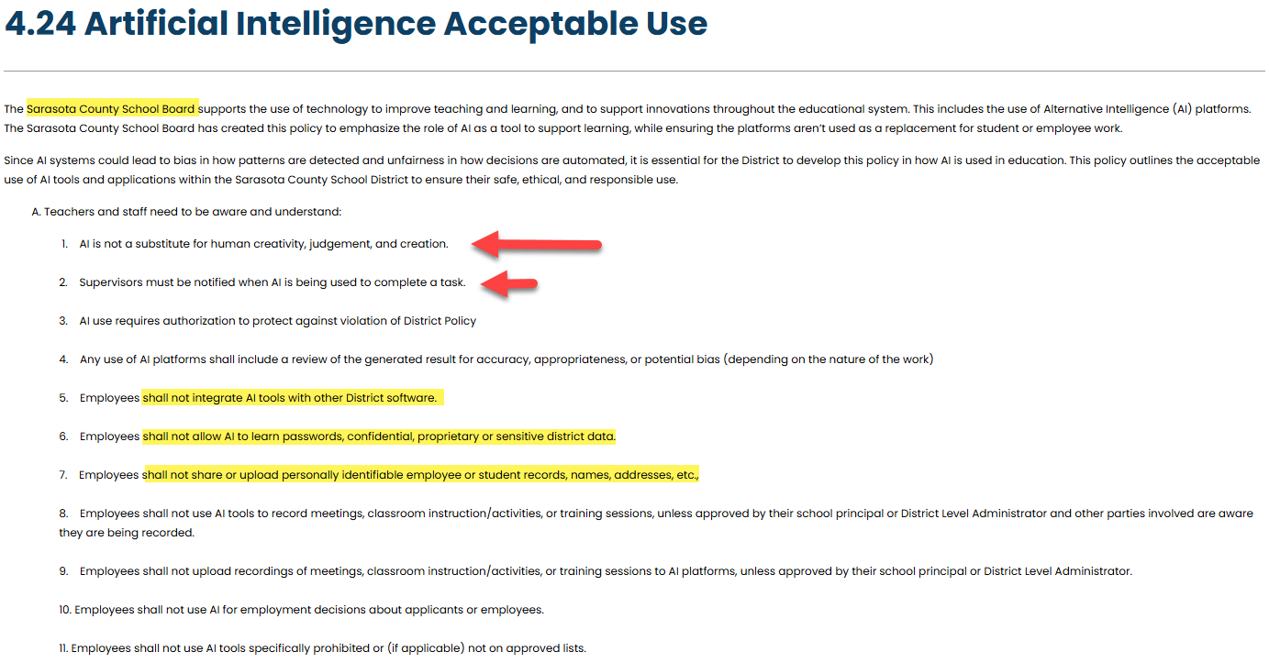

Slide 22
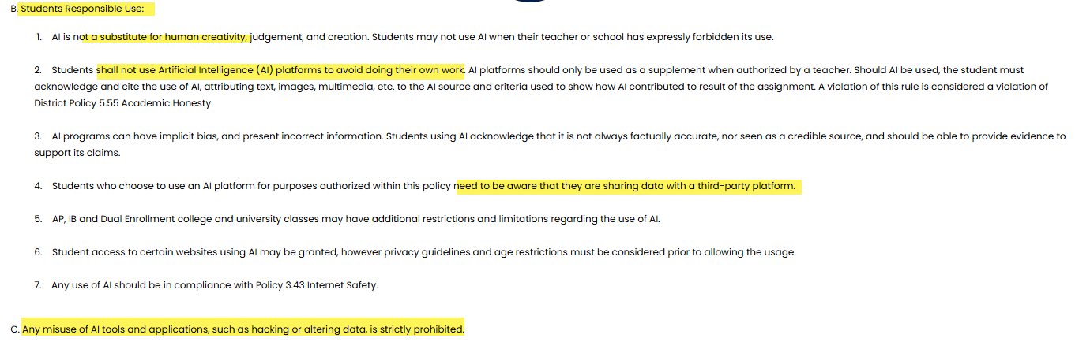
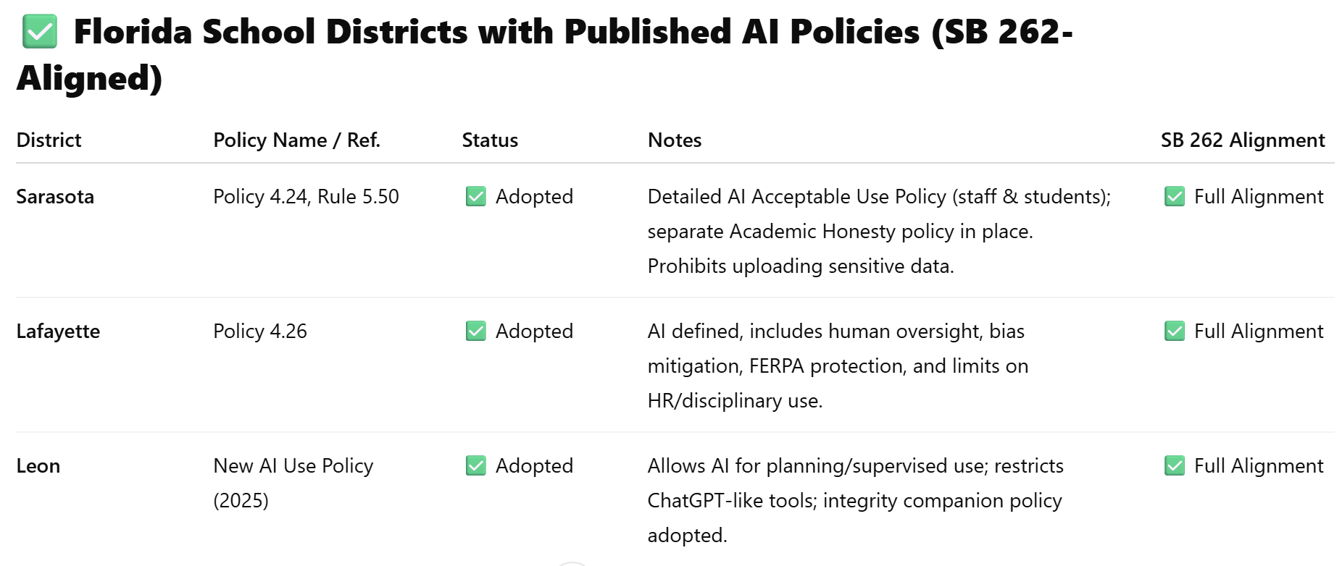

Slide 23


Slide 24
School District AI Policies – What ‘s missing
Overlooked
Policy statement requiring ongoing AI training for employees or AI literacy education for students. “Staff and students shall receive age-appropriate training on AI’s capabilities, limitations, ethical use, and privacy risks.”
Most Often Missed
Transparency Clause:
“The District will publish a list of approved AI tools and notify parents and employees when AI is used to materially affect educational or employment decisions.”
Bias Auditing and Equity Statement:
“All AI tools must be tested for disparate impact across racial, socioeconomic, disability, and linguistic groups prior to use in instructional or administrative decision-making.”
Data Retention and Deletion Policy:
“Any data generated or collected by AI platforms must comply with the District’s data retention policy and be deleted in accordance with FERPA and SB 262 guidelines.”

Slide 25
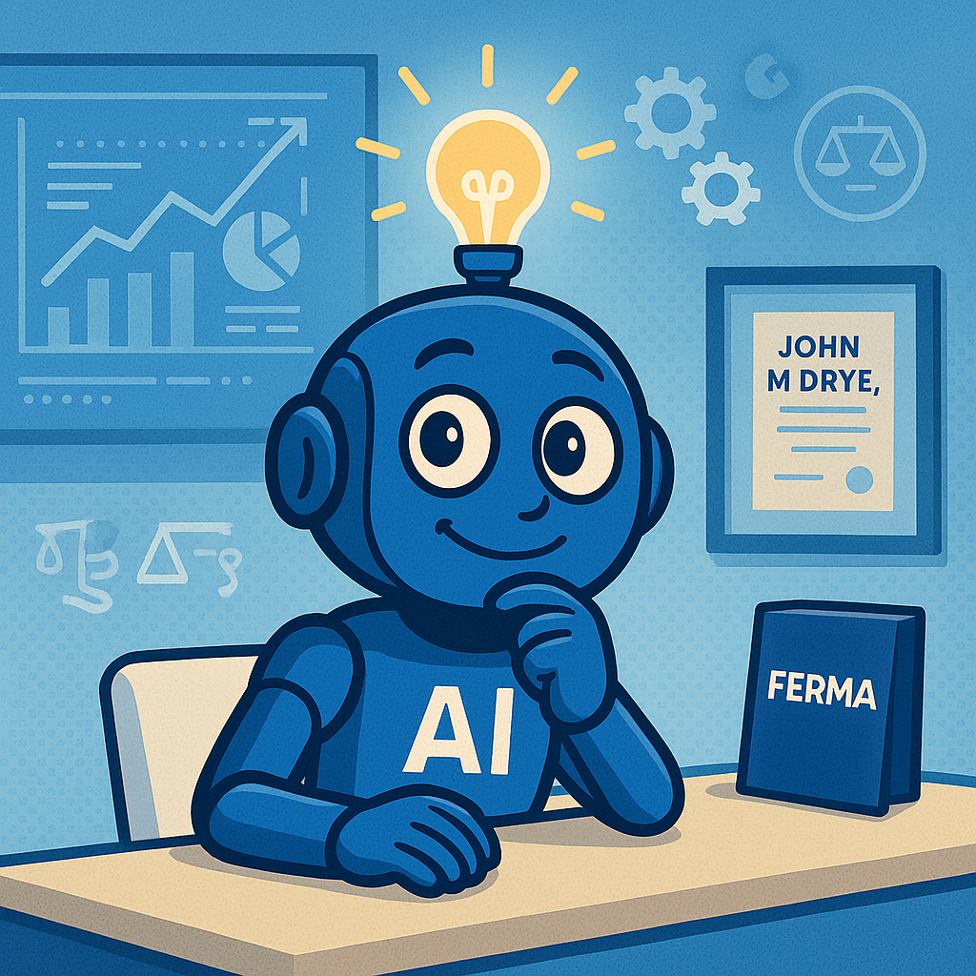
FERMA/FADDS Topics Since 2013
Employee Benefits and Compliance alone are a significant task
DHS Ends Temporary Covid-19 policy on Form I-9
Machine Readable Files
Educating Staff on PHI
Business Associate Agreements for ALL Vendors
Transparency in Coverage Rule
Hospitals Transparency Rule
Security Rule in 2004
HiTech Act of 2009
Omnibus Rule of 2013
No Surprises Act Section 202(c) of the CAA
Laws involving federal-state preemption
Discrimination
Privacy
Employee leave requirements under FMLA
Federal discrimination statues
  ADA (Americans with Disabilities Act)
  Title VII
  Pregnancy Discrimination Act
Criminal Background checks
Employee confidentiality
Data and privacy laws
Employee free speech concerns
Roe v. Wade & Dobbs Decisions on Abortion
PPACA Rollout 4980 (a) & 4980 (H) offers of coverge
Whistle Blower (42 U.S.C §18001)
Understanding the Exchanges
Participating FL Insurance Carriers in Exchanges
Compliance Plans for
                IRS
      DOL
      HHS
Educating Staff on PHI
Florida Information Protection ACT (2014)
SBS “Culturally & linguistically appropriate”
1094 & 1095 Forms
226-J Notices
HHS Audits – HIPPA Compliance Gaps
Privacy Rule
Security Rule
Breach Notification Rule
GDPR & California Privacy rules in the US/FL
Look Back and Affordability Percentages
FIPA and K-12 Cyber
Telemedicine / virtual care clinics
MEC, EHB, SBC and w-2 reporting requirements
PCORI and Transitional Reinsurance Fees

Slide 26

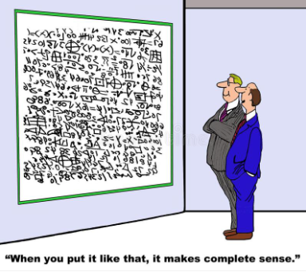

John M Drye, Esq.
Campus Benefits General Counsel
JDrye@CampusBenefits.com
ETupper@CampusBenefits.com (Eric Tupper)
Ask for Help (email me) to get started:
AI Concerns & Policy Questions
AI Readiness Checklist
15 Primer Questions for an AI Policy
Leadership on Campus Magazine
Risk Managers, Board Meetings
HR/Finance Professionals,
Topical Committees

