Slide 1
The Value of a Pre-Season:
Planning for Disaster
Cory Brandt – DRS
Tony Ganstine – FCSRMC
John Scacca – Pinellas County Schools
July 2026

Slide 2
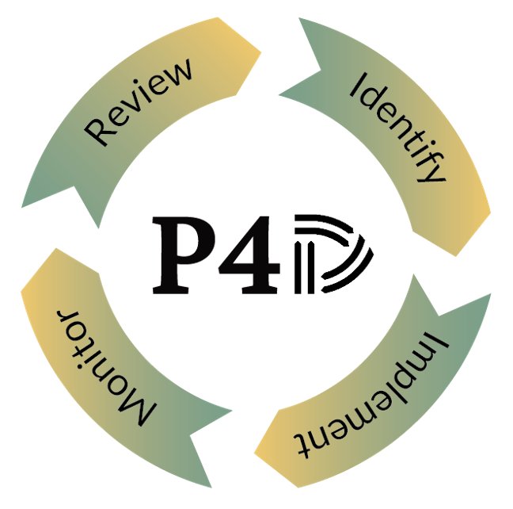
Pre-Season!
Just as in sports, a disaster pre-season affords school districts and colleges the ability to analyze coverage effectiveness, prepare for the uncertainty of a post-disaster environment, and gauge their disaster recovery fitness level.
Before the next fire, flood, hail, tornado, or hurricane, make sure your organization is Planning For Disaster!
Learning Objectives:
1) Simplified approach to develop a disaster recovery plan
2) Proactive steps to minimize downtime and restore your operations quickly
3) Review and assess your commercial property insurance coverage
The Value of a Pre-Season: Planning for Disaster

Slide 3
The Value of a Pre-Season: Planning for Disaster
Review | Identify | Implement | Monitor
Commercial Property insurance coverages Commercial Property Statement of Values Existing Standby Contracts Property Valuations | Potential risks based on location and loss history Key areas for potential improvement Completeness of commercial property documentation Key locations | Standby contracts for critical services Statement of value updates, if needed Property appraisals Analytical modeling Creative broker solutions and strategies | Additions, deletions, and significant changes to locations, operations, etc. Insurance coverage updates Standby contract updates Appraisal Schedules

Slide 4
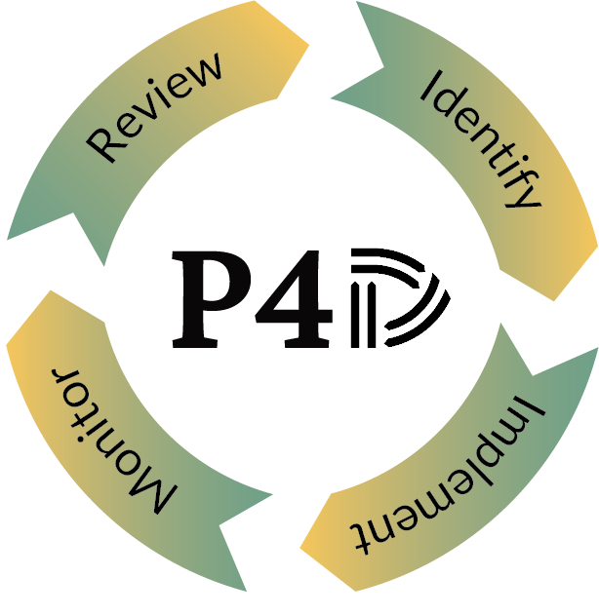
REVIEW
Objectives:
Organization background and loss history
Policy named locations – Statement of Values (SOV)
Insurance coverage and risk retention appetite
Existing business continuity plan (BCP) and/or disaster recovery plans
Risk management plan and resources

Slide 5
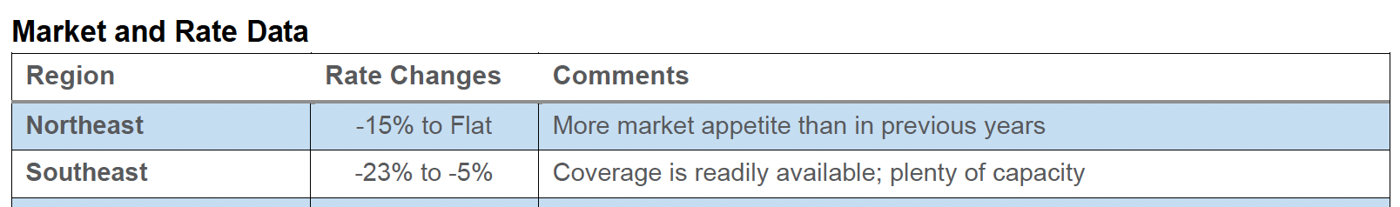
Property Outlook
The property insurance market remains stable. However, there are still affordability and availability challenges in high-risk areas prone to natural disasters. On a positive note, more insurers are using technology like predictive analytics and artificial intelligence to better assess and manage risks, and this is expected to improve market resilience while supporting price stability. There is plenty of capacity available in this segment.
Recommendations
Perform risk assessments to identify and evaluate potential exposures and property-related hazards.
Develop and implement proactive risk mitigation measures, such as installing fire alarms, smoke detectors, and sprinkler systems, improving building security, and ensuring compliance with building codes and safety standards.
Maintain accurate and up-to-date property valuations and ensure all property assets are properly documented.
*Sources: AJG Insurance Market Report Q1 2026, AJG Public Sector Market Conditions Report Spring 2026 Edition

Slide 6
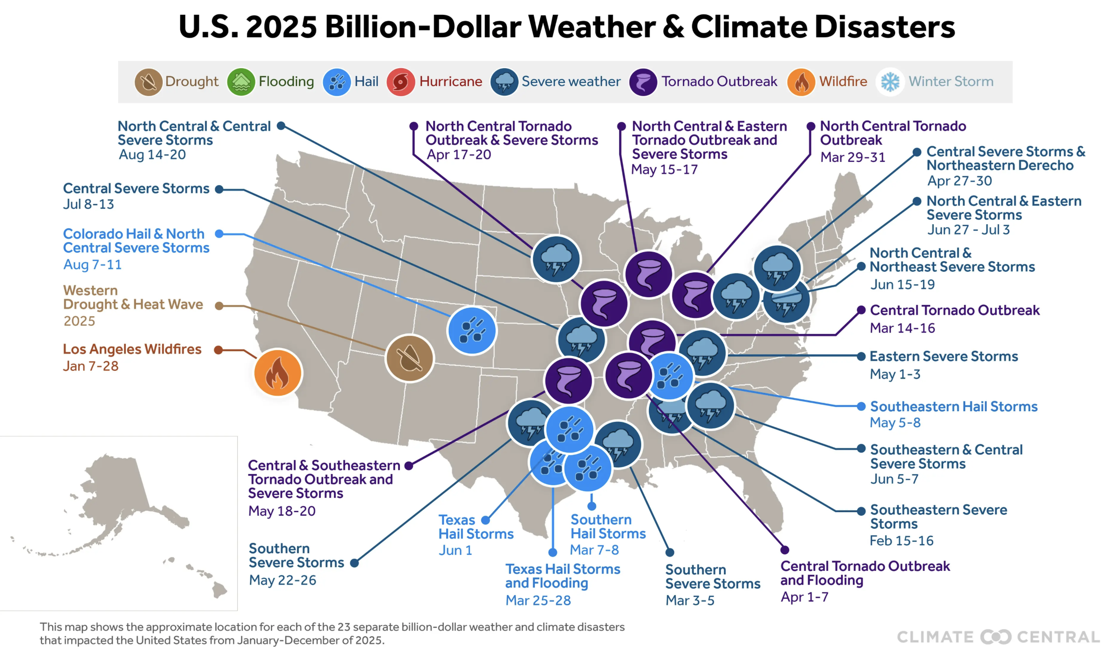
U.S. 2025 Weather and Climate Disasters > $1B

Slide 7
2026 – Atlantic Hurricane Season
NOAA Season Probability
Agency Forecast Comparison
Why CSU Cut Again (July)
Below-Normal
55%
Agency
Named
Storms
Hurricanes
Major
Hurr.
· El Niño strengthening faster than expected — strong by peak season
· Atlantic SSTs now near-normal vs. unusually warm in recent years
Near-Normal
35%
NOAA
8–14
3–6
1–3
· Second consecutive monthly downgrade (June → July)
Above-Normal
10%
CSU
9
4
1
Conditions Still to Watch
Primary Driver: El Niño
TSR
12
5
1
· Rapid intensification possible even in low-activity seasons
Moderate El Niño conditions expected to intensify into a strong El Niño by peak season. Atlantic SSTs are running near-normal — removing the warm-water fuel that drove active seasons in recent years.
· Western Atlantic SSTs near average — not cold enough to fully cap risk
Met Office
9
5
2
· Season runs June 1 – Nov. 30; peak window mid-Aug to Oct
NCSU
12–15
6–9
2–3
2025 Season Context
⚠ Key Caveat
Avg Season
14
7
3
· 13 named storms, 5 hurricanes, 4 major
"It only takes one hurricane making landfall to make for a very bad season." — NOAA NWS Director Ken Graham
· First year with zero US hurricane landfalls in a decade
· 3 storms reached Cat 5 (Erin, Humberto, Melissa)
Sources: NOAA (May 21, 2026) · CSU (July 8, 2026 update) · TSR · Met Office · NCSU · Triple-I / Phil Klotzbach, CSU

Slide 8
REVIEW: Best Practices from Risk Management
Pinellas County Schools | Florida College System Risk Management Consortium (FCSRMC)
Meet with broker frequently. Review property schedules bi-annually. Meet with stakeholders to include department heads within your organization. Consider past disasters that impacted your organization to better understand potential vulnerabilities. Review disaster preparedness strategies of comparable institutions to ensure your practices are up to date. | Meet with underwriters annually Meet with your broker frequently Review property schedules twice a year and keep up to date with changes Review your building names, numbers and campus maps Consider past disasters that impacted your organization to better understand potential vulnerabilities. Review disaster preparedness strategies of comparable institutions to ensure your practices are up to date.

Slide 9
Insurance Policy: Review “Checklist”
Make sure the policy is current
Obtain Copies of ALL applicable policies (including NFIP, stock throughput, etc.)
Ensure each policy is complete
(all pages, declaration page, forms, endorsements, etc.)
Review applicable limits of liability
Maintain a copy of the current Schedule of Values / insured values
Determine if values on Schedule of Values are “Limits”
Confirm and understand deductible structure (peril, % deductibles, average daily value, waiting periods, etc.)
Read and understand Endorsements, and how they apply
Review policy exclusions (compare them against declarations or endorsements)
Read and understand definitions
Identify any time restraints / requirements (notice, reporting claim, filing suit, etc.)

Slide 10
IDENTIFY
Objectives:
Potential risks based on location and loss history
Key areas for improvement
Completeness of commercial property documentation
  SOV
  Proper Valuations
  Obtain & Maintain requirements?
    FEMA
Disaster recovery team resources
  Internal
  External

Slide 11
IDENTIFY: Best Practices from Risk Management
Pinellas County Schools | Florida College System Risk Management Consortium (FCSRMC)
Identify high-risk locations and discuss with broker additional insurance coverages or mitigation strategies with department heads and stakeholders. SOV updates and missing information. Ex. Sq ft, gps, content coverage, etc. Identify policies & procedures from other departments that play a role in the recovery process. Review vendors that may be utilized post storm and identify any shortfalls within the agreements/contracts that may hinder recovery efforts. | Develop relationships with partners Partners are brokers, disaster recovery, appraisal services, FEMA consultants Review property coverages especially after a tough renewal, did carriers implement higher deductibles or coverage restrictions like sub-limits or margin clauses. Understand how identified risks would affect crucial operations of the organization (payroll, security, etc.).

Slide 12
Typically, 81 % of recovery funding will be used to make purchases.
FEMA Public Assistance Purchases

Slide 13
Top 10 Procurement Under Grants Mistakes
#1 Restricting full & open competition
#2 Not performing detailed price or cost analysis for procurements above the Simplified Acquisition Threshold
#3 Engaging in sole-sourcing procurement without documenting emergency or exigent situation
#4 Continuing work under sole-source contract after the urgent need has ended
#5 Not making and documenting efforts to take all "affirmative steps“ for S/M/WBE inclusion
#6 Awarding "time-and-materials" contract without ceiling price and documenting why no other contract type is suitable
#7 Not including the required contract clauses
#8 Awarding a "cost-plus-percentage-of-cost" or "percentage-of-construction-cost" contract
#9 Awarding a contract to contractors that are suspended or debarred
#10 Not documenting all steps of a procurement to answer questions that could arise months or years after
Notes:
#1, 4, 7, 9, & 10 is key to recovery

Slide 14
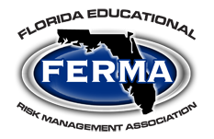
Recent Costly Procurement Missteps
FEMA:
Public School District
HUD:
City CDBG Program
Lack of federal contract provisions
No affirmative steps taken for socioeconomic contracting
Inadequate procurement supporting documentation
Restricting competition
$12.2M
$9.2M
$10M
$187M
DOE:
Public School System
DOT:
FIVE State Grantees
Incorrect procurement of professional services
Absence of procurement supporting documentation.
Inadequate procurement supporting documentation
Lack of internal controls
No Suspension and Debarment Checks

Slide 15
IMPLEMENT
Objectives:
Standby contracts for critical services
  Procurement compliance
  Co-Op consideration?
  Established rate schedules
Statement of value updates, if needed
Disaster recovery strategy and plan
Online web portal for BCP and “phone tree” of POCs
Established relationships with Carriers Claims contacts

Slide 16
IMPLEMENT: Best Practices from Risk Management
Pinellas County Schools | Florida College System Risk Management Consortium (FCSRMC)
Hurricane Preparedness Guide Ensure all employees know what to do in the event of a disaster. Ready OPS, Intranet, & email communications to all employees and key stakeholders. Pre and post hurricane employee messaging with resources. Communication on who, what, when, and where. | In this type of crisis property market, we initiated monthly and then bi-weekly updates to stakeholders. Invest in physical appraisals and desk appraisal software this will alleviate insurance underwriter questions. Implement a disaster response plan, including steps to be taken before, during, and after a disaster. Ensure all employees know what to do in the event of a disaster. Conduct regular drills. Set up systems to keep everyone informed before, during, and after a disaster.

Slide 17
MONITOR
Objectives:
Additions, deletions, and significant changes to locations, operations, etc.
SOV - Assess valuations
  Appraisal Schedules
Insurance coverage updates
  Retention/Deductible changes
Standby contract updates

Slide 18
MONITOR: Best Practices from Risk Management
Pinellas County Schools | Florida College System Risk Management Consortium (FCSRMC)
Business Continuity Plans Keep your disaster response plan up to date. Regularly test and update emergency communication systems: This will help ensure they function when needed. Monitor construction timeframes and update SOV accordingly. | Keep your disaster response plan up to date. Collect feedback after drills or actual disasters: Use this feedback to improve your plans. Regularly test and update emergency communication systems: This will help ensure they function when needed.

Slide 19
QUESTIONS?
Review | Identify | Implement | Monitor
Commercial Property insurance coverages Commercial Property Statement of Values Existing Standby Contracts Property valuations | Potential risks based on location and loss history Key areas for potential improvement Completeness of commercial property documentation Key locations | Standby contracts for critical services Statement of value updates, if needed Property appraisals Analytical modeling Creative broker solutions and strategies | Additions, deletions, and significant changes to locations, operations, etc. Insurance coverage updates Standby contract updates Appraisal Schedules

Slide 20
Contact Us
Cory Brandt – DRS
949.244.1338
Jtrahan@drsconsults.com
Tony Ganstine – Florida College System Risk Management Consortium
850.557.7356
tganstine@fcsrmc.com
John Scacca – Pinellas County Schools
727.588.6078
SCACCAJ@pcsb.org

