Slide 1



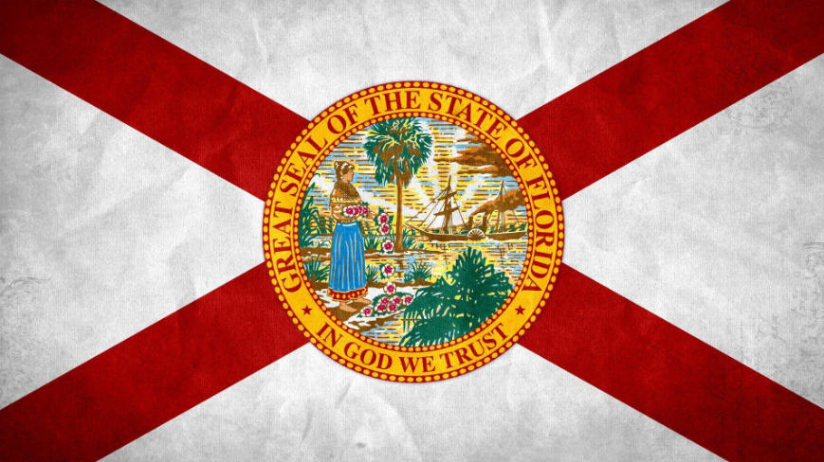
+
Physician Dispensing
July 14
Latest News and its Impacts on Floridians

Slide 2
Agenda
01
Intro
02
Why is this a big deal?
03
How does this impact the parties involved?
04
What are the ramifications?
05
Next steps

Slide 3


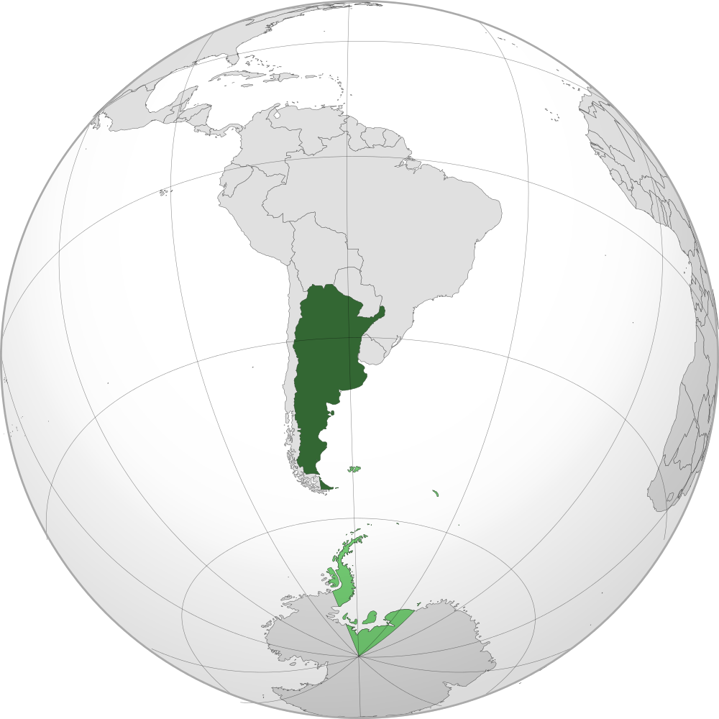
+
A little about me…
Studied law at the University of Cuyo in Argentina
2-20 Insurance Agent since 2004
Certified Professional Coder (CPC) by AAPC
VP of Medical Review Services at CorVel over FL Center of Excellence

Slide 4

Why is this a big deal?
For more than a decade, insurance companies and physician groups have contended over the true meaning of Florida statutes: Are doctors considered pharmacists and therefore allowed to dispense medications to injured workers without additional authorization?
A Florida appeals court has finally answered that question, and in that process has giving a multimillion-dollar win to employers and carriers in Florida
Notes:
This will save employers/insurers an estimated $43M over the next 5 years
Physician Dispensing is very expensive (ex Vicodin is 1.41 vs 0.52)
Advocates for physician dispensing have long said it saves injured workers time and avoids multiple trips to pharmacies, speeding recovery
They are a business and should be able to make a profit. I just don’t want to be the one paying for it

Slide 5
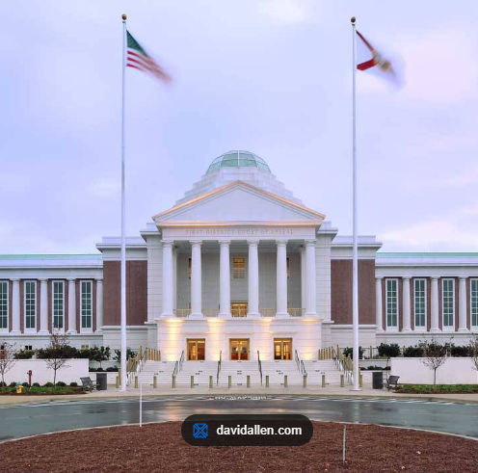

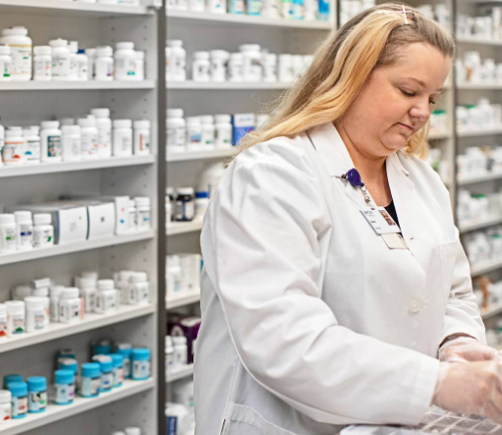
The ruling…
The 1st District Court of Appeal of Florida overturned a Florida Division of Administrative Hearings decision on February 25, 2026
In the case Publix Super Markets Inc. et al. v. Department of Financial Services, Division of Workers’ Compensation
The court held that the statutory term “pharmacy or pharmacist” in Florida’s workers’ compensation law does not include dispensing practitioners
Insurers are no longer prohibited from denying authorization or reimbursement simply because a prescription was dispensed by a licensed “dispensing practitioner” such as a physician
This ruling effectively allows insurers to require injured workers to use pharmacies rather than receiving medications directly from their treating providers

Slide 6



How does this impact all the parties?
Injured Workers
Employers / Carriers
Pharmacies
Physician Groups
Safer
More Convenient
Right thing to do
More cost effective
Less abuse
Pharmacies are the correct place to fill prescriptions due to protocols in place to avoid counter-indications and abuse
Pharmacies subscribe to networks that result in partnership with the employer/carrier
No longer incentivized to dispense out of the office
Notes:
IW:
Safer – protocols to prevent counterindications and shopping
More Convenient – Get them filled anywhere they want, including where they fill their personal RX
Right thing to do – Safeguards the interests of the employer which helps everyone
Employer:
More cost effective – better control of expenses, pays per network rates
Less abuse – minimizes possibility of abuse
Pharmacies:
Pharmacies are the correct place to fill prescriptions due to protocols in place to avoid counterindications and abuse
Pharmacies subscribe to networks that result in partnership with the employer/carrier
Physician:
No longer incentivized to dispense out of the office
No conflict of interest

Slide 7
What are the ramifications?
Pre-ruling
Current
Future state
Notes:
Current: Deny, deny, deny. Update auth forms stating separate auth needed for RX
Future State: $43m in income was gone. This will be replaced with the next creative billing strategy. Be on the look out for that.
Pre-ruling:
Can you go back on any monies paid?
Should you go back on those?
If you did, who would those recouped monies go to?

Slide 8
Next Steps
The ruling can no longer be appealed as that window has closed
Can a new suit be brought?
  Yes
What should you be on the lookout for?
Notes:
March 10 closed the date to appeal
*Whack a mole – New strategies to maximize revenue

Slide 9


Thank you!
Marcelo_Manino@CorVel.com
LinkedIn.com/in/marcelo-manino-cpc-0a491051
Notes:
It was a pleasure. Please feel free to connect. Thank you FERMA for providing such a wonderful platform to share this great information.

