Slide 1

Lisa J. Augspurger, Esq. lja@bushlawgroup.com
1701 Hermitage Blvd., Suite 103
Tallahassee, FL 32308
Tel: (850) 386-7666 ● Fax: (850) 386-1376
605 East Robinson Street, Suite 220
Orlando, Florida 32801
Tel (407) 422-5319 ● Fax (407) 849-1821

Slide 2
FERMA 2026
Summer Conference
“Putting Risk in Your Rearview”

Slide 3


Slide 4


Slide 5


Slide 6

THERE’S A NEW BOAT IN TOWN!!!
The Official Flagship of Florida…

Slide 7

Out with the Western Union Schooner
built in Key West and launched in 1939

Slide 8
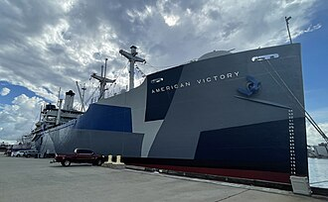
In with the S.S. American Victory, built in 1944
CHAPTER LAW 2026-27
Section 15.0465, Fla. Stat.; effective7-1-2026

Slide 9
Public Schools:
1003.43 Required instruction:
(w)1. For students in grades 3 through 5, the study of cursive writing and the development of the skills necessary for legible cursive writing, including:
2.Letter formation.
3. Proper spacing and alignment.
4. Practice in writing complete words and sentences in cursive
5. By the end of grade 5, each student must demonstrate proficiency in cursive writing. For purposes of this subparagraph, the term “proficiency in cursive writing” means all of the following:
  The ability to write uppercase and lowercase letters of the alphabet in cursive writing.
  Writing words and sentences in cursive legibly and maintaining proper spacing and alignment.
  The ability to read and apply cursive writing in a manner that supports literacy development, including writing essays and assignments in cursive writing in accordance with state academic standards.

Slide 10
Section 1003.44 – Patriotic Programs:
The display of the state motto, “In God We Trust,” designated under s. 15.0301, in a conspicuous place at each public school in the district and in each building used by the district school board.

Slide 11
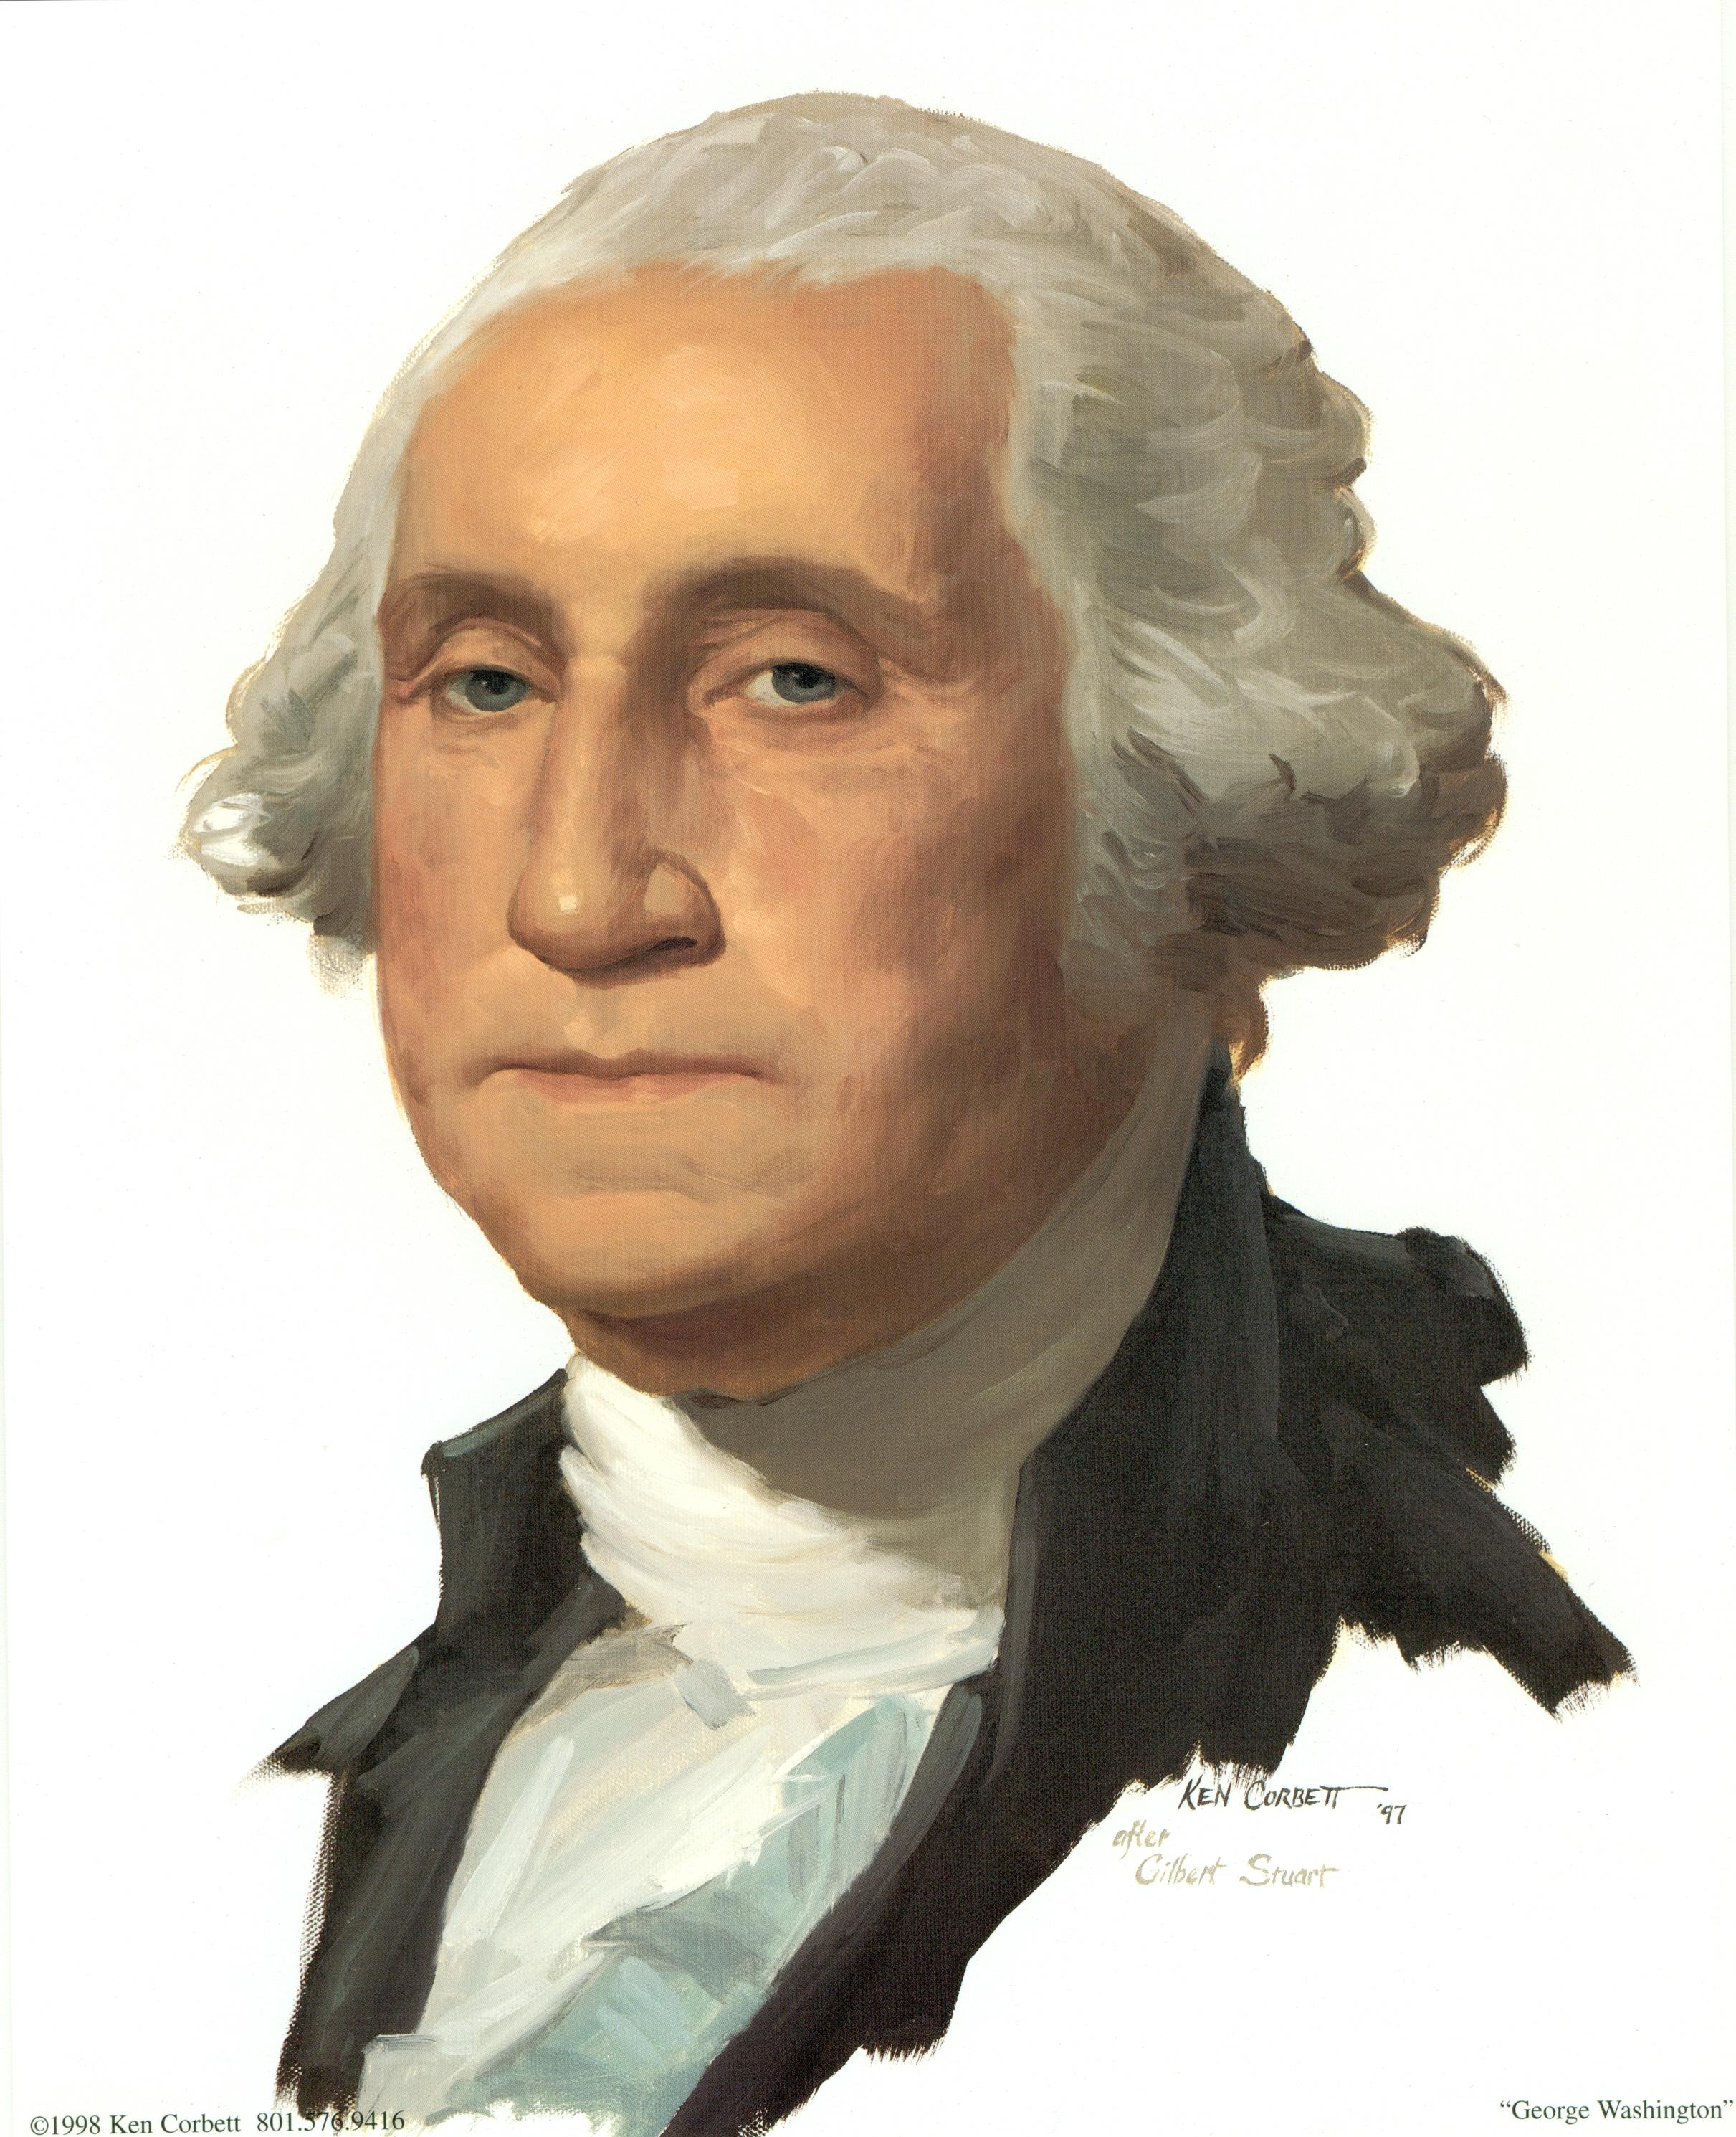
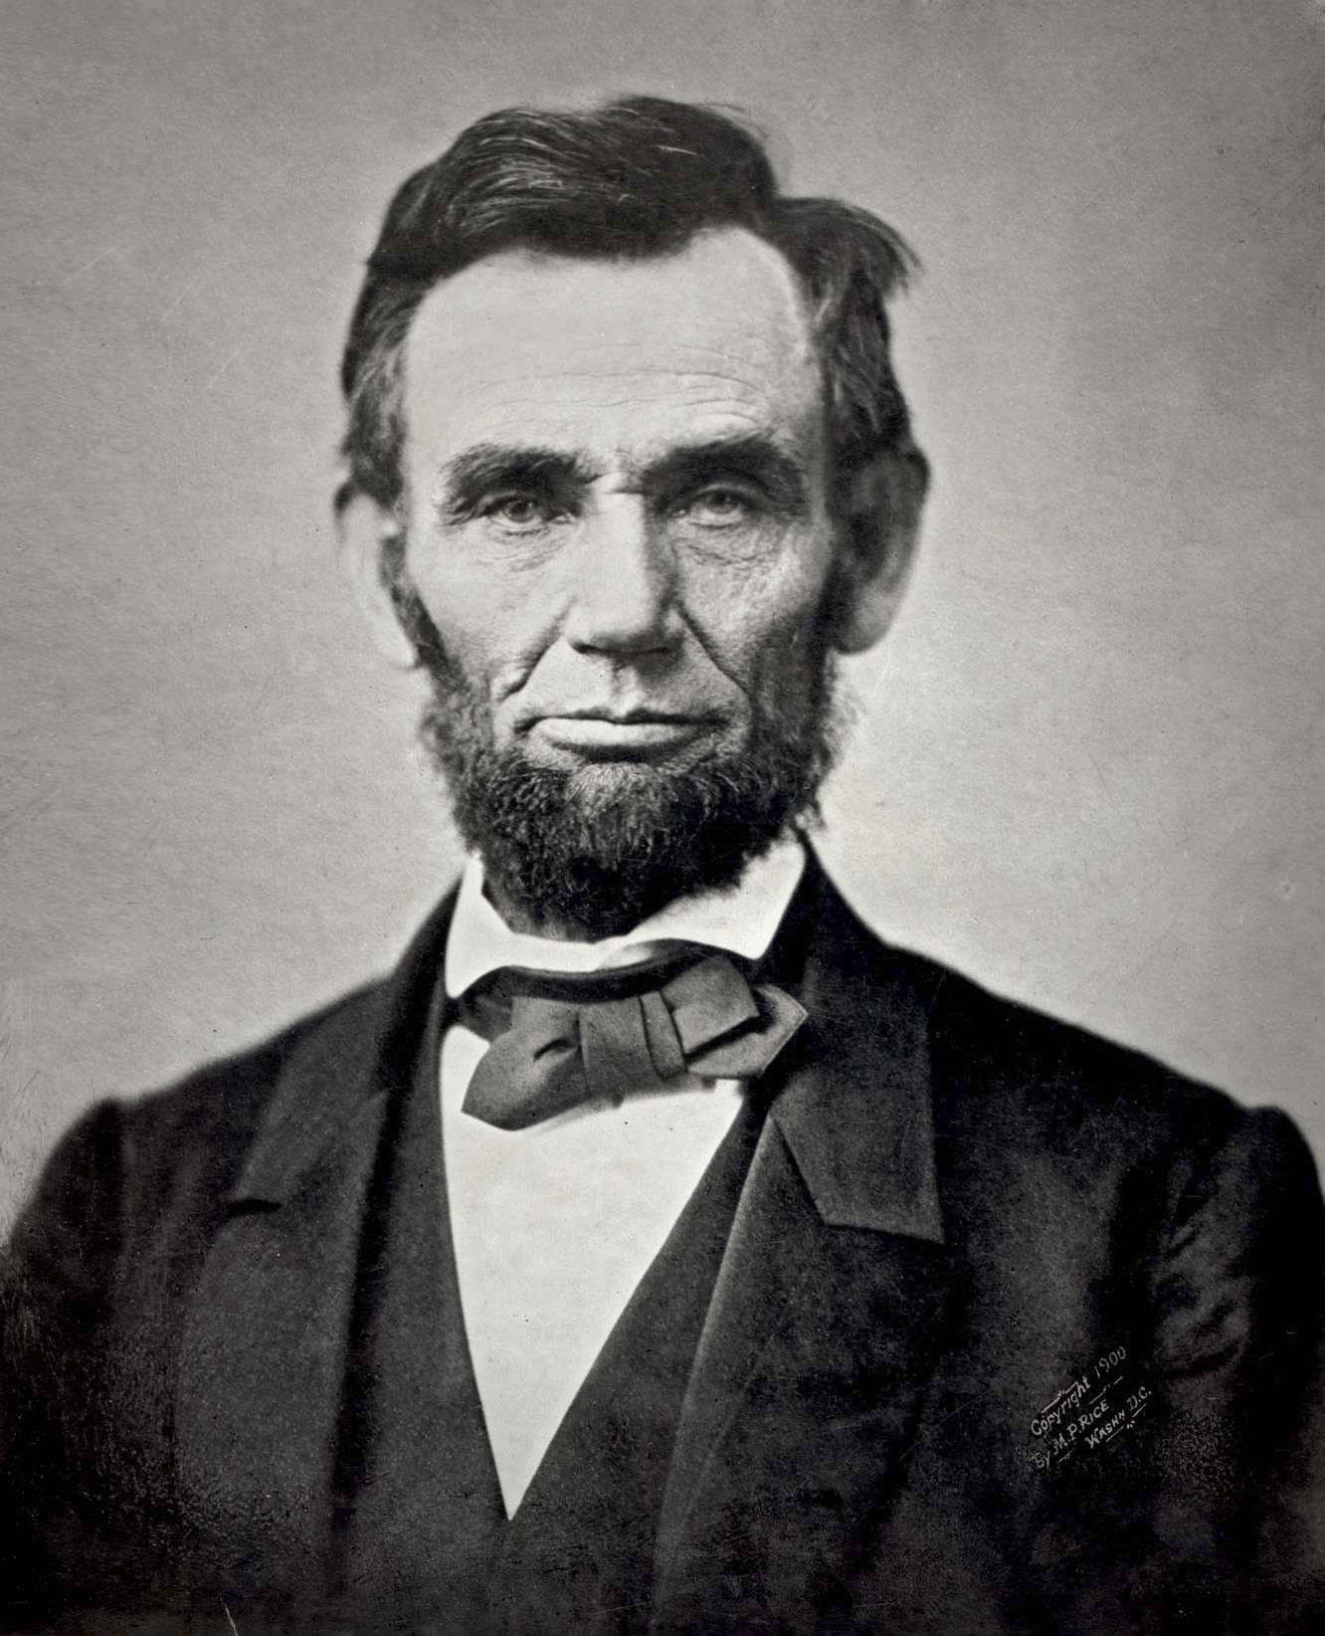
​ Subject to legislative appropriation, the display of portraits of George Washington and Abraham Lincoln in a conspicuous place at each public school in the district. The Department of Education shall select the portraits and make them available to each school district.

Slide 12
Chapter Law 2026-75 // Care of students with epilepsy
Amends Section 1006.0626, Fla. Stat. to include:
Definition of “school” is that found in Section 1004.01(17) and includes Charter Schools under Section 1002.33, Fla. Stat.
Any employee whose duties include regular contact with a child with epilepsy (including those who transport the child) must complete training in the care of students with epilepsy and seizure disorders; training is valid for 5 years.
Created subpart (5) – each school has to display a poster describing the basic steps of responding to an individual having a seizure; DOE is to identify one
or more posters for this requirement.
Effective July 1, 2026

Slide 13
HILLSBOROUGH COUNTY SCHOOL SUPERINTENDENT
WAS AN ELECTED POSITION UNTIL November 8, 1966
HAS BEEN AN APPOINTED POSITION SINCE November 8, 1966
ON THE BALLOT in HILLSBOROUGH COUNTY NOW TO DECIDE IF THE POSITION SHALL REVERT BACK TO AN ELECTED POSITION.
Chapter Law 206-196
House Bill 4027
Approved by the Governor on June 8, 2026.

Slide 14
Chapter Law 2026-122 // Created Section 1013.041, Fla. Stat.
“Statewide inventory of unimproved real property owned by school districts”
Each district is required to annually update the inventory. Included in the annual inventory is a district-commissioned appraisal completed within the past 24 months
A Statewide report will be compiled by the Department of Education to include “any trends or findings DOE determines relevant to effective statewide land use or long-range facilities planning”.
Effective June 11, 2026

Slide 15
CLAIMS BILL // CHAPTER LAW 2026-186
Miami-Dade County bus accident
Jose Correa hit in cross-walk in Miami by bus operated by Miami-Dade County employee
Lawsuit filed on 7-21-2022; case settled for $4.3 million; $200k paid by Miami-Dade County
Mr. Correa incurred below knee amputation
Claims Bill seeking $4.1 million
Legislature directed Miami-Dade County to pay Mr. Correa $4.1 million

Slide 16
CLAIMS BILL // Lourdes Latour and Edward Latour // Miami-Dade County
November 5, 2017 – Mrs. Latour is injured by the malfunctioning automatic gate arm while exiting the Gables by the Sea community on her bicycle.
Lawsuit filed on 11-21-2018
Jury found Miami-Dade County 100% liable for Ms. Latour’s injuries (pain and suffering, physical impairment, disfigurement, mental anguish…)
Jury awarded Mrs. Latour $4.75 million and Mr. Latour $165,000
In lieu of appeal, Miami-Dade and the Latourses agreed to $800,000 settlement.
$300k paid by Miami-Dade, Claims bill for $500k
Legislature directs Miami-Dade to pay Mr. and Mrs. Latours $500,000.00.
Approved by Governor on June 25, 2026.

Slide 17
CLAIMS BILL // Chapter Law 2026-185
Estate of Mark LaGatta
Florida Department of Transportation
Motorcycle accident on July 27, 2020 in Cedar Key in Levy County
DOT performing road work to repair a sink hole; westbound lane closed with cones; eastbound only open lane; flagger directed Mr. LaGatta into the path of a DOT employee on a tractor.
Severe injuries incurred resulting amputation of left leg; 7 surgeries; case settled for $2.32 million on February 28, 2023; Mr. LaGatta died in August of 2024;
DOT paid $120k, Legislature paid $1.2 million from DOT Trust fund to be paid to Mr. LaGatta’s estate.
Approved by the Governor on June 8, 2026.

Slide 18
CLAIMS BILL // CHAPTER LAW 2026-228 // Heriberto A. Sanchez-Mayen
City of St. Petersburg
Homeless person; asleep after 10:00 am in a daytime-only designated park (so lawfully in the park).
City of St. Petersburg police officer arrested him; he was shackled and put into the back of a transport van without any seatbelt; van stopped-short; he was thrown head-first in the interior of the van; no medical assistance rendered; van continued to the Pinellas County Jail; he was removed from the van by dragging him by his feet; causing his head to hit the rear bumper, rear door and cement floor; taken to a local hospital for 12 hours and then transported to Tampa General Hospital; numerous fractures and dissection of thoracic aorta; now a quadriplegic;
Suit filed on March 18, 2024.
Settlement agreement entered into for $2.5 million. City of St. Petersburg paid $200k
Florida and Pennsylvania Medicaid liens still outstanding;
Legislature directed City of St. Petersburg to pay remaining $2.3 million to Mr. Sanchez-Mayen.
Approved by the Governor on June 8, 2026.

Slide 19
CLAIMS BILL // Foster child: L.E.
Department of Children and Families Child Protective Investigation Unit returned an infant to her parents when out-of-home placement/friend could no longer care for the child; L.E. presented to emergency room with shaken-baby-syndrome; both biological parents incarcerated;
DCF agreed to settlement for $4 million;
DCF paid $200,000.00.
Legislature directed payment of $3.8 million to L.E. from the General Revenue Fund.
Approved by the Governor on June 8, 2026.

Slide 20
Chapter Law 2026-116 // Changes to the Florida Civil Rights Act
Section 760.11 is amended:
Specifically allows a lawsuit to be filed if the Florida Commission on Human Relations or the Equal Employment Opportunity Commission fail to render a decision within 180 days after the Charge of Discrimination is filed. And the Plaintiff has 18 months from the date the Charge of Discrimination was filed to file a lawsuit.
Effective July 1, 2026

Slide 21
Chapter Law 2026-107 // Amends Section 1012.34 Personnel evaluation procedures;
Sub-section (3)(a)2.b. is added:
b. For certified school counselors, evaluation criteria must be based upon indicators of the Florida School Counseling Standards adopted by the State Board of Education.
Amends Section 1012.55 – Positions for which certificates are required:
Subsection (6) is added:
(6) A person who is seeking employment as a school counselor is exempt from the educator certification requirements in s. 1012.56(2)(g) and (i). Such exemption does not preclude a school district from requiring a certified school counselor to satisfy the requirements of s. 1012.56(2)(g) and (i) as a condition of employment.

Slide 22
(cont’d…)
[Section 1012.56(2)(g) and (i) read:
(2) ELIGIBILITY CRITERIA.—To be eligible to seek certification, a person must:
…
(g) Demonstrate mastery of general knowledge pursuant to subsection (3).
…
(i) Demonstrate mastery of professional preparation and education competence, pursuant to subsection (6), if the person serves as a classroom teacher or school administrator as classified in s. 1012.01(2)(a) and (3)(c), respectively.]
Effective July 1, 2026.

Slide 23
Chapter Law 2026-70
Changes to Standard High School Diploma requirements for students with disabilities;
Section 1003.4282 is amended to state that one year of marching band meets the requirement of one credit of physical education AND one credit of performing arts.
(8) (b)2. Is added:
2. A student with a disability may participate in the Special Olympics as a course substitution for the physical education requirement under para-graph (3)(f). A student who chooses this option must participate in the Special Olympics for one school year, as determined by the student’s IEP team.
Effective July 1, 2026

Slide 24
Chapter Law 2026-109
Changes to Section 1012.98, the School Community Professional Learning Act;
Section 1012.98(5)(b)12 is added:
(b) Each school district shall develop a professional learning system as specified in subsection (4). The system shall be developed in consultation with teachers, teacher-educators of Florida College System institutions and state universities, business and community representatives, and local education foundations, consortia, and professional organizations. The professional learning system must:
….
12. Provide at least one autism-specific professional learning opportunity annually for instructional personnel and school-based administrators. The professional learning must be developed in consultation with the district’s assigned Center for Autism and Related Disabilities and must include evidence-based practices for supporting students with autism spectrum disorder across all levels of need, including academic instruction, behavioral supports, communication strategies, and inclusive practices.
Effective July 1, 2026.

Slide 25
Chapter Law 2026-90 // Amends Section 1006.20, Athletics in K-12 schools;
Adds subsection (2)(c):
​ The FHSAA shall adopt bylaws that authorize the head coach of an athletic team to support the welfare of a student he or she coaches only by using personal funds to provide, in good faith, effects such as food, transportation, and recovery services. The bylaws must require a parent to provide written consent before a head coach may provide such effects to a student. The bylaws must also restrict such use of funds to one head coach per athletic team.
  1. A head coach who uses personal funds to provide such effects must report such use to the FHSAA in a manner provided by FHSAA bylaw.
  2. Such use of personal funds is presumed not to be an impermissible benefit, unless such use of personal funds is:
    Not reported;
    Reported and deemed not to be in good faith by the FHSAA; or
    Used for recruiting purposes.
3. The maximum amount of personal funds a head coach may use per athletic team per year is $15,000.
Any other organization governing interscholastic athletic competition in this state may adopt bylaws similar to those required by this paragraph.
Effective July 1, 2026.

Slide 26
Chapter law 2026-93
Extracurricular activities
Section 1001.43, Fla. Stat., Supplemental Powers and Duties of the School Board
(i) Use of voluntary donations and revenues generated by authorized booster clubs or associations to provide funds to athletic coaches, activity directors, or activity sponsors of an extracurricular activity supported by the booster club or association. Any policy authorizing payment by booster clubs or associations may not control the provision of funds except that such funds may not be used for severance pay or for compensation as defined in s. 1012.22 and must comply with all applicable laws.
Home schooler extracurricular activities:
Section 1006.15, Fla. Stat. – Student standards for participation in extracurricular activities.
(f) If no public or charter schools in the district in which the student resides offer the interscholastic or intrascholastic extracurricular activity, and an agreement cannot be reached with a private school in the district in which the student resides, the student may participate at a public, charter, or private school that is appropriate for the student’s grade level located outside of his or her school district. The school at which the student participates pursuant to this paragraph must be in a school district adjacent to the school district in which the student resides.

Slide 27
(cont’d…)
(8)(7) INSURANCE.—Any insurance provided by district school boards for participants in extracurricular activities must shall cover any eligible the participating home education student. If there is an additional premium for such coverage, the participating home education student shall pay the premium.
(c)1. Each public school may assess an activity fee to an enrolled student. Each public school may assess an activity fee to a student who is not enrolled but is eligible to participate pursuant to this section, provided that such fee does not exceed the greater of the following:
The fee students enrolled at the school pay to participate in the activity; or
A reasonable fee based on the costs to the school, not to exceed $400
per activity.
1002.31 Controlled open enrollment; public school parental choice.—

Slide 28
(cont’d…)
1006.20 Athletics in public K-12 schools.—
(2) ADOPTION OF BYLAWS, POLICIES, OR GUIDELINES.—
(o) The FHSAA shall adopt, maintain, and enforce sport-specific manuals or handbooks that govern interscholastic competition. The man-uals or handbooks may include, but are not limited to, timing, scoring, equipment, officiating, and athlete safety. The FHSAA must ensure that athletes may request exemptions or accommodations from real-time scoring requirements not later than 72 hours before a sanctioned event. If a request is made within the prescribed time, the FHSAA must provide access to accommodations for such participants.
1012.01 Definitions.—As used in this chapter, the following terms have
the following meanings:
(d) Extracurricular activities administrator.—Included in this classifi-cation is any athletic director or coach or any activity director or sponsor specified by the district school superintendent at the request of the individual. The district school superintendent may negotiate individual compensation in excess of compensation otherwise awardable pursuant to s. 1012.22. Such compensation may not exceed the compensation of the highest paid administrator in the district.
Effective July 1, 2026

Slide 29
Chapter Law 2026-114 // Changes to school athletics:
Section 943.0438 – athletic coaches for independent sanctioning authorities:
“athletic coach” definition adds: volunteer: coach, assistant coach, manager or referee.
(c) “Team based in this state” means a group of players which is assembled in this state to form one side in a competitive game or sport and which primarily practices and competes in this state.
1. Be considered a qualified entity for purposes of participating in the Care Provider Background Screening Clearinghouse under s. 435.12.
The authority may:
b Exempt a person under 18 years of age or a referee disqualified under this subparagraph from the background screening requirement if the person passes a Level 1 background screening pursuant to s. 435.03 and is under the direct supervision of an athletic coach who meets the background screening requirements of this subsection. For purposes of this subparagraph, the Level 1 background screening must include a search of the person’s name or other identifying information against state and federal registries of sexual predators and sexual offenders, which are available to the public on Internet websites provided by the Department of Law Enforcement under s. 943.043, and the Attorney General of the United States under 42 U.S.C. s. 16920.
The qualified entity shall designate a user administrator to act as the primary point of contact and to manage compliance with state and federal laws regarding the security and privacy of criminal history information. The qualified entity may designate additional authorized users with delegated authority to manage or access the system for the purpose of requesting and reviewing background screening information pursuant to this section.
Expunged matters must still be disclosed by the applicant.
Effective July 1, 2026.

Slide 30
Chapter Law 2026-73 // School Board Members’ Bill of Rights // Creates a new section 1001.366, Fla. Stat.:
1001.366 District School Board Members’ Bill of Rights.—A member of a district school board has the right to:
​ Upon request, be given free and timely access to all school district documents necessary to fulfill the duties and responsibilities required under the State Constitution and the Florida Early Learning-20 Education Code. Access to documents that are confidential or exempt from public disclosure must be provided in compliance with applicable law. A request not related to a matter on a publicly noticed meeting of the district school board must be fulfilled within 10 business days after receipt of such request. Any document provided to a district school board member must be offered to all board members.
​ Consult with the school district’s chief financial officer on general matters related to the budget and sources and uses of school district funds, and have reasonable access, upon request, to any detail or line item in any proposed or approved budget or in any financial transaction by the school district.
​ Request any document or information, except for documents or information that the member would be prohibited by law from accessing, from school district staff with the permission of the superintendent or other members of the administration where such permission may not be unreasonably withheld.
​ Comment publicly during or outside of district school board meetings on any matter of district school board business, except for student and employee disciplinary hearings that are specifically addressed in ss. 1006.07 and 1012.34, respectively, or other matters prohibited by law.

Slide 31
(cont’d..) Amends 1001.42, Fla. Stat. to required the Superintendent to keep as public records:
(c) Other records.—Other documents, including attachments for agenda items, such as vendor contracts or budget documents, must be kept as a public record with the minutes of each meeting.
Amends Section 1012.22; Public School Personnel; School Board powers and duties:
(a) 2. The district school board may reject for good cause any employee nominated.
Adds Subsection 5:
5. For the purposes of this paragraph, the term “good cause” means the district school board has determined any of the following:
a. That the nominated employee fabricated or materially exaggerated his or her credentials or background.
b. That the nominated employee does not meet the minimum requirements for the position.
c. That the nominated employee’s educator certificate has been revoked by another state.
Adds Subsection (k):
(k) Nondisclosure or confidentiality.—A school district employee may not be required or otherwise incentivized to sign a nondisclosure agreement or confidentiality agreement. A school district may not impose conditions on employment to circumvent this paragraph.
Effective July 1, 2026.

Slide 32
CHAPTER LAW 2026 -106 // Educator preparation institutes:
Amends Section 1004.85(3)(b)1:
Adds:
An educator preparation institute may allow a program participant to enroll in and complete coursework while the participant is working to obtain an eligible statement of status of eligibility in the certification subject area of the educational plan.
Amends Section 1012.56 Educator certification requirements.—
(7) TYPES AND TERMS OF CERTIFICATION.—
(b) The department shall issue a temporary certificate to any applicant who:
…
4. Completes the requirements in paragraphs (2)(a)-(f) and whose previously issued professional certificate has expired.
Adds: “reinstatement” to Section 1012.585:
(b) Completes the requirements in s. 1012.56(2)(a)-(f).
[removes subsection C re. 5 years immediately preceding reinstatement ……]

Slide 33
(cont’d…)
The requirements of this subsection may not be satisfied by subject area examinations or college credits or inservice points completed for issuance of the certificate that has expired.
Amends Section 1012.981, the Florida Center for Teaching Excellence:
(3) the Center:
(a) Must may submit a professional learning system for approval pursuant to s. 1012.98.
(b) Shall allow a certified educator seeking to renew or reinstate his or her certificate to use the system at no cost and submit any inservice points earned by the educator through the system to the department on the educator’s behalf.
(c)Shall provide a certified educator seeking to renew or reinstate a certificate with information on school district professional learning systems that provide access to inservice training to persons not employed by the school district.
Effective July 1, 2026

Slide 34
Chapter Law 2026-67
Changes to Florida Virtual School
Shall serve all students; [“priorities” in 1-3 removed];
Allows funding to the Florida Virtual School from “other supplemental funding sources”.
Can obtain supplemental funding from direct-support organizations;
Can enter into contracts with “other public and private entities and governmental agencies”
Effective July 1, 2026.

Slide 35
CHAPTER LAW 2026-235 // Changes to DROP
Section 121.053
(7) – a member wo is elected or appointed to elective office who is in DROP …
(a) at the end of the member’s DROP period:
3. The officer, except while serving as a legislator, may remain in elective office and receive his or her accumulated DROP proceeds, including interest earned in accordance with subparagraph 1., after attaining the age of 59 ½ years.
121.101 Cost-of-living adjustment of benefits.—
New section (5) is added:
(5)(a) Commencing July 1, 2026, and in lieu of any annual adjustment authorized in paragraph (4)(b) occurring after the fifth anniversary of retirement of an eligible Special Risk Class member whose effective retirement date is on or after July 1, 2011, the adjusted monthly benefit of each eligible Special Risk Class retiree and annuitant shall be the amount of the monthly benefit being received on June 30 immediately preceding the adjustment date plus the greater of the amount determined by multiplying the benefit by the factor calculated pursuant to paragraph (4)(c) or the amount equal to 1.5 percent of this benefit.

Slide 36
(cont’d…)
​ For purposes of this subsection, the term “eligible Special Risk Class retiree” means a retiree:
  Initially enrolled in the Florida Retirement System prior to July 1, 2011, who has completed at least 72 calendar months of creditable service as a Special Risk Class member; or
  Initially enrolled in the Florida Retirement System on or after July 1, 2011, who has completed at least 96 calendar months of creditable service as a Special Risk Class member.
Section 7. The Legislature finds that a proper and legitimate state purpose is served when employees, officers, and retirees of the state and its political subdivisions, and the dependents, survivors, and beneficiaries of such employees, officers, and retirees, are extended the basic protections afforded by governmental retirement systems. These persons must be provided benefits that are fair and adequate and that are managed, administered, and funded in an actuarially sound manner as required by s. 14, Article X of the State Constitution and part VII of chapter 112, Florida Statutes. Therefore, the Legislature determines and declares that this act
fulfills an important state interest.
Effective July 1, 2026.

Slide 37
Chapter Law 2026-33
Changes to:
Charter Schools:
A student may not be dismissed based on academic performance while a school is implementing a school improvement plan pursuant to paragraph (9)(n) or corrective action plan pursuant to s. 1002.345.
Florida Tax Credit Scholarship Program:
All funds that revert to the organization must be separately accounted for and used to fund scholarships in the fiscal year the reversion occurs. Any funds remaining at the end of the fiscal year may be carried forward to the following fiscal year and must be fully expended for annual or partial-year scholarships in the following fiscal year.
By July 1 of each year, an organization must report to the Department of Education the total number of scholarship accounts that were closed during the prior fiscal year and the amount of funds that reverted to the organization.
Private Schools:
(d) A private school enrolling 150 or fewer students, or located within the unincorporated area of a county as defined in s. 125.011, shall be considered a permitted use and occupancy in a commercial or mixed-use zoning district within a county or municipality without rezoning or obtaining a special exception or a land use change, and without complying with any mitigation requirements, conditions, performance standards, ordinances, rules, codes, or policies, except that a county or municipality may require proportionate mitigation measures necessary to mitigate vehicular traffic and pedestrian safety.

Slide 38
(cont’d…)
(e) Notwithstanding any other provision of law, a private school enrolling 150 or fewer students may operate in a facility that is an existing assembly, day care, mercantile, or business occupancy, as defined in the Florida Fire Prevention Code. A private school operating in such a facility must meet the standards for existing educational occupancy requirements under the Florida Fire Prevention Code, adopted by the State Fire Marshal. Completion of the fire safety evaluation system for educational occupancies in the National Fire Protection Association, Life Safety Code, NFPA 101A: Guide on Alternative Approaches to Life Safety, adopted by the State Fire Marshal, by a registered design professional licensed under chapter 471 or chapter 481, with a determination of achieving at a minimum an “at least equivalent” conclusion, is considered evidence of compliance with the Florida Fire Prevention Code. The State Fire Marshal may adopt rules to implement this paragraph.

Slide 39
1012.966 School teacher training and mentoring program is created:
(1) The School Teacher Training and Mentoring Program is established within the Department of Education. The purpose of the program is to increase the effectiveness and involvement of classroom teachers and improve student achievement, classroom management, and excellence in the state’s public schools.
(2)(a) School districts and charter schools may place retired classroom teachers or current classroom teachers in schools earning a grade of “D” or “F” to act as teacher mentors
Effective July 1, 2026

Slide 40
Chapter law 2026-22 // Changes to employment of relatives;
112.3135 Restriction on employment of relatives.—
(2)(c) This subsection does not prohibit the board, council, commission, or collegial body on which an elected public official serves from appointing, employing, promoting, or advancing a relative who is an elected public official serving on the same board, council, commission, or collegial body to a leadership position thereof.
1002.33 Charter schools.—
(24) RESTRICTION ON EMPLOYMENT OF RELATIVES.—
Is reenacted;
1012.23 School district personnel policies.—
(2) Neither the district school superintendent nor a district school board member may appoint or employ a relative, as defined in s. 112.3135, to work under the direct supervision of that district school board member or district school superintendent. The limitations of this subsection do not apply to employees appointed or employed before the election or appointment of a school board member or district school superintendent. The Commission on Ethics shall accept and investigate any alleged violations of this section pursuant to the procedures contained in ss. 112.322-112.3241.
Is reenacted.
Effective April 1, 2026.

Slide 41
CHAPTER Law 2026-237
Changes to Section 1001.92, State University System Performance-based incentive-
the performance-based metrics must include:
(a) The 4-year graduation rate and adjusted cohort graduation rate for engineering programs and co-op programs for first-time-in-college students. For purposes of this paragraph, a “co-op program” is a program identified by a state university, subject to approval by the Board of Governors, that combines academic study with up to four semesters of related paid work experience prior to graduation;
Creates Section 1004.243 pertaining to state university assets in Manatee and Sarasota counties;
Creates section 1004.64992 – Disaster Preparedness Center at Florida International University;
Effective June 29, 2026.

Slide 42
Chapter law 2026-80 // School safety
Sheriff’s offices to assist with postsecondary educational institutions, private schools, and child care facilities in implementing a guardian program if requested.

Slide 43
Increased penalty for weapons discharges at a school sponsored event or on school property:
Section 790.115, Fla. Stat.
2 d) A person commits a felony of the second degree, punishable as provided in s. 775.082, s. 775.083, or s. 775.084, if he or she:
2. Discharges any weapon or firearm within 1,000 feet of a school, during school hours or during the time of a sanctioned school activity, unless discharged for lawful defense of himself or herself or another or for a lawful purpose. This subparagraph does not apply to the discharge of a weapon or firearm on private real property within 1,000 feet of a school by the owner of such property or by a person whose presence on such property has been authorized, licensed, or invited by the owner commits a felony of the second degree, punishable as provided in s. 775.082, s. 775.083, or s. 775.084.
(4) A person arrested for a violation of paragraph (2)(d) must be held in custody until brought before the court for admittance to bail in accordance with chapter 903.

Slide 44
(cont’d…)
1003.25 Procedures for maintenance and transfer of student records.—
(4) When the education records of a student contain the documents described in subsection (2) and the student enrolls in a Florida College System institution or state university, such records must be transferred to his or her institution or university of enrollment. The State Board of Education and the Board of Governors shall adopt rules and regulations, respectively, to establish the procedures for the transfer of a student’s threat assessment report pursuant to this subsection.

Slide 45
Section 7. Section 1006.601, Florida Statutes, is created to read:
1006.601 Active Response and Mitigation of On-Campus Risks (ARMOR) Act.—
(1) SHORT TITLE.—This section may be cited as the “Active Response and Mitigation of On-Campus Risks (ARMOR) Act.”
(2) DEFINITION.—As used in this section, the term “public postsecondary educational institution” has the same meaning as in s. 1000.04(3).
Effective July 1, 2026.

Slide 46
Chapter Law 2026-59
1001.42 Powers and duties of the School Board
17) PUBLIC INFORMATION AND PARENTAL INVOLVEMENT PROGRAM.—
Adopt procedures whereby the general public can be adequately informed of …approved virtual instruction program providers under s. 1002.45 or the school district’s virtual instruction program
EDUCATIONAL EMERGENCY.—To free schools that have with a school grade of “D” or “F” or are persistently low-performing schools as described in s. 1002.333 from contract restrictions
(23) VIRTUAL INSTRUCTION.—Provide students with access to courses, based on the students’ choice, available through the school district’s a virtual instruction program option or an approved virtual instruction program provider under s. 1002.45, including the Florida Virtual School and other approved providers, and award credit for successful completion of such courses.

Slide 47
3. The school district and its employees, agents, and the physician who provides the standing protocol for school FDA-approved epinephrine delivery devices auto-injectors are not liable for any injury arising from the use of such an epinephrine delivery device auto-injector administered by trained school personnel who follow the adopted protocol and whose professional opinion is that the student is having an anaphylactic reaction:

Slide 48
(f) One credit in physical education.—
Completion of 1.0 credit with a grade of “C” or better in a dance techniques course, a significant component of which is activities designed to maintain or improve health-related fitness and lifelong fitness, shall satisfy the one-credit requirement in physical education or the one-credit requirement in performing arts. This credit may not be used to satisfy the personal fitness requirement or the requirement for adaptive physical education under an IEP or 504 plan.

Slide 49
(cont’d…)
The Department of Education shall develop applied algebra courses aligned with the identified mathematics pathways and the established career and technical education career clusters by January 1, 2027, with availability for district implementation in the 2029-2030 school year.
  The applied algebra for engineering and technology course must incorporate content and contexts that apply to the following career clusters: energy, engineering and technology education, and information technology.
  The applied algebra for health science course must incorporate content and contexts that apply to the health science career cluster.
  The applied algebra for business and finance course must incorporate content and contexts that apply to the following career clusters: business management and administration; finance; government and public administration; and marketing, sales, and service.

Slide 50
d. The applied algebra for industrial pathways course must incorporate content and contexts that apply to the following career clusters: architecture and construction; manufacturing; and transportation, distribution, and logistics.
e. The applied algebra for agriculture and natural resources course must incorporate content and contexts that apply to the agriculture, food, and natural resources career cluster.

Slide 51
(cont’d…)
1003.5716 Transition to postsecondary education and career opportunities. All students with disabilities who are 3 years of age to 21 years of age have the right to a free, appropriate public education. As used in this section, the term “IEP” means individual education plan.
(5)
3. ​ If a related service identified in a student’s IEP is not provided as scheduled, the school district must notify the parent or guardian in writing or by electronic means within 10 school days, explain the reason the service was not provided, and discuss a plan for make-up services.
4. ​ A parent or guardian has the right to access, upon request, all service provider logs or progress notes within 15 school days after such service is provided. The school district shall inform parents of this right at each IEP meeting.

Slide 52
(cont’d…)
Section 1011.62 Funds for operation of schools –
Calculation of additional full-time equivalent membership based on Florida advanced courses and tests scores of students.—A value of 0.16 full-time equivalent student membership shall be calculated for each student in a Florida advanced course who achieves a minimum score on an assessment identified by the Department of Education pursuant to s. 1007.27(2) and added to the total full-time equivalent student membership in basic programs for grades 9 through 12 in the subsequent fiscal year. Each district shall allocate at least 80 percent of the funds provided to the district for advanced course instruction, in accordance with this paragraph, to the high school that generates the funds. The school district shall distribute to each classroom teacher who provided the advanced course instruction:
A bonus in the amount of $50 for each student taught by the Florida advanced course teacher in each Florida advanced course who achieves a minimum score on an assessment identified by the Department of Education pursuant to s. 1007.27(2).
An additional bonus of $500 to each Florida advanced course teacher in a school designated with a grade of “D” or “F” who has at least one student who achieves a minimum score on an assessment identified by the Department of Education pursuant to s. 1007.27(2), regardless of the number of classes taught or of the number of students who achieve a minimum score on an assessment identified by the Department of Education pursuant to s. 1007.27(2).
Effective July 1, 2026.

