Slide 1

Neurodiversity in the Workplace:
Employee Expectations and Employer Obligations
Thursday, July 16, 2026
Notes:
Confirmed image is from Getty (1156390242)

Slide 2

Daniel Jolivet, PhD
Workplace Possibilities Practice Consultant
Speaker
Notes:
Dan Jolivet is the workplace possibilities practice consultant at The Standard, where he provides leadership, analysis, and consultative insights into the Workplace Possibilities service line. He provides specialized focus on behavioral health, stay at work, return to work, ADAAA services, health management integration, and other related employer solutions. He is a clinical psychologist licensed in Georgia and Oregon, and he has worked in behavioral health since 1980. He joined The Standard in 2016 as the Behavioral Health Director.
Prior to joining The Standard, Dan worked in managed behavioral health care organizations for 20 years in a variety of management roles and was in clinical practice as a child psychologist until 2003.

Slide 3
Agenda
Understanding neurodiversity
Why employers should care
Determining if an employee is neurodiverse
Neurodiversity in the workplace
What neurodiverse individuals need

Slide 4
Disclaimer
The following slides are provided for informational purposes only and do not constitute legal or medical advice. They should not be relied upon or treated as legal or medical advice. This information is intended, but not promised or guaranteed, to be current, complete or up-to-date, as statutes, regulations, clinical guidelines and best practices are subject to change. You should not act or rely on any information contained in this document without first seeking the advice of an attorney or an appropriate treatment provider.

Slide 5
Understanding Neurodiversity

Slide 6
Key Concepts for Understanding Neurodiversity
Diversity
Neurodiverse
Neurotypical
Neurochameleon
Genetically-determined variability of traits
Neurological variations seen as differences, not disorders
Reflecting “average” neurological functioning
Adopting behaviors to fit in with neurotypical people
Notes:
Diversity: Biological term for the genetically-determined variability of many traits within a species, seen across all life.
Neurodiverse: Exhibiting behaviors, thoughts and emotions that suggest atypical neurological development and functioning based on the natural variation of human brains and nervous systems; used as synonymous with neurodivergent in this presentation. This is a different paradigm for understanding variations in neurological functioning. Contrasting with the medical model, and it includes issues diagnosed under the medical model as mental health and substance use disorders, as well as developmental and learning disorders, Traumatic Brain Injury (TBI), and other neurological conditions (such as Fetal Alcohol Syndrome).
Medical Model: The traditional way to understand variations in thoughts, emotions, and behaviors, this considers differences pathological, as diseases or disorders to be cured. Differences are seen as bad: Any divergence from the norm is considered a problem. The aim of treatment is to fix the patient: Treatment aims to make people conform to the societal definition of normal.
The neurodiversity framework understands variations in behaviors, feelings and thoughts as natural deviations that are merely different. Diversity is seen as good, since differences can be adaptive and confer advantages. While some differences may create difficulties for the individual, the goal is well-being, not conformity. The aim of treatment is to support the individual.
Neurotypical: Exhibiting behaviors, thoughts and emotions that suggest typical neurological development and functioning.
Neurochameleon: A neurodiverse person who adopts behaviors to fit in with others who are neurotypical; a type of code-switching.
Code-switching: The practice of changing how we express ourselves to conform to expectations in different scenarios. This includes changing our language, especially accent, slang, and grammar, as well as our behavior. Neurodiverse individuals often learn how to act like neurotypical people when they’re children.
See also:
Jolivet, D. (July 28, 2023). Neurodiversity and Labels, LinkedIn. https://www.linkedin.com/pulse/neurodiversity-labels-dan-jolivet/, accessed on March 13, 2026.
Sharma, N. (November 14, 2023). Let’s Talk About Code-Switching: A Double-Edged Sword, UC Berkeley Graduate Division. https://grad.berkeley.edu/news/announcements/lets-talk-about-code-switching-a-double-edged-sword/, accessed on March 13, 2026.
Thompson, M. (April 13, 2013). Five Reasons Why People Code-Switch, NPR. https://www.npr.org/sections/codeswitch/2013/04/13/177126294/five-reasons-why-people-code-switch, accessed on March 13, 2026.

Slide 7
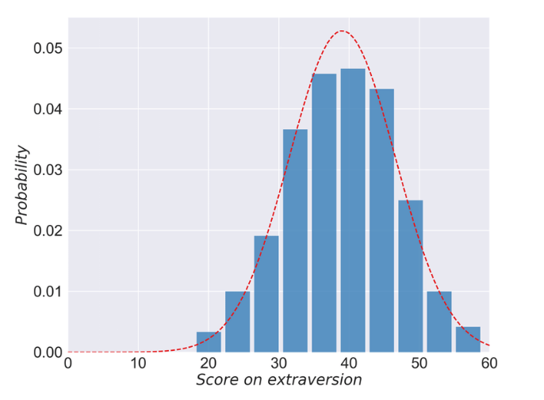
Neurodiversity: Variation in Extraversion
One psychological trait that’s normally distributed is how introverted or extraverted an individual is.
Source: Zhou, Z, Ke, X. and Zhao, Ji; 2017.
Notes:
People in the middle of the distribution are called ambiverts. That’s a word that you don’t hear much, especially considering it applies to the majority of people.
By the way, I’m about as far over to the introverted side of the distribution as it’s possible to be: This is one way in which I’m a neurochameleon and am able to pass as an extravert.
Sources:
Extroverts Tweet Differently from Introverts in Weibo - Scientific Figure on ResearchGate. Available from: https://www.researchgate.net/figure/The-distribution-of-scores-on-extraversion-from-self-reports-of-293-valid-samples_fig1_315456499 [accessed 21 May 2025] from Zhou, Zhenkun & Xu, Ke & Zhao, Jichang. (2017). Extroverts Tweet Differently from Introverts in Weibo. EPJ Data Science. 7. 10.1140/epjds/s13688-018-0146-8.
Chong, E. (2023, January 1). Introverts VS Extroverts — The Long Standing Debate on Which is Better, Medium, https://medium.com/illumination/introverts-vs-extroverts-the-long-standing-debate-on-which-is-better-6980378b78be, accessed on May 22, 2025.

Slide 8
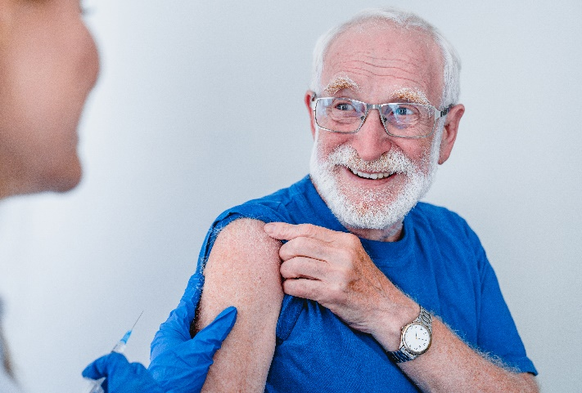
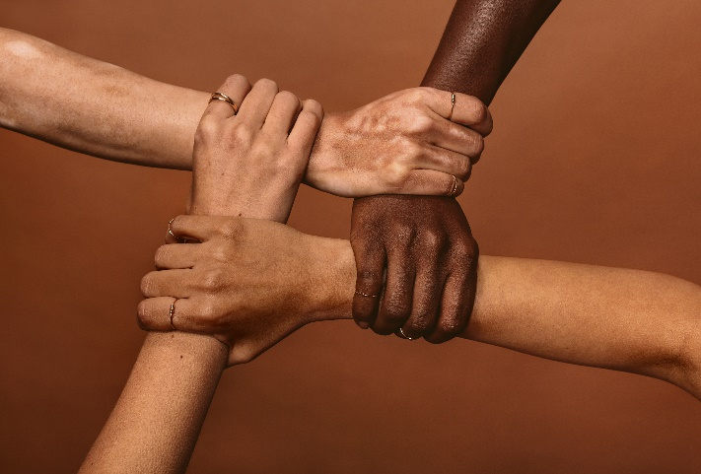
Neurodiversity applies to all different types of brains.
The neurodiversity perspective contrasts with the traditional medical model, which considers differences to reflect pathology.
Differences are seen as bad. Any divergence from the norm is considered a problem.
The aim of treatment is to fix the patient. Treatment aims to make people conform to the societal definition of normal.
Differences are seen as natural and potentially good. Differences can confer advantages.
The aim of treatment is support and well-being. While some differences may create difficulties for the individual, the goal is not conformity.
Notes:
Confirmed images are from Getty (1279370441 + 872-36864)
Although the term was coined in reference to Autism-Spectrum Disorder, it is now applied to all kinds of neurological difference.
See also:
Pellicano E, Heyworth M. The Foundations of Autistic Flourishing. Curr Psychiatry Rep. 2023 Sep;25(9):419-427. doi: 10.1007/s11920-023-01441-9. Epub 2023 Aug 8. PMID: 37552401; PMCID: PMC10506917. https://pmc.ncbi.nlm.nih.gov/articles/PMC10506917/, accessed on May 5, 2025.

Slide 9
Most Behavioral Health Conditions May Be Viewed as Neurodiverse
Neurological conditions may also be considered neurodivergent although there’s disagreement about whether acquired conditions should be included.
Autism Spectrum Disorder may include exceptional memory skills, increased understanding of natural systems and behaviors, heightened perception and/or creativity and unusual problem-solving approaches.
Anxiety Disorders may serve as an early warning system for threats and encourage groups to prepare for potential dangers.
Addictions promoted fitness through reward-seeking behaviors and identified substances useful as medicines.
PTSD by priming the fight-flight-flee response centered in the amygdala, affected individuals respond more quickly and strongly to potential dangers.
Notes:
Any characteristics that present along a normal distribution are likely to have a genetic basis and to confer a specific evolutionary advantage.
“All human evolution was driven by slightly autistic Asperger’s and autistic people. The human race would still be sitting around in caves chattering to each other if it were not for them.” Michael Fitzgerald, professor of child and adolescent psychiatry specializing in autism spectrum disorder, quoted in Spikins (2017).
Sources:
Spikins, P. (2017, May 9). What Role Did Autism Play in Human Evolution? Sapiens: Anthropology Magazine, https://www.sapiens.org/biology/autism-human-evolution/, accessed on May 22, 2025.
Liester, M.B. (2024, June 1). The Stoned Ape Theory Revisited, Psychology Today, https://www.psychologytoday.com/us/blog/the-leading-edge/202406/the-stoned-ape-theory-revisited, accessed on May 22, 2025.
University of Edinburgh Science Media (2024). PTSD: The evolutionary advantage, https://eusci.org.uk/2019/08/29/ptsd-the-evolutionary-advantage/, accessed on May 22, 2025.

Slide 10
Why Should Employers Care?

Slide 11
Neurodiversity is Very Common
As many as one-third of U.S. adults may be considered neurodiverse.
Many people who meet the criteria for a neurodiverse diagnosis are not formally diagnosed and many people who self-identify as neurodiverse have no formal diagnosis.
Neurotypical
67% of the adult population.
Any mental illness
Any substance use disorder
Both mental illness and substance use
Autism-spectrum disorder
Source: SAMHSA, 2025.
Notes:
Note that these statistics are taken from a survey that is based on the medical model and so uses terminology that is inconsistent with the neurodiversity paradigm.
People often ask why we’ve seeing an increase diagnosable behavioral health conditions, but the truth is we don’t actually know. Some of it is attributed to the ongoing epidemic of Diseases of Despair, and the associated Deaths of Despair (overdose, primarily driven by opioid misuse; suicide; and deaths caused by alcohol misuse), which appear to be partly caused by some areas of the country refusing to implement evidence-based public health initiatives. Although the rate of mental health conditions is increasing worldwide, especially since the pandemic, the epidemic of Deaths of Despair is unique to the United States.
With respect to the increase in Autism-Spectrum Disorder diagnoses over the past 40 years, that appears to be primarily a result of changes to the diagnostic criteria, increased screening, and improved tracking. Autism is highly heritable, although there are a variety of other risk factors associated with it (such as the age of the father at the time of conception, maternal fever during the pregnancy, & premature birth). There is no evidence that vaccines cause autism, while numerous studies have found no correlation between vaccination and autism.
There are a variety of reasons why many neurodiverse individuals are not formally diagnosed:
People with behavioral health disorders are often in denial about their problems, either believing they don’t have a problem or that their problems aren’t bad enough to require treatment.
People who recognize they have a problem frequently avoid treatment because of fears around stigma and discrimination.
These people also often feel significant shame about their problems, so they conceal them, even avoiding treatment because of their shame.
In addition to these issues, there is an ongoing shortage of behavioral health providers across the country.
Many people self-diagnose as being “on the spectrum” or neurodiverse
Fewer than half the people with a diagnosable psychiatric condition will seek treatment for it, while less than 20% of those with an addiction will get treatment. Further, even when they do seek treatment, they typically delay for more than a decade.
Diagnosis Percentage
Any Mental Illness Only 14%
Any Substance Use Disorder Only 8%
Both Mental Illness and Substance Use 8%
Autism-Spectrum Disorder 2%
Neurotypical Adults 67%
All Neurodiverse Adults 33%
It might be noted that around 32%% of people fall outside one standard deviation from the mean in any standard normal distribution.
Sources:
Dietz PM, Rose CE, McArthur D, Maenner M. National and State Estimates of Adults with Autism Spectrum Disorder. J Autism Dev Disord. 2020 Dec;50(12):4258-4266. doi: 10.1007/s10803-020-04494-4. PMID: 32390121; PMCID: PMC9128411. https://pmc.ncbi.nlm.nih.gov/articles/PMC9128411/, accessed on May 22, 2025.
Substance Abuse and Mental Health Services Administration. (2025). Key substance use and mental health indicators in the United States: Results from the 2024 National Survey on Drug Use and Health (HHS Publication No. PEP25‑07‑007, NSDUH Series H‑60). Center for Behavioral Health Statistics and Quality, Substance Abuse and Mental Health Services Administration. https://www.samhsa.gov/data/data‐we‐collect/nsduh‐national‐survey‐drug‐use‐and‐health/national‐releases. https://www.samhsa.gov/data/report/2024-nsduh-annual-national-report, accessed on September 3, 2025.
Beseran E, Pericàs JM, Cash-Gibson L, Ventura-Cots M, Porter KMP, Benach J. Deaths of Despair: A Scoping Review on the Social Determinants of Drug Overdose, Alcohol-Related Liver Disease and Suicide. Int J Environ Res Public Health. 2022 Sep 29;19(19):12395. doi: 10.3390/ijerph191912395. PMID: 36231697; PMCID: PMC9566538. https://pmc.ncbi.nlm.nih.gov/articles/PMC9566538/, accessed on May 22, 2025.
Montez JK, Mehri N, Monnat SM, Beckfield J, Chapman D, Grumbach JM, Hayward MD, Woolf SH, Zajacova A. U.S. state policy contexts and mortality of working-age adults. PLoS One. 2022 Oct 26;17(10):e0275466. doi: 10.1371/journal.pone.0275466. PMID: 36288322; PMCID: PMC9604945. https://pmc.ncbi.nlm.nih.gov/articles/PMC9604945/, accessed on May 22, 2025.
Neurology Advisor (2025, March 12). 1990 to 2021 Saw Global Decline in Mortality Rate for Suicide. https://www.neurologyadvisor.com/news/1990-to-2021-saw-global-decline-in-mortality-rate-for-suicide
Pappas, S. (2025, April 17). RFK, Jr., Is Wrong about Cause of Rising Autism Rates, Scientists Say, Scientific American, https://www.scientificamerican.com/article/the-real-reason-autism-rates-are-rising/, accessed May 21, 2025.
American Psychiatric Association (n.d.). Stigma, Prejudice and Discrimination Against People with Mental Illness, https://www.psychiatry.org/patients-families/stigma-and-discrimination, accessed on May 22, 2025.
McLaughlin CG. Delays in treatment for mental disorders and health insurance coverage. Health Serv Res. 2004 Apr;39(2):221-4. doi: 10.1111/j.1475-6773.2004.00224.x. PMID: 15032951; PMCID: PMC1361004. https://pmc.ncbi.nlm.nih.gov/articles/PMC1361004/, accessed on May 22, 2025.
Modi, H., Orgera, K. & Grover, A. (2022, October 10). Exploring Barriers to Mental Health Care in the U.S. Association of American Medical Colleges, https://www.aamcresearchinstitute.org/our-work/issue-brief/exploring-barriers-mental-health-care-us, accessed on May 22, 2025.
Cassata, C. (2024, April 11). People Are Misdiagnosing Themselves with Autism from TikTok Misinformation, healthline, https://www.healthline.com/health-news/autism-self-diagnosis-tiktok, accessed on May 22, 2025.

Slide 12

The Neurodiversity Employment Crisis
4.2%
10.0%
vs.
Unemployment rate for people without a disability
Unemployment rate for people with any disability
85%
50%
vs.
Percentage college-educated people with autism who are unemployed
Percentage of people with severe mental illness who are unemployed
Sources: Bureau of Labor Statistics, 2025; NAMI, 2025.
Notes:
Confirmed image is from Getty (846333890)
Despite the ongoing labor shortage and the importance employers give to recruitment and retention, unemployment remains high among neurodiverse individuals.
It’s impossible to differentiate people who are unemployed because of a substance use disorder versus those who use substances as a result of unemployment; similarly, there is a bidirectional relationship between mental illness and unemployment.
Sources:
Palumbo, J.J. (2022, June 29). How Autistic Individuals Can Offer Special Skills To Your Business, Forbes. https://www.forbes.com/sites/jenniferpalumbo/2022/06/29/how-autistic-individuals-can-offer-special-skills-to-your-business/, accessed on May 22, 2025.
Autism Society (n.d.). Employment Statistics, https://autismsociety.org/employment/, accessed on May 22, 2025.
Azagba, S., Shan, L., Qeadan, F. et al. Unemployment rate, opioids misuse and other substance abuse: quasi-experimental evidence from treatment admissions data. BMC Psychiatry 21, 22 (2021). https://doi.org/10.1186/s12888-020-02981-7, accessed on May 22, 2025.
Luciano A, Meara E. Employment status of people with mental illness: national survey data from 2009 and 2010. Psychiatr Serv. 2014 Oct;65(10):1201-9. doi: 10.1176/appi.ps.201300335. PMID: 24933361; PMCID: PMC4182106, https://pmc.ncbi.nlm.nih.gov/articles/PMC4182106/, accessed on May 22, 2025.
National Alliance on Mental Illness (n.d.). Mental Health By the Numbers, https://www.nami.org/about-mental-illness/mental-health-by-the-numbers/, accessed on May 22, 2025.
Bureau of Labor Statistics (2025, August 1). News Release: The Employment Situation, U.S. Department of Labor, https://www.bls.gov/news.release/pdf/empsit.pdf, accessed on September 3, 2025.

Slide 13
Neurodiverse Workers Make Significant Contributions
Innovative perspectives: including unique cognitive perspectives, which can lead to greater innovation.
Unique strengths: including strong detail orientation, exceptional memory, enhanced multitasking, excellent pattern recognition, outstanding math skills, etc.
Problem-solving abilities: neurodiverse individuals often have a long history of problem solving to overcome societal barriers.
Focus and attention to detail: some neurodiverse individuals have an enhanced ability to focus, leading to improved work quality and high productivity.
Creativity: some neurodiverse individuals are highly creative.
Notes:
See also:
Fermin, J. (2023, April 5). Neurodiversity in the Workplace: Benefits and Strategies, All Voices, https://www.allvoices.co/blog/neurodiversity-in-the-workplace, accessed on May 22, 2025.

Slide 14
EEOC Discrimination Lawsuits Involving Neurodiversity Have Been Increasing
Diagnoses included under the neurodiverse label may be considered a disability under the Americans with Disabilities Act, or ADA, and its Amendment Act, or ADAAA.
Autism discrimination lawsuit
$155,000 settlement
Depression discrimination lawsuit
$250,000 settlement
Autism and ADHD discrimination lawsuit
$30,000 settlement
Opioid addiction harassment lawsuit
$60,000 settlement

Slide 15
How Do You Know If An Employee is Neurodiverse?

Slide 16


You Don’t.
The only way to know that someone is neurodiverse is through a comprehensive assessment and diagnosis by a trained professional.
Notes:
Confirmed image is from Getty (1329526369)

Slide 17

Don’t Fall into the Trap of Trying to Diagnose Employees
It’s always a bad idea to informally diagnose employees and that’s especially true with neurodiversity.
“Are you on the Spectrum?”: This is just as bad of an idea as asking a person if they’re pregnant.
“Are you autistic?”: Please tell me you know this is off limits.
“He seems neurodiverse.” The ADA/ADAAA, protects workers who do not have a disability, if their employer believes they do and is regarding them as disabled.
“He told me he was neurodiverse.”: Many people describe themselves as “neurodiverse” without ever receiving a formal diagnosis. Although it’s probably a good idea to accept their self-identification, don’t make assumptions about what they mean or how you should treat them.
Notes:
Confirmed image is from Getty (1297542576)
See also:
U.S. Equal Employment Opportunity Commission (EEOC) (Undated). The ADA: Your Employment Rights as an Individual With a Disability, https://www.eeoc.gov/publications/ada-your-employment-rights-individual-disability, accessed on May 22, 2025.

Slide 18
The Challenge: If you don’t know who’s neurodiverse, how do you accommodate them?

Slide 19
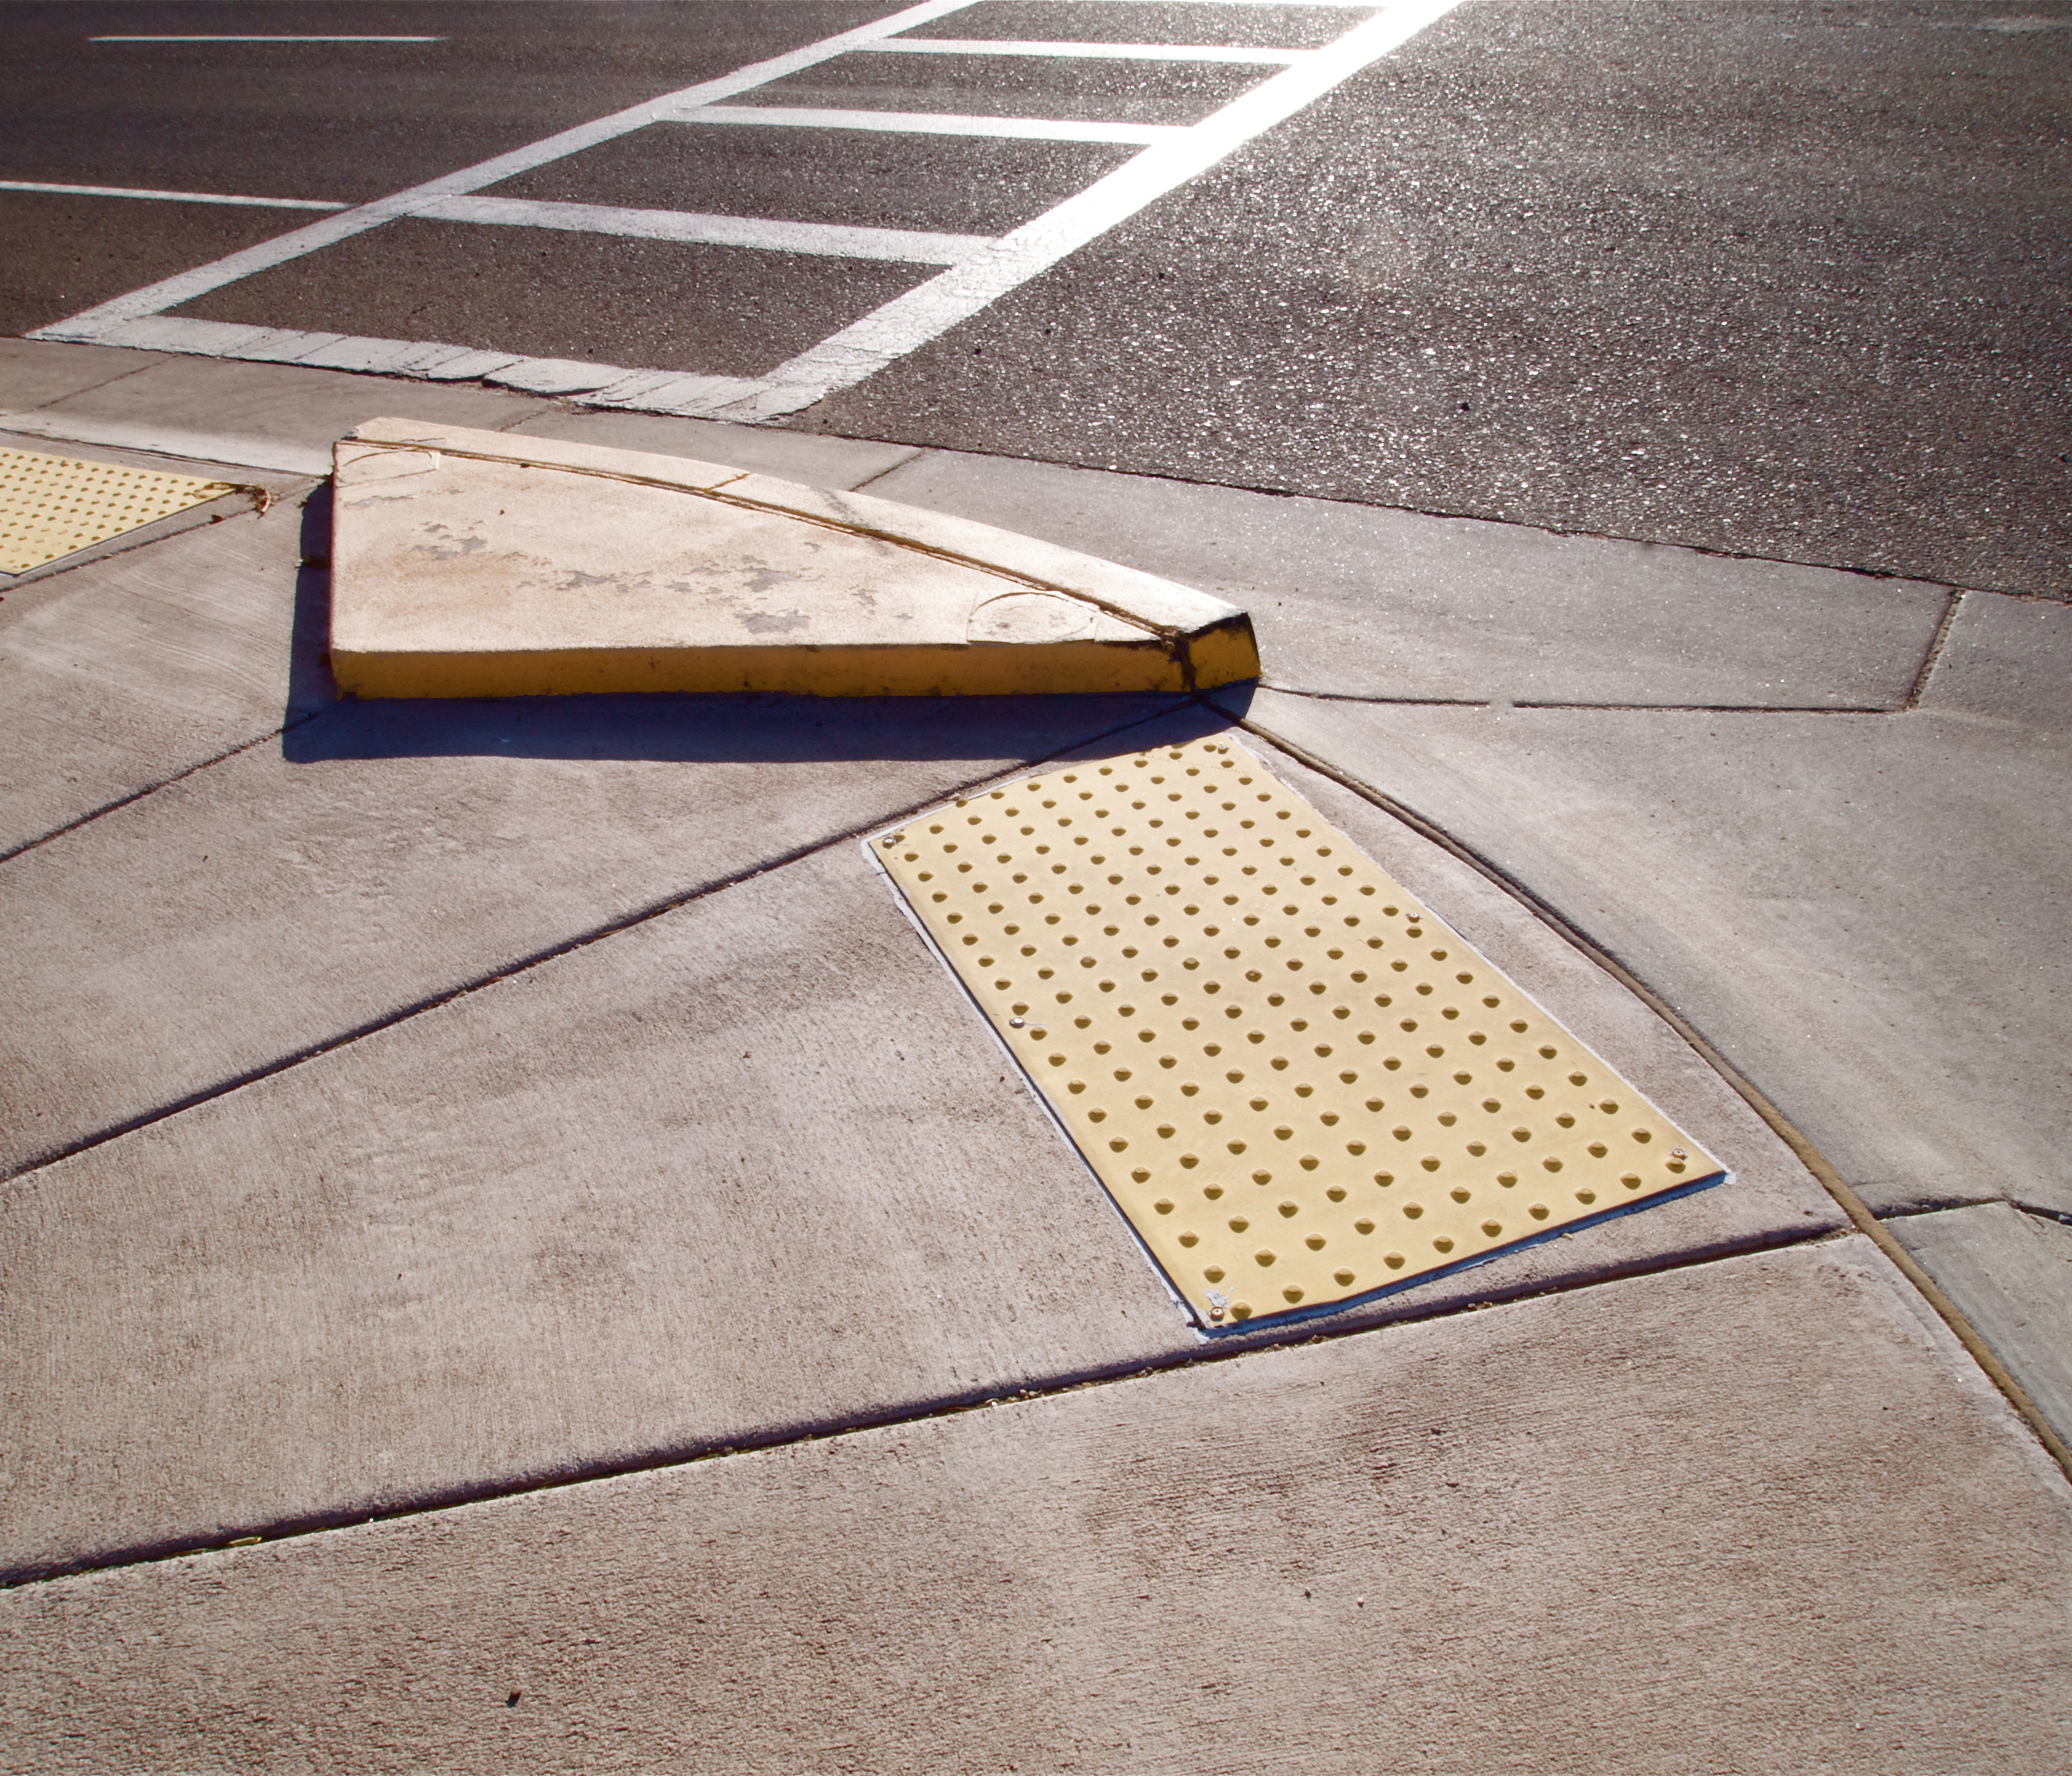
Universal Design
Develop processes and procedures that minimize barriers for all people.
Source: Nick-philly
Notes:
Replaced image. New image from Getty (984116508)
A cut curb: Although cut curbs were initially designed for people using wheelchairs, they have subsequently been used and appreciated by a much wider segment of the population. Similarly, accommodations that reduce barriers for neurodiverse individuals may helpful other, neurotypical individuals. This is a kind of universal design, which is an approach to designing things so they are accessible and useful to everyone.
By Nick-philly - Own work, CC BY-SA 4.0, https://commons.wikimedia.org/w/index.php?curid=84618901

Slide 20
Neurodiversity Across the Employment Life Cycle

Slide 21
Tips to Interact Effectively with a Neurodiverse Coworker
These strategies are effective when dealing with individuals who are neurodiverse but they’re also effective when interacting with any coworker.
Practice clear
and direct communication, avoiding idioms or similar figures of speech.
If the person seems to have difficulty following up, ask if an email or other written communication would help.
Recognize that their way of
doing things may have benefits you don’t know about.
When in doubt, ask them what they need and how you can help.
Notes:
Employers should be aware of and use appropriate terms around neurodiversity.
Person-first language: Identifies differences as only one aspect of the person, for example:
“A person diagnosed with depression” vs. “A depressed person”
Generally (but not universally) preferred for people diagnosed with a behavioral health condition.
Identity-first language: Identifies differences as a central aspect of the person’s identity:
“I’m autistic” vs. “I have been diagnosed with autism-spectrum disorder.”
No general agreement on which to use; will depend on the specific person’s preferences.
See also:
Rimmer A. How can I support a neurodivergent colleague? BMJ 2025; 388 :r559 doi:10.1136/bmj.r559, https://www.bmj.com/content/388/bmj.r559, accessed on September 3, 2025.
Mousseau, J. (ND). Understanding Neurodiversity in the Workplace, Diversity Resources, https://www.diversityresources.com/understanding-neurodiversity-in-the-workplace/, accessed on September 3, 2025.

Slide 22
Tips to Create a Psychologically Safe Environment for Neurodiverse Coworkers
Psychological safety is the belief that it’s safe to take interpersonal risks with your supervisor and teammates, and to be your authentic self to an appropriate degree that you’re comfortable with.
Be patient, treat others with kindness, respect, and dignity.
Acknowledge the strengths of others.
See differences and/or disagreements
as learning opportunities.
Educate yourself and avoid assumptions or common myths.
Notes:
Again, these are also best practices for interacting with any coworker, even if they’re not neurodiverse. We all benefit when we feel safe at work.
Psychological safety is the belief that it’s safe to take interpersonal risks with your supervisor and your team, including:
Admitting mistakes.
Voicing contrary opinions.
Asking questions, especially if you think the question is “dumb.”
Sharing new ideas.
Being as appropriately authentic at work as you’d like to be.
See also:
American Psychological Association (Updated March 4, 2024). What is psychological safety at work? Here’s how to start creating it, https://www.apa.org/topics/healthy-workplaces/psychological-safety, accessed on September 3, 2025.
Spenser-Thomas, S. (2023, March 3). Why and How To Improve Psychological Safety in the Workplace, IRMIm https://www.irmi.com/articles/expert-commentary/why-and-how-to-improve-psychological-safety-in-the-workplace, accessed on September 3, 2025.

Slide 23




The ADA Applies at Every Employment Stage
Neurodiverse individuals may be protected by and have specific rights under the law.
Recruitment
Hiring
Management
Retention
Notes:
Formal Diagnoses Under the Neurodiverse Label May Be Covered Under the ADA
It’s essential to remember that we don’t accommodate medical conditions or disorders, we accommodate limitations and restrictions. Neurodiverse individuals often have limitations around:
Attention and concentration, Difficulty with change, Emotional regulation, Impulse control, Interaction with coworkers, Organization, Performing work effectively, Sensory issues, Social skills, Speaking and communicating, Stress management, Time management.
Adapted from:
Job Accommodation Network (n.d.). A to Z By Disability: Neurodiversity. https://askjan.org/publications/Disability-Downloads.cfm?pubid=11141477&action=download&pubtype=doc, retrieved on May 22, 2025.
Accommodations exist for each of these limitations.

Slide 24
Accurate and Up-to-date Job Descriptions are Essential
A Crucial First Step
Job descriptions frequently include characteristics that exclude neurodiverse individuals even though they are not truly essential job functions.
“Excellent communication skills” are often included in every job description but may not be truly necessary for people whose work doesn’t involve interactions with others, such as those in engineering or statistical fields.
“Strong interpersonal skills” are similarly included in many job descriptions for positions that don’t involve interactions with others.
Train hiring managers to make objective decisions based on qualifications and essential job tasks, rather than their social impressions.
Source: How to Optimize Job Descriptions for Neurodivergent Job Seekers, Society for Human Resource Management; Leopold, M., accessed May 2025.
Notes:
Employers tend to prefer applicants who are extroverted, highly verbal, have excellent social skills and present with positive affect, even when those qualities are irrelevant to the essential duties of a position.
Source:
Leopold, M. (2023, March 23). How to Optimize Job Descriptions for Neurodivergent Job Seekers, Society for Human Resource Management, https://www.shrm.org/topics-tools/news/inclusion-diversity/how-to-optimize-job-descriptions-neurodivergent-job-seekers, accessed on May 22, 2025.

Slide 25

Recruitment Barriers
Disability discrimination in recruitment is prohibited by the ADA/ADAAA but difficult to identify or track. Potential barriers for neurodiverse employees can include:
Traditional recruitment strategies often exclude neurodiverse individuals. Neurodiverse individuals may not network as well as others.
Job listings may deter neurodiverse people from applying. Descriptions that include extensive requirements that might apply to any position may be overwhelming and some neurodiverse individuals may read specific requirements very literally and decide they don’t meet them.
Notes:
Confirmed image is from Getty (1249770285)
Source:
Leopold, M. (2023, March 23). How to Optimize Job Descriptions for Neurodivergent Job Seekers, Society for Human Resource Management, https://www.shrm.org/topics-tools/news/inclusion-diversity/how-to-optimize-job-descriptions-neurodivergent-job-seekers, accessed on May 22, 2025.
Hollinshead, L. & Bernick, M. (2022, August 3). ADA Considerations for Neurodiversity Hiring Programs, Duane Morris, https://www.duanemorris.com/articles/ada_considerations_for_neurodiversity_hiring_programs_0803.html, accessed on May 22, 2025.

Slide 26
Recruitment Opportunities
Opportunities to improve recruitment of neurodiverse employees
There are recruitment platforms specifically for neurodiverse candidates.
Adding a resource for neurodiverse individuals to the recruitment process can increase the diversity of applicants and uncover excellent candidates who might otherwise be missed.
The ADA allows employers to target neurodiverse individuals for recruitment.
Check with an employment attorney before implementing targeted recruitment initiatives or programs..
Notes:
Source:
Leopold, M. (2023, March 23). How to Optimize Job Descriptions for Neurodivergent Job Seekers, Society for Human Resource Management, https://www.shrm.org/topics-tools/news/inclusion-diversity/how-to-optimize-job-descriptions-neurodivergent-job-seekers, accessed on May 22, 2025.
Hollinshead, L. & Bernick, M. (2022, August 3). ADA Considerations for Neurodiversity Hiring Programs, Duane Morris, https://www.duanemorris.com/articles/ada_considerations_for_neurodiversity_hiring_programs_0803.html, accessed on May 22, 2025.

Slide 27

Hiring Barriers
The job interview process often includes elements that effectively limit the ability of neurodiverse individuals to present well.
Live, individual interviews may cause anxiety. Most people have some anxiety around interviews, but this may be debilitating and even verge on panic for some neurodiverse individuals.
Group interviews can be anxiety-provoking for most people but can eliminate neurodiverse applicants from the process.
Notes:
Confirmed image is from Getty (1156506168)

Slide 28
Hiring Opportunities
Opportunities to improve recruitment of neurodiverse employees
Focus on skills, not social norms.
For example, communication skills may not be essential for applicants who will not be communicating with external customers.
Offer a menu of interview options.
Unless the essential job functions prohibit this kind of accommodation, employers may offer:
  Accommodations when the interview is scheduled
  Written interviews
  To provide questions in advance
  A sensory-friendly an/or private area for the interview

Slide 29

Management Opportunities
Specific strategies and techniques may be used when managing neurodiverse individuals.
Create sensory-friendly workspaces: Employees who are distracted by excessive stimuli may do better in quiet areas with natural lighting.
Neurodiversity management: Neurodiverse employees may need specific management approaches to succeed.
Trauma-informed management: This strategy uses a neurological understanding of trauma to guide management.
Recovery-friendly management: Recognizing and supporting employees during challenges in addiction recovery can help them succeed.
Notes:
Confirmed image is from Getty (1500382418)
Sources:
Love, K. & Burrell, L. (2025, March 19). Inclusivity is the Future of Work. Here Are 6 Ways to Support Neurodivergent Team Members. Spring Health, https://www.springhealth.com/blog/6-ways-to-support-neurodiverse-team-members, accessed on May 22, 2025.
Ali, M., Grabarski, M.K. & Baker, M. (2024, July 11). The influence of neurodiversity management on affective commitment and turnover intention: the role of neurodiversity awareness, Employee Relations, ISSN: 0142-5455, https://www.emerald.com/insight/content/doi/10.1108/er-09-2023-0476/full/html, accessed on May 22, 2025.
Manning, K. (2022, March 31). We Need Trauma-Informed Workplaces, Harvard Business Review, https://hbr.org/2022/03/we-need-trauma-informed-workplaces, accessed May 22, 2025.
U.S. Department of Labor (n.d.). Recovery-Ready Workplace. https://www.dol.gov/agencies/eta/RRW-hub/Recovery-ready-workplace, accessed on May 22, 2025.

Slide 30
Additional Management Opportunities
Offer modifications to address specific limitations.
Employees who are overwhelmed in social situations may do better working alone or with a single colleague.
Encourage an explicit culture of inclusion and belonging.
Diversity is a fact of life but is often overlooked, forcing some people to work to hide their differences.
Leverage individual strengths.
Neurodiverse team members can offer a more varied skillset that strengthens the overall team.

Slide 31

Support with the ADA Interactive Process
Neurodiverse individuals may struggle with specific issues during the interactive process.
Break
the process into a series of brief interactions rather than a marathon session of negotiations.
Let
the employee determine the pace of the process and allow breaks as needed.
Encourage
the employee to discuss each issue with their provider, especially around accommodation options.
Follow up
with written summaries with action items for employers and/or employees with specific target dates.
a menu of choices for interactions ─ virtual meetings, phone only or in writing.
Offer
Notes:
Confirmed image is from Getty (1217439321)
Q: When working with employers, do you find that there’s great awareness that they many need to provide accommodations during the interactive process?
No. Most ERs who get an accommodation request do not think about the interactive process as being something that may need to be accommodated as well. But this is something that we all do everyday. The interactive process is a conversation, and we all have our preferred way to communicate. Some prefer written communication, email, letter, while others require verbal communication. Some need to speak with people face to face while others can't do this. These preferences, once honored, are all accommodations that we are making for each other when we communicate. And it is easy not to think of these are accommodations because they are not necessarily done or documented as a formal process.
With neurodiverse EE these types of accommodations are needed in an informal or formal ADA interactive process.

Slide 32

Retention Opportunities
Neurodiverse employees may be more loyal to their employers than other workers but companies must still do the work to retain them.
Create career paths that don’t requirement management. Many solid performers don’t want to manage others but they still want a path for advancement.
Reward performance even without promotions. Employees who demonstrate excellent performance must be rewarded, even if they remain in the same role.
Challenge myths and assumptions. Consider each employee’s skills in relations to the actual essential job functions, rather than focusing on limitations that may not be relevant.
Notes:
Confirmed image is from Getty (1207517462)
Sources:
De Castro, C. (2024, October 2). Neurodiversity in the Workplace: Embracing Powerful Perspectives, Purple Goat, https://www.purplegoatagency.com/insights/neurodiversity-in-the-workplace/, accessed on May 22, 2025.
Mentra (n.d.). The Benefits of Neurodiversity in the Workplace, https://www.mentra.com/guide-to-the-untapped-strengths-of-neurodivergence, accessed on May 22, 2025.

Slide 33

Reasonable Accommodations
Reasonable accommodations exist for every common limitation and restriction associated with neurodiversity however, they must be appropriate to the specific situation. Unfortunately, not every neurodiverse individual can be successfully accommodated.
Reminders:
Ask each worker about their needs.
Understand how limitations and restrictions affect job tasks.
  The accommodation of behavioral health diagnoses is much more individualized and involves more trial/error than musculoskeletal diagnoses.
Re-assess after implementing an accommodation.
Notes:
Confirmed image is from Getty (1300554862)
Training and Education:
Disability etiquette training for team
Anti-stigma campaigns
Education about mental health
Assertiveness training
Most employees prefer quiet workplaces, which points to the idea of Universal Design.
Employers can provide environments and develop processes & procedures to minimize barriers for all people, including those who are neurodiverse.
Accommodations that reduce barriers for neurodiverse individuals may helpful other, neurotypical individuals.
The Job Accommodation Network at https://askjan.org/disabilities/Neurodiversity.cfm is an exceptional resource for ideas around accommodations.

Slide 34
Examples of Reasonable Accommodations
Emotional regulation
Difficulty with change
Modified break schedule to allow time to use techniques suggested by treatment providers
Job restructuring to minimize situations that lead to emotional reactions
Support person to help prevent meltdowns
Extended transition period to allow time to adjust to change
Workflow and task separation documentation, giving step-by-step instructions for revised processes
Job coaching to identify strategies for adjusting
34
Notes:
Workplace expectations:
Remote work: allowing WFH whenever possible helps for those who have social anxiety of limitations with interpersonal interactions and/or communication. Being in crowded places is a common l/r we see
Advance notice of change: Being able to let an employee know of upcoming change as soon as possible is also helpful for those who are not quick to acclimate to change well. This is another universal design that, if possible, is recommended.

Slide 35
More Accommodations Examples
Difficulty with attention and concentration
Social skills
Active seating allows the person to change positions, can enhance focus, increase comfort, decrease restlessness/hyperactivity and boost productivity
Noise cancelling headsets are effective tools to assist in focus/concentration by blocking out external noise
Fidget devices help with focus, comfort and sensory regulation
Therapeutic glasses may help to reduce visual distractions
Social skills training such as communication training may help make interactions easier
Disability awareness and etiquette training help coworkers understand how to treat others with dignity and respect
Management approaches, including written directions, should be tailored to each employee’s abilities
35
Notes:
Attention:
Fidgets
Active seating
Therapeutic glasses
Recording devices
Chunk tasks into designated blocks of times
“Do Not Disturb” times
Relocate employee
Allowing the employee to designate specific chunks of time that can be blocked off on their calendars so they can focus on projects and/or tasks is very helpful.
Being able to have a way to notify others that they are not to be disturbed during specified times of the day to help reduce distractions and interruptions. This is especially helpful with EE who have difficulty transitioning from task to task quickly.
Sensory overload:
White noise machines
Sound reduction
Cooling or heated clothing or tools
Cubicle doors and shades
Air purifier
Natural lighting is something that we can all benefit from. Sometimes being able to be by a window and get some sun can help with mood and sensory overload by providing a stable light environment
Camera fatigue: allowing people to not be on camera every time they attend an online meeting can be extremely helpful with burnout. It takes a lot of energy for some people to be on camera. They focus so much on how they appear and having to stay still that they can’t focus on what is being discussed and find that they get tired quickly.
Fragrance free zone: Smells can be very distracting, cause physical responses such as nausea and migraines.
Fragrance-free zones
Modified uniform or dress code
Use of avatar vs. being on camara
Sleep disturbance:
Flexible start time
Modified breaks
Doze alert, nod-stopper, and anti-sleep alarms
The Job Accommodation Network at https://askjan.org/disabilities/Neurodiversity.cfm is an exceptional resource for ideas around accommodations.

Slide 36
Even More Accommodations Examples
Task Management and Organization
Project management tools: software or even simple check lists can provide structure and reminders to help employees stay on track
Visual timer: helps users perceive time better by showing how much has passed, aiding in accurate task time projections and keeping them on track
Chunking work tasks: helps employees break tasks down into designated blocks of time and identifying “do not disturb” times can improve productivity
Smart pen: digitizes handwritten notes and records audio
Notes:
Task Management and Prioritization:
Label items, color coding, checklists
Organizing technology
Visual timers or alarms
Smart pen/notebook
Weekly 1:1 meetings to review progress on tasks
Provide priority levels with assignments
Having weekly 1:1 we find help those who need assistance with task prioritization and completion. This is also another example of something that can fall under universal design as it is helpful for all employees to be able to meet with their direct supervisors to discuss how work is going, identify areas of opportunity for growth and focus
Providing due dates for responses and project goal marks help to keep those with neurodiverse conditions on task and focused
Workplace expectations and management:
Flexible work schedules
Remote work
Advance notice for all changes
Change management strategies
Neurodiverse management strategies
Trauma-informed management
Recovery-friendly workplaces

Slide 37
Case Studies and Success Statistics
Case studies are for illustrative purposes only. Actual savings may vary depending on a variety of factors. Interventions discussed are specific to the cases presented and should not be taken as blanket recommendations. Please speak to your HR department and/or employment attorney before implementing reasonable accommodations.
Notes:
Two types of case studies are presented here:
Return-to-Work (RTW) cases in which the employee was already out on a leave, and the RTW Specialist assisted them to return to their jobs as soon as medically feasible.
Note that the insurance company does not set the RTW date; that is always set by the treating provider. However, treating providers frequently allow employees to return to their jobs sooner when they are working with a RTW Specialist.
The RTW specialist will generally complete an evaluation and offer suggestions for changing work processes, recommendations for ergonomic equipment, support, and other services to help the employee be able to complete their essential job functions despite limitations and restrictions identified by their treating provider.
Stay-at-Work services (SAW) cases in which the employee is still on the job and the SAW Specialist provides the same type of services as for RTW cases, now intended to assist the employee to avoid a leave.
Both RTW and SAW services may be funded through Reasonable Accommodation Expense (RAE) benefits through disability insurance.

Slide 38

Stay-at-Work Case Study 1: Professional
Diagnoses: Major depression, panic disorder, PTSD
Barriers: Losing focus/concentration due to noise, bright lights, being fidgety and privacy concerns.
Accommodations: Flexible seating chair, privacy screen, noise-cancelling headset, fan, cube shield and therapeutic glasses.
Cost: $1,415
Estimated Savings: $7,792
Estimated Disability Days Saved: 75
Identifying information has been changed to protect the privacy of the employee.
Notes:
Replaced image. New image from Getty (1020593510)
Estimated Stay-at-Work claim cost savings and disability days avoided are based on the assumption that 75% of successful Stay-at-Work claims would have resulted in a claim without intervention and use the IBI benchmarks for average closed STD claim costs and durations for the sector, the year the claim was closed, and the primary diagnosis. IBI data are available only for calendar years 2014 through 2023, so the average durations (unadjusted) and the average costs, adjusted to reflect wage inflation, are used for claims outside of those dates.
Return-to-Work claim cost and disability days savings are based on the difference between the Anticipated RTW Date from the treating provider and the actual RTW date. Note that the Return-to-Work date is always determined by the treating provider in collaboration with the employee (patient); neither The Standard nor Workplace Possibilities ever sets the Return-to-Work date, although the provider and the patient often move it up based on adaptive equipment or accommodations provided by The Standard.

Slide 39

SAW Case Study 2: Program Coordinator
Diagnoses: ADHD
Barriers: Memory and processing of verbal information in meetings.
Accommodations: Visual timer, rolling footrest, digital voice recorder and training on Microsoft 365 office tools.
Cost: $2,008
Estimated Savings: $7,485
Estimated Disability Days Saved: 75
Identifying information has been changed to protect the privacy of the employee.
Notes:
Confirmed image is from Getty (1006511862)

Slide 40
Stay-at-Work Success Statistics
94%
99.6% participation rate
$2,279 = the average cost per SAW referral
$4,056 = the average estimated gross claim cost savings per referral
$14,012 = the average estimated total (claim and non-claim) cost savings per referral
57 days = the estimated disability days saved per referral for SAW services
success rate
Source: Combined insured and self-insured results between January 1, 2008, and December 31, 2025, based on internal data developed by Standard Insurance Company. These data include employees with both primary and secondary diagnoses indicating neurodiversity, with 52% having a co-occurring medical condition.
Notes:
Note that employees who declined to participate in or dropped out of the Stay-at-Work program may have remained at work but were not counted as successful for outcome reporting.
Estimated Stay-at-Work claim cost savings and disability days avoided are based on the assumption that 75% of successful Stay-at-Work claims would have resulted in a claim without intervention and use the IBI benchmarks for average closed STD claim costs and durations for the sector, the year the claim was closed, and the primary diagnosis. IBI data are available only for calendar years 2014 through 2023, so the average durations (unadjusted) and the average costs, adjusted to reflect wage inflation, are used for claims outside of those dates.

Slide 41

Return to Work Case Study 1: Healthcare Instructor
Diagnoses: Autism-spectrum disorder, anxiety, and depression
Barriers: Ceased work after telling provider he was suicidal and experiencing problems in primary relationship
Accommodations: Gradual RTW plan with one week part-time before increasing to full-time
Cost: $623
Estimated Savings: $6,238
Estimated Disability Days Saved: 29
Identifying information has been changed to protect the privacy of the employee.
Notes:
Confirmed image is from Getty (2176121621)
Return-to-Work claim cost and disability days savings are based on the difference between the Anticipated RTW Date from the treating provider and the actual RTW date. Note that the Return-to-Work date is always determined by the treating provider in collaboration with the employee (patient); neither The Standard nor Workplace Possibilities ever sets the Return-to-Work date, although the provider and the patient often move it up based on adaptive equipment or accommodations provided by The Standard.

Slide 42

RTW Case Study 2: Academic Counselor
Diagnoses: Alcohol use disorder and bulimia
Barriers: Extended inpatient hospitalization
Accommodations: Coordination between employee, employer and provider to facilitate return to job
Cost: $619
Estimated Savings: $3,447
Estimated Disability Days Saved: 30
Identifying information has been changed to protect the privacy of the employee.
Notes:
Confirmed image is from Getty (1350747999)

Slide 43
Return-to-Work Success Statistics
72%
77% participation rate
$458 = the average cost per RTW referral
$3,107 = the average estimated gross claim cost savings per referral
$10,952 = the average estimated total (claim and non-claim) cost savings per referral
17 days = the estimated disability days saved per referral for RTW services
success rate
Source: Combined insured and self-insured results between January 1, 2008, and December 31, 2025, based on internal data developed by Standard Insurance Company. These data include employees with both primary and secondary diagnoses indicating neurodiversity, with 12% having a co-occurring medical condition.

Slide 44
What Do Neurodiverse Individuals Need?

Slide 45

The Same Things We All Need
Neurodiverse individuals, like people with other disabilities, want to be able to live a full and productive life.
A work environment where:
  They are treated with dignity and respect.
  They have the opportunity to contribute and succeed.
  Differences are accepted, even celebrated.
  Their skills are recognized and appreciated.
  Artificial barriers are removed, so they can do the essential functions of their jobs.
Notes:
Confirmed image is from Getty (648617500)
See also:
Fung, L., Weddle, B., Hancock, B. & Rahilly, L. (2024, September 16). Understanding what neurodivergent employees need to succeed, McKinsey & Company. https://www.mckinsey.com/capabilities/people-and-organizational-performance/our-insights/understanding-what-neurodivergent-employees-need-to-succeed, accessed on May 22, 2025.

Slide 46
Closing Quote
In the quest for an inclusive and dynamic work environment, acknowledging neurodiversity is crucial. It’s not just about ticking boxes. It’s about recognizing and leveraging the unique strengths that each individual brings to the table through awareness and support.
Kali Love
Inclusivity is the Future of Work
Notes:
Sources:
Love, K. & Burrell, L. (2025, March 19). Inclusivity is the Future of Work. Here Are 6 Ways to Support Neurodivergent Team Members. Spring Health, https://www.springhealth.com/blog/6-ways-to-support-neurodiverse-team-members, accessed on May 22, 2025.

Slide 47
Daniel Jolivet, PhD
Workplace Possibilities Practice Consultant
Daniel.Jolivet@standard.com
Thank You

Slide 48
Resources
The Job Accommodation Network: Neurodiversity
Council of State Governments: Disability Awareness, Etiquette, and Training
The Employer Assistance and Resource Network on Disability (EARN): Neurodiversity in the Workplace
Substance Abuse and Mental Health Services Administration (SAMHSA): Trauma-Informed Approaches and Programs
U.S. Department of Labor: Recovery-Ready Workplace Resource Hub

Slide 49
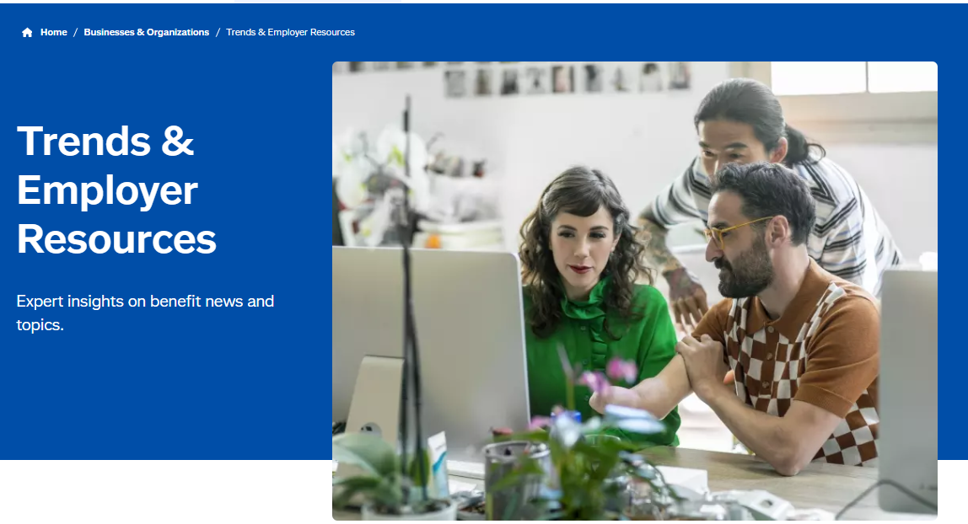
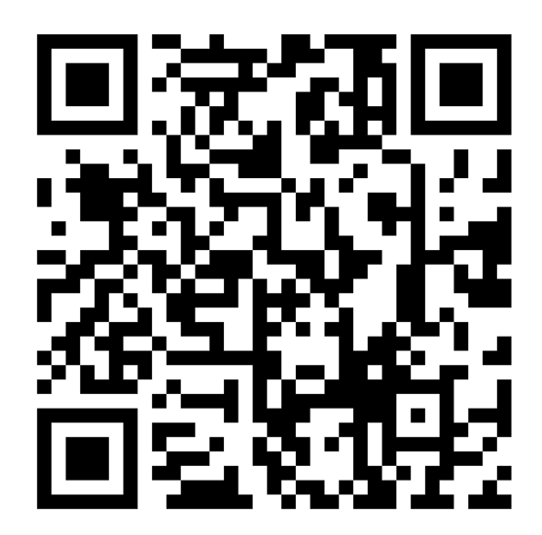
Resources (cont.)

