Slide 1
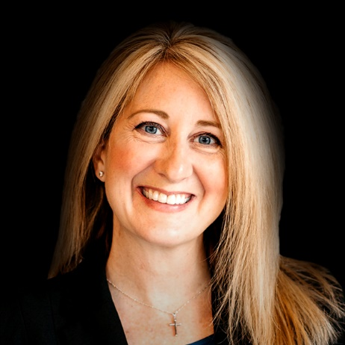
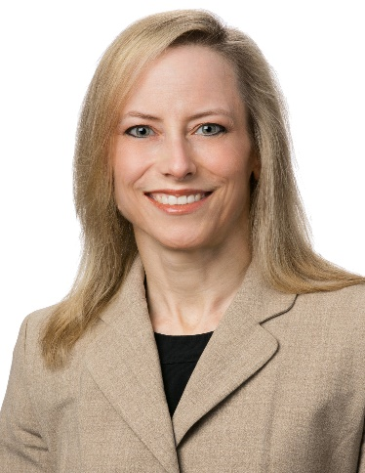
FERMA Large Claim/Pharmacy Trends
Jennifer Dimura
VP, Director of Pharmacy
Lockton Companies
Christine Hale, MD
SVP, Chief Medical Officer
Lockton Companies

Slide 2
01
High-Cost Claim Trends

Slide 3
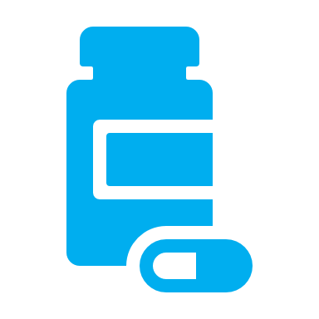
What’s Really Driving Employer Health Plan Costs?
0.6%
High-cost claims are different
Specialty Medicines, especially injectables, are the fastest-growing driver of high-cost claimants
35%
of a population drives
High-cost claimants are made up of cancers, kidney failure, sepsis, complex newborns and hemophilia
of employers’ spend
High-Cost Claimant Predictive Analytics can sometimes identify these individuals and target early interventions
Health care inflation is driven by price increases, not utilization, think new medical and Rx technologies.
Chronic conditions are the direct cause of less than a quarter of medical and pharmacy claims over $50,000 (high-cost claims)
Notes:
2022

Slide 4
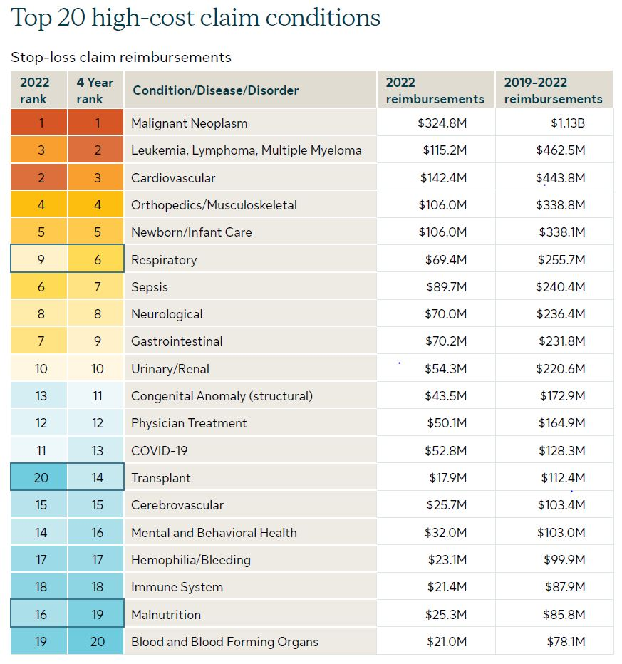
Stop Loss Market Overview 2023
In the past four years, million-dollar claims have increased by 45%
These top 10 conditions have contributed to 71% of total reimbursements
87% of employers had a stop loss claim from 2018-2021
Sources: Sun Life 2023 High-cost claims and injectable drug trends analysis

Slide 5
Trend: Cancer
Cancer is the #1 and #2 (solid organ, blood) driver of high-cost claims, nearly 4x higher than the next category. The number of cancer claimants increased 39% from 2018 to 2021.
Due to delayed/missed screenings, we may see a 10-14% increase in new cancer diagnoses this year, including more late-stage cancers. ₄
Example levers
Prevention– Emphasis on healthy lifestyle (e.g., diet, exercise, smoking cessation) and risk factor (e.g., weight management)
Early Detection – Screening options (e.g., Cologuard, MCED tests) and accessibility (e.g., health fair, onsite clinic, mobile mammograms)
Navigation – Emphasis on understanding goals of care and options (including palliative care), steerage to cost-effective providers
Second Opinion – Routine vs. complex cancers, virtual vs. in person, direct to patient versus provider, triggers
Site of Care – Options for cancer treatments, e.g., office or private infusion center
4 – Sunlife: High-Cost Claims and injectable drug trends analysis 2022

Slide 6
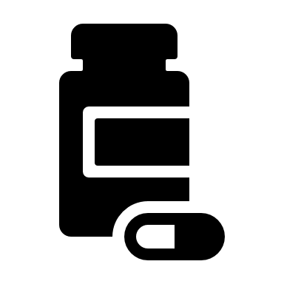
Trend: Specialty Pharmacy
Less than 2% of the population uses specialty drugs, yet specialty pharmacy represents 51% of total pharmacy spending.
Growth projected at 8% per year through 2025, largely driven by new-to-market drugs, including biosimilars, gene/cell therapies, and cancer drugs. ₁
Example levers
Site of Care – Administering medications (particularly infusions) in the most cost effective and convenient setting safely possible
Acquisition – Procurement through pharmacy plan (vs medical), use of 340b, drug formulation
Drug Appropriateness – Confirmation of medical diagnosis, evidence-based treatment, access to clinical trials, authorization via third party, targeted pharmacogenomics, biosimilars
Elimination of waste – Shorter initial authorization, eliminating stockpiling, adherence management
1 - EVERNORTH 2022

Slide 7
Trend: Neonates
Costs for neonatal intensive care have increased dramatically and are highly unpredictable. Cases in the multi-millions are now routine. Costs also vary widely and are often not tied to differences in quality. An estimated nearly 20% of stop loss claims are birth related. ₇
Approximately 1 in 10 live births are preterm and may have ongoing sequelae. ₂
Example levers
Prevention – Prenatal care, managed fertility
Medical Policies – Clearly articulated and consistently implemented policies for specialized treatments (e.g., nitric oxide, ECMO)
Specialized Utilization Management – Frequent review of level of care and medical management
Specialized Case Management – Discharge planning, family education, nurse hotline for avoided ER visits and readmissions
Payment Innovation – Case rates, network design, and other novel approaches
2 – CDC, 7 – Progeny Health 2020

Slide 8
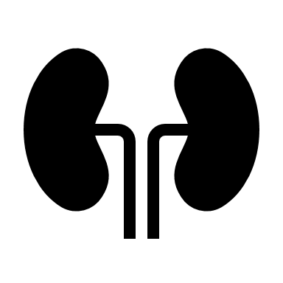
Trend: Chronic Kidney Disease and ESRD
Chronic kidney disease is present in 12% of individuals aged 45-64 and 6% of individuals aged 18-44. ₂ The cost of dialysis (per session) for private payors is estimated to be 6 times higher than that for Medicare. ₃ Lawmakers recently ruled that private plans can cap exposure at Medicare rates for eligible members.
Example levers
Prevention – Emphasis on aggressive management of risk factors (e.g., diabetes, hypertension), advances in medical management of CKD/ESRD, early involvement of nephrology and centers of excellence, mitigation of complications
Medicare Enrollment – Member education on Medicare eligibility, plan cap for eligible members
Site of Care – Network status, peritoneal dialysis and home hemodialysis
Transplantation – Consideration of pre-emptive transplant, coverage of associated costs (travel, etc)
2 – CDC, 3 – JAMA NETWORK: ASSESSMENT OF SPENDING FOR PATIENTS INITIATING DIALYSIS CARE 2022

Slide 9
Trend: COVID and Sepsis
Sepsis is the #1 killer of hospital inpatients and a top ten driver of high-cost claims. _{4,5} Sepsis claims rose dramatically during the COVID era, due to co-Infection, hospital acquired infections, and delays in accessing care. Each hour sepsis treatment is delayed decreases survival by 7.6%. ₆
Long COVID is also an area of great interest and current investigation.
Example levers
Access – Ability to get timely evaluation of and treatment for predisposing conditions (e.g., other infections, immune suppression)
Prevention – Vaccines, masking, hand washing, isolating, and other public health measures
Early Recognition and Intervention – Awareness campaigns, anti-microbials, other supportive care
Care Escalation – Transfer options for individuals needing a higher level of care
Decision Support – Understanding of patient and family goals, use of palliative care
4 – Sunlife: High-Cost Claims and injectable drug trends analysis 2022, 5 – Sepsis alliance 2022, 6 – Plos one: The golden hour of sepsis 2018

Slide 10
Case examples
Est. Savings = $820K
Est. Savings = $300K
Est. Savings = $910K
Est. Savings = $240K
Est. Savings = $1M+
Est. Savings = $5M+
Right Diagnosis
Right Treatment
Care Setting
Billing and Coding Accuracy
Claim Processing
Fraud, Waste and Abuse
Patient admitted monthly for blood transfusions and off-label drug use. Referred to Mayo for diagnosis and treatment
Patient receiving high-risk, high-cost narcotic without diagnosis of cancer switched to appropriate medication
Patient treated with high-cost Soliris, site of care moved to home infusion
High paid charges for Electrocardiogram; billing error, so engaged medical administrator
Seven patients with incorrectly approved private duty nursing due to auto-adjudication system error
Unusual pattern of OON IONM claims identified fraud – up to $5M+ in restitution in one carrier’s book

Slide 11
02
Pharmacy Trends

Slide 12
Pharmacy landscape
Government
Specialty
Market dynamics
Legislation on rebates, cost, reimbursement and transparency
Supreme Court ruling in favor of Arkansas could lead to increase in plan-sponsor cost
Executive orders
CAA reporting requirements
2% of members drive over 50% of cost
Gene therapy products cost in the millions per patient
Rare disease drugs >$100,000 per year
Pharma coupon funding
More specialty generics and biosimilars
Contracting strategies may not provide the right management
“Big 3” have 75% of market
Group purchasing organizations (GPO) arrangements
Amazon entering pharmacy space
Niche vendors
PBM/carrier impact carve-out options
Specialty carve-out becoming more prevalent
Pharma consolidation and impact to pipeline
Notes:
Government
State legislation – historically ERISA plans exempt but Supreme Court ruling on case in AR opens up more PBM regulations than can have a downstream impact on employers. We are seeing the impact of this in multiple states that limit plans ability to do exclusive specialty or traditional pricing.
Inflation Relief Act – limits on price increases and government negotiations for Medicare; unknown how this will impact commercial clients. May shift more cost to them.
Specialty
Gene therapy – while promise of cure can be several million dollars.
Rare (also called Orphan ) – is a disease that impact less than 200k Americans. Pharma coupons – most specialty drugs have a non-financial based assistance program to cover member costs. Most PBMs now have programs that allow payors to gain the benefit of the pharma dollars while keeping the member from paying for the medication.
Biosimilars – while several have been FDA approved adoption has been low. Humira expected in 2023
Contracting strategies –the carriers and PBMs want exclusive specialty under their control. The carrot has always been better price discounts. However, you may not be getting the management you need by using the PBM specialty pharmacy.
Market Consolidation
While not a new topic we continue to see the impact of market consolidation within PBM/carriers as well as Pharma. The big 3 PBMs are all now aligned with a carrier and represent over 75% of the PBM market..
Pharma consolidation – generic competition, increased cost to develop, and pipeline have caused more consolidation in the market.

Slide 13
Drug spend
Average plan cost per claim
Specialty: $3,647
Brand: $295
Generic: $12
Source: Lockton RxMart Q1-Q2 2022 data
Generic fill rate (GFR) excludes vaccines
Notes:
Let’s start by looking at the average drug spend. This is drug spend in the pharmacy benefit based on Lockton BOB data for first 6 months of 20212 1.9% of specialty pharmacy claims driving 54% of the spend.
What are some of the reasons behind that? Increased cost and utilization of specialty drugs are one of the biggest reasons for increased cost.

Slide 14
Pharmacy cost containment
PROGRESSION
Level III
Narrow retail network
True member out-of-pocket accumulation for specialty drugs
High-cost/low-value drug exclusions
Narrow formulary
Level I
Formulary with exclusions
DAW penalties
Quantity limits
4-tier copays (generic, preferred brand, non-preferred brand, specialty)
Optional 90-day retail or mail
Level IV
Specialty copay coupon optimization
Specialty UM carve-out
Specialty dispensing carve-out
Level II
Step therapy
Prior authorization
Tiered specialty copays (generic/biosimilar and brand specialty)
Tiered retail network
Mandatory 90-day retail or mail
General market
Plan sponsor
M
Mainstream
P
Progressive
Notes:
Examples of progression plans can take to tackle their pharmacy spend

Slide 15
Pharmacy specialty solutions
Standard
Progressive
Limited
Updated deductible and OOP amounts to reflect actual member payments when they use a manufacturer coupon
Works well with HDHP plans but limited value in PPO plans
Savings 5%-20% of specialty spend
Carve-out administration, adjudication and rebates to third-party specialty vendor
25%-30% savings
Can also administer medical pharmacy claims
Requires specific PBM approval
TRUE OUT-OF-POCKET
CARVE-OUT SPECIALTY PBM
PATIENT ASSISTANCE PROGRAM¹
Uses money from grants, foundations and other charitable organizations to cover the medications
Shared savings of 25%-40%
Will require third-tier PBM
Up to 70% savings on specialty
CARVE-OUT UTILIZATION MANAGEMENT
DRUG COUPON MAXIMIZATION PROGRAM
Use third-party UM criteria for more robust management
Few of the major PBMs will support
Increases the members’ copays to maximize pharma assistance cards, but member still pays $0
Best with PPO plans; caution in HDHP plans
Shared savings arrangements with most PBMs
Savings 15%-20% of specialty spend
¹Some programs use drug reimportation, which will require plan sponsor to thoroughly vet with their legal counsel before implementing.
Notes:
True OOP TOOP –
A True Out Of Pocket copay accumulator – or accumulator adjustment program – is a strategy used by PBMs and Pharmacy Benefit Managers (PBMs) that stop manufacturer copay assistance coupons from counting towards two costs: 1) the deductible and 2) the maximum out-of-pocket spending.
Drug Coupon Maximation -
Under a copay maximizer, the full value of the manufacturer's copayment program is applied evenly throughout the benefit year. A maximizer reduces or eliminates the patient's out-of-pocket obligations, and leverages the coupon to lower both the member and plan sponsors cost.
Carve Out Specialty PBM
When specialty drugs are carved-out from the traditional pharmacy benefit, there is a covered benefit administered by a third-party vendor. Processes are run separately from the primary PBM Pharmacy benefit management
Carve Out Utilization Management – Leveraging a Third ‘unbiased’ party to review the clinical prerequisite criteria, in the prior authorization UM program.
Patience Assistance Program –
This program requires to remove specialty from their covered specialty benefit. They then look for alternative funding from foundations or international sourcing. Savings is up to 70% savings.

Slide 16
What’s “Trending” in Pharmacy
COST AND UTILIZATION
TRENDS
Diabetes – new branded products replacing older cheaper drugs as standard of care
Migraine – new branded products replacing older cheaper drugs, increased chronic utilization
Weight Management – continued increase in utilization of Wegovy/Saxenda for weight loss
Inflammatory – increased utilization and price inflation. Highest direct-to-consumer advertising spend category
Hemophilia – two new gene therapies, expected $2.5M-$3.5M cost. Ultra low member use (~30K in US)
PURCHASE OPTIMIZATION
Multiple innovative, transparent/pass-through PBMs continue to grow market share
Mark Cuban Cost Plus Pharmacy and Amazon Pharmacy entering networks with PBMs/Carriers
Specialty Carve Out - multiple types
leverage Specialty PBM to manage Specialty drugs
Patient Assistant Programs – variety of vendors in the market and requires removing specialty drugs from coverage so members can obtain funding through Pharma programs (member income limit considerations)
DISRUPTORS
Biosimilars
launch of Humira biosimilars throughout 2023 – PBMs deploying various strategies
Potential Stelara biosimilar in 2023 (pending litigation)
Gene Therapies – healthy pipeline of gene therapy agents to treat/cure ultra-rare conditions (Hemophilia, Sickle Cell Anemia, Duchenne Muscular Dystrophy, etc.)
Notes:
Carve Out Specialty PBM
A few clients have implemented some more progressive management options. When specialty drugs are carved-out from the traditional pharmacy benefit, there is a covered benefit administered by a third-party vendor. Processes are run separately from the primary PBM Pharmacy benefit management. Examples are Vivio and Archimedes
Carve Out Utilization Management – Leveraging a Third ‘unbiased’ party to review the clinical prerequisite criteria, in the prior authorization UM program. Eliminate the fox guarding the hen house concerns with the PBM doing the PA. Example would be RxResults
Patience Assistance Program – very limited adoption amongst Lockton clients but many PE firms are now pushing this solution.
This program requires to remove specialty from their covered specialty benefit. They then look for alternative funding from foundations or international sourcing. Savings is up to 70% savings before the fees. Many vendors take 25-50% of savings as the fee. Caution with some vendors promote internal sourcing which plan sponsors should review with their legal team.

Slide 17
Newer Hormone-based Medications
CANDIDATE PROFILE & SAFETY CONCERNS
Approved in adult patients with an initial body mass index (BMI) of 27 kg/m2 or greater who have at least one weight-related comorbid condition (hypertension, Type 2 diabetes, or high cholesterol), or in patients with a BMI of 30 kg/m2 or greater.
WEGOVY
SAXENDA
Safety concerns include a strong warning against use in patients who have previously been diagnosed with thyroid C-cell tumors, a family history of medullary thyroid carcinoma, or in patients with multiple endocrine neoplasia syndrome type 2.
Also known as “Semaglutide”
Approved in 2021
Once-weekly subcutaneous injection
Originally designed to treat diabetes, now repurposed (at higher doses) for chronic weight management
Also known as “Liraglutide”
Approved in 2014
Once-daily subcutaneous injection

Slide 18
Today’s obesity risks
LIVER DISEASE
CANCER
AUTOIMMUNE &
INFLAMMATORY
INFECTIOUS
DISEASE
MENTAL HEALTH
Obesity is associated with Non-Alcoholic Fatty Liver Disease (NAFLD), the most common form of liver disease in the U.S., and can result in liver failure, need for liver transplant, disability, and premature death.
Obesity and physical inactivity are now considered the primary population health risk factors driving cancer incidence in the U.S. Being overweight or having obesity increases cancer risk for 13 types.
Excess weight is linked to both the onset and progression of certain autoimmune conditions. Specialty drugs for inflammatory conditions are the #1 Rx cost driver for employers.
Increased risk and worse outcomes for respiratory, including COVID-19, skin and urinary tract infections.
Excess weight is associated with mental health problems and decreased quality of life.
NEWER RISKS ILLUMINATED BY MODERN RESEARCH
HISTORICAL RISKS
Individuals with obesity are about six times more likely to develop Type 2 diabetes than those at a healthy weight.​
Obesity can spike bad cholesterol levels and cause blood pressure to increase beyond a healthy level. These factors contribute to heart disease and incidence of a heart attack.
DIABETES
CARDIOVASCULAR

Slide 19
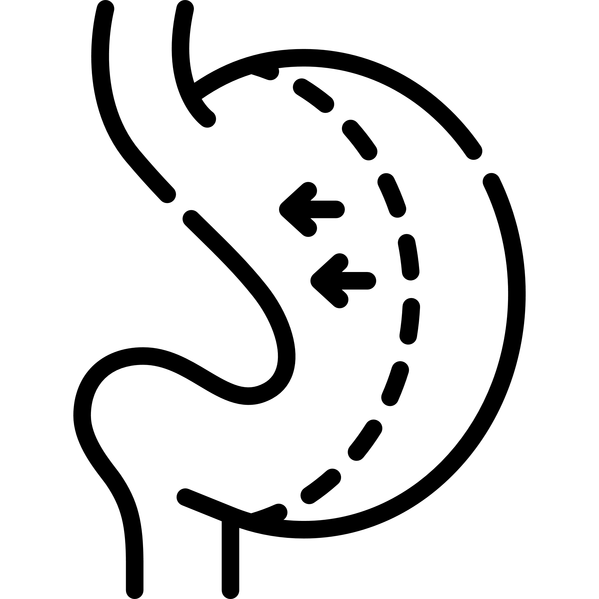
Recommendation – comprehensive weight management strategy
Behavior-based Interventions
Weight Management Drugs
Bariatric Surgery
Workplace Culture & Design

Slide 20
Available to Prime members only
Not part of the benefit
Subscription fee of $5 per month that covers all medications- not eligible for COB, HSA or FSA
Not available in all states. California, Louisiana, Maryland, Minnesota, New Hampshire, Pennsylvania, Texas, and Washington are excluded
Client impact – another cash option
Not available to Medicaid or Medicare members
Medication List:
Some are antibiotics – not commonly dispensed at mail order
Some are ACA preventative list medications that are $0 on most employer plans
Currently (Jan 2023) over 50 medications on the RxPass list

Slide 21
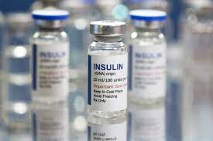
Insulin Market
Manufacturers announced a 70-78% reduction in list price for late 2023 & 2024 for many products
Rebates expected to be eliminated
High-cost options expected to remain on the market for rebate focused formularies (e.g. Tresiba)
Lilly and Sanofi capping patient price at $35 per month
Favorable to patients
Humalog, Novolog, Levemir, and Lantus are primary brands used today
Insulin represents 5% of brand claims and 1% of overall claims
0 -1% net plan sponsor savings with reduction in AWP and loss of rebates
Lower ingredient cost and lower rebates to plan sponsor

Slide 22
Biosimilar Update: Humira
Humira (adalimumab)
First biosimilar (“Amjevita,” Amgen) launched end of January, 2023 having two different pricing structures:
High list price + rebates
Low list price + (low or no) rebates
Up to 11 more products/formulations expected to launch on or around July 1, 2023
“AVT02,” a high-concentration version seeking interchangeability status, received notice of deficiencies in its manufacturing process from the FDA, putting its launch in jeopardy. It had been a “front-runner” to gain a substantial foothold on PBM formularies owing to its unique combination of features most resembling Humira’s most popular version (high concentration + interchangeable)
We expect formulary decision announcements from PBMs/carriers will occur right up until the July 1 date.
Based on the experience with Amjevita, each PBM will handle contract and rebate ramifications differently.
It is not at all clear whether any other biosimilar adalimumab manufacturers will mimic Amgen’s dual-pricing-method approach
Be alert that Humira’s manufacturer field sales reps may attempt to convince prescribers to transition long-stable Humira patients to “successor products” Rinvoq or Skyrizi

Slide 23
Biosimilar Update: Stelara
Eight pending versions (no high concentration vs. low concentration issue as with Humira)*
1 product expecting FDA approval in November 2023
1 product expecting FDA approval in “2H2023”
6 remaining products in Phase 3 clinical trials
Caution - seven years elapsed between FDA approval and biosimilar products being launched for Humira, due to legal delays and entanglements
Unknown if that history will repeat for Stelara biosimilars
Far too early to know anything about definitive launch dates, pricing, formulary placement, etc.
Be alert that Stelara’s manufacturer field sales reps may attempt to convince prescribers to transition long-stable Stelara patients to “successor product” Tremfya

Slide 24
Gene therapy pipeline –
There were over 900 gene therapy applications with the FDA as of January 2020.
Estimated Approval | Drug Name | Condition | Incidence
2023 | Roctavian | Hemophilia A in adults | Ultra-rare
2023 | Delandistrogene moxeparvovec | DMDD | Ultra-rare
Updated: May 2023
This is a select pipeline based on IPD Analytics, CVS Health Clinical Affairs based on drugs in Phase III and expected to be approved in 2022-2024.

Slide 25
Gene therapy today
Gene therapy is broadly defined as the introduction, removal or change in the content of a person’s genetic code. While many believe gene therapy could be curative with a single treatment, the results in real-life settings are mixed. The durability is also unknown based on the current information.
Specifically with spinal muscular atrophy (SMA), there are cases of members continuing therapy with Spinraza post-gene therapy of Zolgensma, and the manufacturers are currently conducting clinical trials on the combination therapy.
CURRENT STATE OF FDA-APPROVED GENE THERAPY
Drug/Disease | Incidence | Drug Cost (AWP)
Luxturna: Biallelic RPE65 mutation-associated retinal dystrophy | 1,000-2,000 patients in U.S. | $425,000 per eye
Zolgensma: Type 1 spinal muscular atrophy (SMA) | 1 out of every 10,000 births each year | $2.1 million
Zynteglo: Beta thalessemia | 1,500 prospective patients in the US | $2.8 million
Skysona: Early, active cerebral adrenoleukodystrophy (CALD) | 40 cases per year in the US | $3 million
Hemgenix: Hemophilia B (Factor IX deficiency) | 1 in 25,000 male births | $4.2 million

Slide 26
An independent consultant drives better results
Right & creative solutions
Vendor agnostic
Execution
Work with plan sponsors to find the best solution and value for their specific needs
Identify best-in-market vendors and strategies
Oversee pharmacy solution execution
Size and scale: 27 million lives
Identify 15%-22% savings on pharmacy spend
Lockton custom solutions
Placement of business¹
33% employer-based coalitions
35% carve-in
32% carve-out PBMs
Specialty carve-out
Pharmacists
Pharmacy finance experts
RFPs and contracts: Clear definitions and requirements
Audit of PBM performance to contract
Quarterly utilization reviews
1Based on average over 2019 and 2020
Notes:
With the complexity and landscape, you need expertise.
Size and Scale – have worked with 27M lives and that gives insight into industry pricing large (health plans) and small. We know the best-in-class pricing and terms and negotiate that on behalf on all of our clients
Lockton Custom Solutions – have a custom Lockton formulary with BCBS (HCSC Plans) that removes high cost/low value drugs.
Vendor Agnostic – we don’t have a coalition because we believe it has a conflict on interest. We want to find the best solution for our clients. When we take plans to RFP of those that elect to change to a new PBM solution we’ve seen almost equal distribution over the last two years. This allows us to be independent.
Execution –
We have pharmacy experts – pharmacist, former PBM executives, former PBM pricing experts and analysts that work with our clients. Our model gives you access to these specialists whereas other competitors may not include pharmacy support.
We provide clear definition and requirements to remove the hidden profits of the PBM contracts.
We audit the PBM performance to ensure contracts are followed.

