Slide 1
Decoding Duplication of Benefits: Understanding It’s True Meaning and Strategies for Maximizing Recovery
Thursday 18, 2024

Slide 2
Topics to be Covered
1. Different Types of Funding Available After a Disaster
2. What is a Duplication of Benefit
Statues / Regulations / Policy
Examples
3. Understanding Insurance and Anticipated Insurance Reductions
Flow of Funding
Types of Insurance Structures
Anticipated vs. Actual
4. Techniques to Estimate / Quantify Duplication of Benefits Reductions
First Event Analysis
Subsequent Event Analysis
5. Brief Overview of Obtain & Maintain (“O&M”)
Notes:
BRIEF DESCRIPTION OF WHAT WILL BE PRESENTED:
FEMA, known as the 'payer of last resort,' can tend to interpret this role quite strictly. This interpretation can lead to withholding of funds from applicants or subgrantees until insurance claims or payments from other sources are finalized. In our presentation, we will demystify the concept of duplication of benefits. We'll explore the various types of funding typically available after a disaster and provide strategies to estimate and accurately assess duplication of benefits. Our goal is to equip you with the knowledge to maximize your recovery effectively.

Slide 3
Section 1: Available Disaster Funding
Commercial Property Insurance
National Flood Insurance (NFIP)
FEMA Public Assistance
406-Mitigation
Other Funding
404 Hazard Mitigation Grant Program
CDBG-DR
Other State / Agency Grants (e.g., LAP, Restart, etc.)
Donations
Legal Damages

Slide 4
Section 2: What is a Duplication of Benefit
Statutes / Regulations / Policy
Statute = Robert T. Stafford Disaster Relief and Emergency Assistance Act, as Amended (Stafford Act), Title 42 of the United States Code (U.S.C.) § 5121 et seq.
Title III - Sec. 312. Duplication of Benefits
Section 312 prohibits federal agencies from providing assistance to any person, business concern, or other entity for ''any part of such loss as to which he has received financial assistance under any other program or from insurance or any other source. '' 42 U.S.C. 5155(a).
Regulation = Title 44 of the Code of Federal Regulations (C.F.R.), Emergency Management and Assistance. 44 CFR Part 206 Subpart I
“Prior to approval of a Federal grant for the restoration of a facility and its contents which were damaged by a disaster other than flood, the recipient shall notify the Regional Administrator of any entitlement to insurance settlement or recovery for such facility and its contents. The Regional Administrator shall reduce the eligible costs by the actual amount of insurance proceeds relating to the eligible costs.”44 CFR 206.253(a)
FEMA Policy = FEMA’s Insurance Policy (FP-206-086-1)

Slide 5
Section 2: What is a Duplication of Benefit
FEMA PA
Insurance
CAT A – Vegetative Debris Removal
CAT B – Emergency Protective Measures (e.g., EOC costs, training, etc.)
Replacement of Facilities Based on FEMA’s 50% Rule
406 – Hazard Mitigation
CAT C, D, F, G (e.g., roadways, waterway, etc.)
CAT Z – Management Costs
In-Kind Repair, Plus Codes & Standards
Construction & Demolition Debris Removal
Extra Expenses (e.g., Temporary Facilities, Temporary Generators)
Damage to Vehicles and Contents
Remediation Services
Business Income Losses
Landscaping
Claim Preparation Expenses

Slide 6
Section 2: What is a Duplication of Benefit
National Flood Insurance Program (NFIP)
Commercial Insurance Policy
Other Funding (e.g., Donations, Other Grants, Legal Damages)
FEMA Public Assistance
FEMA is the “Payor of Last Resort”

Slide 7
Section 3: Types of Insurance Structures
Blanket Policy: A single insurance policy that provides multiple types of coverage and/or covers multiple properties.
Insurance Pools: Two or more entities which agree to share their risks under a contractual agreement. A pool is not under the control of a single pool member and is governed by a board or similar organizational entity comprised of participating members.
Self-Insured Retention: A type of retained risk whereby the policyholder retains an amount of loss before an additional layer (or layers) of coverage become available. With a self-insured retention, the insured retains responsibility for paying covered claims up to a set threshold. Upon meeting, the threshold, the insurer offering the additional layer(s) (i.e., excess insurer) assumes liability. FEMA does not consider self-insured retentions to constitute self-insurance plans.
Self-Insurance Plan: A formal means to manage risk through dedicated self-funding rather than through commercially available insurance. FEMA distinguishes self-insurance plan from non-insurance, “rainy-day funds,” or other forms of risk retention through evidence of fixed contributions and a formalized plan or system to pay losses as they occur.
Notes:
Deductible programs: Public entities can choose to assume a portion of the risk by paying a set amount before insurance coverage begins.
Self-insured retention (SIR) programs: Similar to deductibles, but the entity typically handles claims up to a certain amount before the insurer gets involved.
Aggregate deductibles: These set a total amount the entity will pay across all claims in a policy period before full coverage applies.
Risk retention pools: Groups of public entities that pool their resources to provide insurance coverage for members.
Monoline coverage: This refers to standalone property insurance policies that cover only property-related risks.
Multi-line coverage: This structure combines property insurance with other types of coverage, such as liability, in a single policy.
All lines aggregate: This structure sets an overall limit for multiple types of coverage, including property insurance.
Retention or buffer buy-downs: These allow entities to adjust their risk retention levels.
Reinsurance: Public entities or their insurers may use reinsurance to transfer some of the risk to another insurer.
Customized policies: Insurance companies often tailor coverage to the specific needs of public entities, considering factors like size, type of entity, and unique risk exposures.

Slide 8
Section 3: “Anticipated” vs. “Actual” Insurance Proceeds
FEMA will reduce assistance by actual proceeds unless the amount is unavailable, in which case the anticipated proceeds will be used to estimate the reduction until the actual amount of insurance proceeds is determined. 44 C.F.R. 206.252(c) and 206.253(a).
FEMA will not reduce assistance for any retained risk, such as a deductible, where there is no previous insurance purchase requirement.
There is no insurance purchase requirement for Category A and B work.
If the facility is damaged in a subsequent disaster, FEMA will reduce assistance in the subsequent disaster by the amount of the previous requirement, regardless of the amount of retained risk.

Slide 9
Section 4: First Event (Basic Model)
Event 1
EXAMPLE 1
Background: Total Loss
Event #: 1
Facility Name: Building 1
Total Damage from Disaster: $10,000,000
FEMA Assistance Applied For: $10,000,000
Maximum Insurance Coverage: $8,000,000
Insurance Deductible: $500,000
Insurance Reimbursed Amount = $8,000,000
FEMA Validation: $10,000,000
FEMA Reimbursed Amount = $2,000,000
Amount Includes Deductible
Applicant Out-of-Pocket = $0
Insurance Requirement = $10,000,000

Slide 10
Section 4: Subsequent Event (Basic Model)
EXAMPLE 1
Background: Total Loss
Event #: 2
Facility Name: Building 1
Total Damage from Disaster: $10,000,000
O&M Requirement: ✓ Eligible
FEMA Assistance Applied For: $10,000,000
Previous Insurance Requirement: $10,000,000
Maximum Insurance Coverage: $10,000,000
Insurance Deductible: $500,000
Insurance Reimbursed Amount = $9,500,000
FEMA Validation: $10,000,000
FEMA Reimbursed Amount = $0
Deductible not paid in subsequent disaster
Applicant Out-of-Pocket = $500,000
Event 2

Slide 11
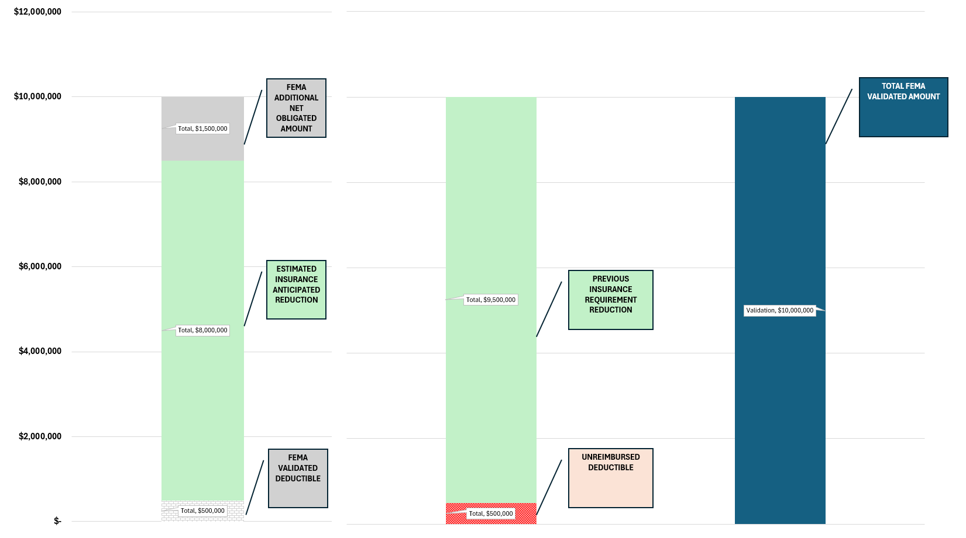
Section 4: Comparison (Basic Model)
Event 1
Event 2
Event 1 & 2

Slide 12
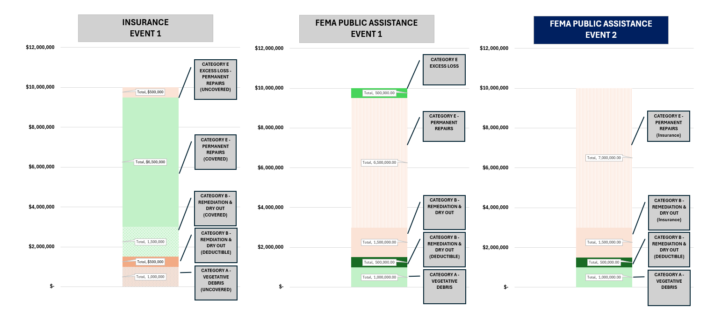
Section 4: Reality
EVENT 1
FEMA PA = $2 M
Insurance = $8 M
Total Loss = $10 M
Applicant OOP = $0
O&M = ✓
Prev. Ins. Requirement = $10 M
FEMA PA = $1.5 M
Insurance = $8.5 M
Total Loss = $10 M
Applicant OOP = $0

Slide 13
Section 5: Obtain & Maintain Overview
Obtain & Maintain
Type of Coverage – Peril/Risk
Assets Covered – Buildings, Contents, & Equipment
Amount of Coverage – Eligible Project Cost
Timing – ???
No requirement for 1st event – maybe…
Subject to modification by State Insurance Commissioner
Reduces future PA Awards, potentially jeopardizing deductibles
Failure to preclude may prevent closeout, jeopardize funding, and/or preclude eligibility in a new event

Slide 14
THANK YOU!
Contact:
Joseph J. Mascali Principal 917.399.6187 286 Madison Ave, 12th FL
New York, NY 10017
framegrp.com | LinkedIn
Kipp Nelson Managing Director 985.507.2011 8282 Goodwood Blvd., Ste. W5
Baton Rouge, LA 70806
thinkemergent.com | LinkedIn

