Slide 2
Have a Strong reporting system

Slide 3
Have a strong reporting system
Report all injuries - a seemingly minimal accident can snowball into a much larger claim.
Require immediate reporting, with an online system if possible.
Florida law allows up to 30 days for reporting an injury, but each day of delay brings complications and increased risk.
When a report is filed quickly, the claim severity is minimized since the employee gets to a doctor sooner, making the injury more manageable, which translates to the district controlling its costs.
Injury claims are time-sensitive, and prompt reporting helps lead to better outcomes.

Slide 4
Have a strong reporting system
No claim is too unserious to report.
Knowledge that the accident occurred is imputed to the carrier. The claimant doesn’t need to do anything other than report the accident to a supervisor. From there, the burden is on the employer to report to their claims handler. Gomez Lawn Serv. v. Hartford, 98 So. 3d 212 (Fla. 1st DCA 2012).
Often, the “it’s nothing” claim becomes an “it’s something” claim.
Drug testing done more than 24 hours after the accident is usually worthless.

Slide 5
Have a strong reporting system
Immunity issues –
“Ocean Reef admits it was aware of Wilczewski's and Leon's illnesses but hesitated to report to the carrier that the injuries were work-related. Ocean Reef delayed notifying its workers' compensation insurance carrier until after suit was filed only to result in a denial of coverage by the carrier on the grounds that the injuries sustained by Wilczewski and Leon were not within the scope of their employment and were time barred.”
WC immunity was barred as a result. See Ocean Reef Club, Inc. v. Wilczewski, 99 So. 3d 1, 4 (Fla. 3d DCA 2012).

Slide 6
Investigate every claim immediately& thoroughly

Slide 7
Investigate every claim immediately and thoroughly
If a workplace accident has not been investigated by the time it becomes a litigated claim, we have already lost the initiative.
As soon as a report is made, it’s important that someone goes to the scene, interviews witnesses and takes photos, even if just using a cell phone.
Witness statements should be reduced to writing and must include full name and contact information. If a video camera recorded the accident, administrators should review the footage, download and save it. Keeping the footage is helpful in case a claim is later reopened or litigated.
Every incident should be investigated as if it is a potential large claim.
Initial contact/recorded statement with the employee should be thorough. Must ask detailed questions about medical history, specifically related to the injured body part or parts. Florida law imposes strict waiver requirements on the ability to contest accidents/resulting conditions, and failure to investigate or timely assert denials leads to increased claims costs.

Slide 8
Investigate every claim immediately and thoroughly
The recorded statement – very important, often poorly executed.
Post-accident drug testing – must be done immediately.
Subrogation. Most carriers and TPA’s have dedicated subrogation adjusters who should be placed on notice.
Spoliation of evidence. Section 440.39(7), Fla. Stat., imposes a duty of cooperation on the employer and employee in claims against third party tortfeasors, which includes a duty to preserve evidence critical to the suit. Failure to preserve the evidence (i.e. the defective ladder) or even a failure to produce it upon request, can result in a loss of subrogation rights or even a direct cause of action.
Background checks; social media checks; medical canvass reports; ISO’s; OJCC research for prior claims.

Slide 9
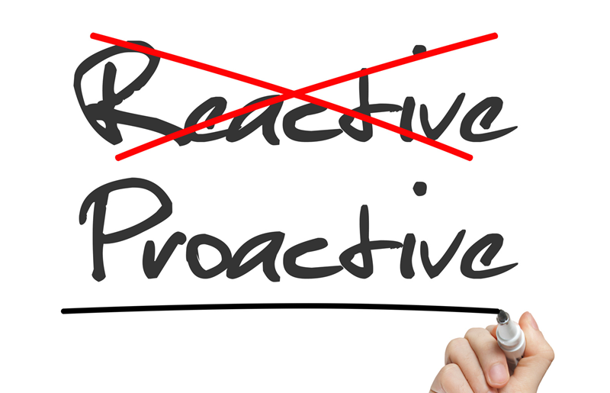
Be proactive

Slide 10
Be proactive
Programs that promote wellness are helpful for supporting overall health and can ultimately reduce the risk of injury.
Provide basic workers’ compensation trainings to school leaders and administrators, as well as those leading operational departments like buildings and grounds or food services.
Recognize employees who do a good job following safety practices.
Send a safety survey to staff at each of their buildings, so employees have a chance to highlight any safety concerns they may have. Follow up regarding what projects staff are working on or plan to improve.
Keep up with the latest changes in workers’ compensation laws and regulations.
Ensure all required documentation in WC programs is accurate and submitted in a timely manner.

Slide 11
Be proactive
120-day rule – failure to diligently investigate the claim within that time frame usually results in waiver of defenses that would otherwise apply.
“Willful wall of ignorance” cases. Failure to diligently determine the benefits due will be construed against the employer and may result in the waiver of defenses otherwise available.
”You break it, you buy it.” After we have provided surgery or other invasive care it is usually too late to “investigate” whether the claim was covered in the first place.
Front-load investigative efforts.

Slide 12
Pick the right doctors

Slide 13
Pick the right doctors
In Florida we control the selection of doctors. Some districts, however, cede the choice of doctors to their carriers or TPA’s who may or may not maintain an up-to-date list of the best doctors.
District risk management leaders must be assertive and knowledgeable regarding available physicians. Closer is not always better. Injured workers have a right to care but not convenience. There is no “50-mile” rule.
Walk-in clinics are not all the same. Some have more aggressive return-to-work philosophies. Some fail to timely or fully complete DWC-25’s, or inquire about prior injuries, conditions or treatment. Others are too quick to refer to specialists.
Districts must communicate and negotiate with their chosen clinics to assure top results. The vast majority of injured employees start with walk-in clinics, and they often set the tone for the entire claim.
Be careful who you select because we are generally stuck with our choice even if it turns out very, very badly for us. The E/C cannot deauthorize a previously authorized physician without proving that doing so is in the best interest of the claimant. See Marine Max, Inc. v. Blair, 268 So. 3d 839, 846 (Fla. 1st DCA 2019).

Slide 14
Pick the right doctors
One-time change – failure to authorize a doctor by name in 5 CALENDAR days leaves the choice of doctor to the claimant’s lawyer.
Peer reviewers – their opinions are not admissible in Florida.
IME’s – we have no right to an IME unless a PFB is filed by the injured worker, and the need for the IME relates in some way to the issues it raises.
Responsiveness – the E/C has 10 days to respond following a request for authorization for “specialist consultations, surgical operations, physiotherapeutic or occupational therapy procedures, X-ray examinations, or special diagnostic laboratory tests that cost more than $1,000.” Failure to respond waives objections to medical necessity. A VERY common trap for claims handlers.

Slide 15
Select & control your defense team

Slide 16
Select and control your defense team
Districts must insist on selecting the claims team that adjusts the claims. For those with their own adjusters that process is baked in.
For those using a carrier or a TPA, insist that claims are handled by an experienced, and preferably, account-dedicated adjuster.
The adjuster must become a part of the risk management team, involved not only on a per-file basis, but also in the formulation of policy and strategy.
Finally, no district should cede the choice of defense lawyer to a carrier or TPA. The defense lawyer must be included as part of the risk management team.
Experience matters. Insist on Florida Bar Board Certified experts in WC law. Remember, the claim belongs to the District, not the lawyer. Lawyers advise but do not decide. The District must maintain control over all aspects of the claim, including the decisions taken by their lawyers.
Regular/quarterly file review/strategy sessions are vital to ensure everyone is on the same page with the management of claims. Defense counsel should also keep you abreast of trial level/appellate decisions and how those impact District actions and claims handling

Slide 17
Select and control your defense team
Fla. Bar v. James, 329 So. 3d 108 (Fla. 2020)
Defense attorney was secretly texting answers to client during deposition and accidentally copied the C’s attorney. These actions resulted in time-consuming, embarrassing and expensive litigation, followed by the defense lawyer’s suspension from the Bar.
Horning-Keating v. Wausau, 969 So. 2d 412 (Fla. 5th DCA 2007).
Defense attorney set up a ”sting operation” to entice C’s lawyer to commit fraud.
The C’s lawyer brought invasion of privacy and violation of Security of Communications Act action against WC insurer and lawyer for secretly tape recording a meeting.
Protegrity Services, Inc. v. Vaccaro, 909 So.2d 445 (Fla. 4th DCA 2005)
Intentional tort claim. Defense attorney sent threatening letter to claimant’s doctor in an effort to terminate medical benefits.

Slide 18
Wrogner@hrlawflorida.com Rturner@hrlawflorida.com

Slide 19
