Slide 1
FERMA Conference
Emerging Risk Trends in Artificial Intelligence
©2025 ARTHUR J. GALLAGHER & CO.

Slide 2


Today’s Presenters
John Farley
Managing Director, Cyber Practice
John Keir
Partner
Constangy, Brooks, Smith & Prophete, LLP

Slide 3
AGENDA
Trends in AI Adoption
AI Claims Trends
Insurance Implications
Current Regulatory Landscape
AI Governance Best Practices

Slide 4
Trends in AI Adoption
1

Slide 5
Gallagher’s Attitudes to AI Adoption & Risk Survey

Slide 6
To mitigate the
potential risks
associated with
AI adoption,
many businesses
are updating their
risk management
frameworks.
HOW BUSINESSES ARE RESPONDING
Nearly 1 in 5 (17%) small businesses indicated they have "no plans yet."
Attitudes to AI Adoption and Risk Global Survey ©2026 Arthur J. Gallagher & Co.
Gallagher

Slide 7
AI Driven Claims:
Emerging Risks
2

Slide 8
Claims Trends Associated with Use of AI
Rising Securities Class Actions
1
High-profile lawsuits targeting "AI-washing" are surging. Shareholders are actively suing companies that allegedly overstate their AI capabilities or, conversely, downplay severe AI-related operational risks.
Claims are migrating from AI Developer to Organizations that Deploy AI
2
While foundational developers build the underlying models, and effectively push the risk downstream. As a result, the organizations that deploy and integrate AI into their daily operations are increasingly becoming the primary targets for claims alleging copyright infringement, algorithmic bias, and technology E&O failures.
3
IP
Over 70 intellectual property infringement lawsuits by IP owners against AI companies. The risk of IP infringement from AI software arises when algorithms ingest, process, or generate protected content without proper authorization.
Bodily Injury Claims Arising from AI Software
4
The risk of bodily injury from AI software arises when digital algorithms govern physical actions or critical human decisions. This dynamic creates a complex exposure for an insured, as it bridges traditional Tech E&O with GL, often blurring the lines of where a bodily injury claim should appropriately fall.
5
Regulation
State, federal, and international AI regulations are emerging rapidly. The EU AI Act became effective August 1, 2024, and 19 of the most populous U.S. states have enacted specific Ai governance laws affecting automatic decision making and transparency.
©2026 Arthur J. Gallagher & Co.

Slide 9
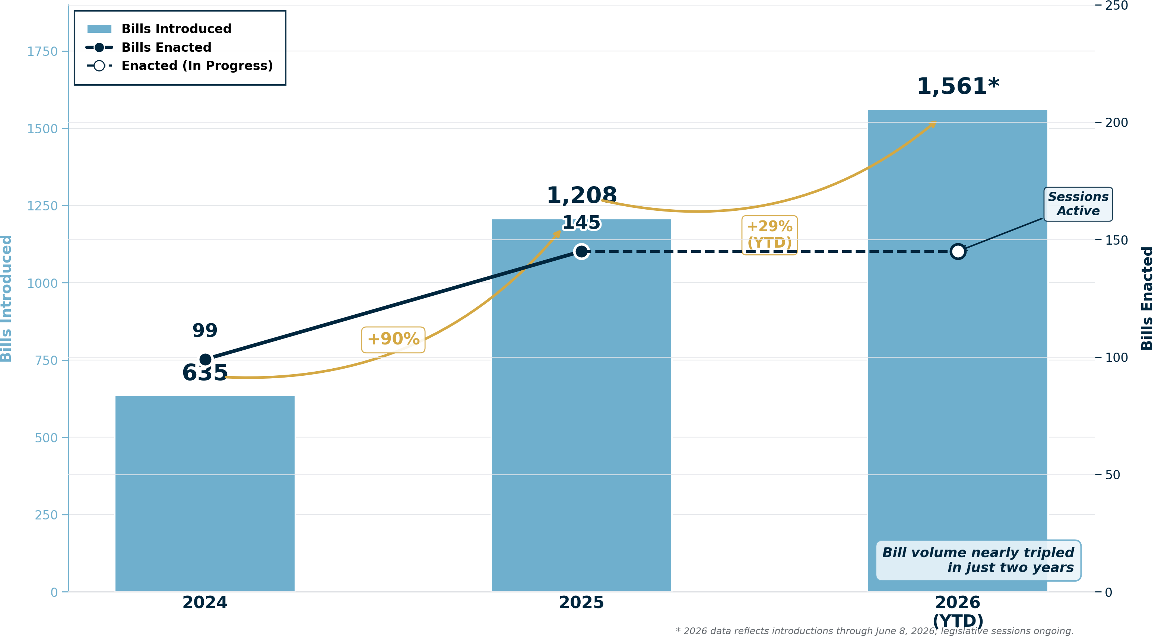
US State-Level AI Legislative Velocity
Growth in State AI Bills Introduced & Enacted | 2024-2026
Sources: NCSL, MultiState.ai, BSA | As of June 8, 2026

Slide 10
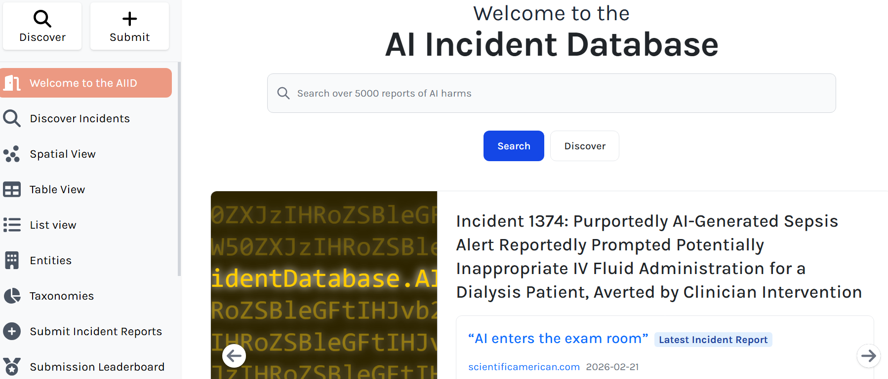
AI Incident Database
Partnership on AI (PAI). The AI Incident Database (AIID) is a project under this organization, which is a nonprofit coalition of academic, civil society, industry, and research organizations.
Key Features of the Website:
Comprehensive database of AI-related incidents.
Search and filter functionality for targeted reviews.
Detailed insights into claims and outcomes.
Access:
https://incidentdatabase.ai
Welcome to the Artificial Intelligence Incident Database

Slide 11
Insurance Market Response:
Cyber
3

Slide 12
THE CHALLENGE
AI risk is real — the cyber and technology insurance market hasn’t quite caught up
Fragmented Market
Legacy Policy Gaps
Rapid Risk Evolution
Dozens of carriers offering AI coverage but no standard policy concepts, definitions, or trigger language. Buyers can't compare apples to apples.
Traditional cyber and tech E&O policies weren't designed for AI perils. Coverage may be contested when AI-specific losses occur.
Model drift, hallucination liability, supply chain compromise, and agentic liability are new exposures emerging faster than policy language can adapt.

Slide 13




BUYER SEGMENTATION
Coverage needs vary by who is buying and why
AI Developer
AI Deployer / Enterprise
AI-Augmented Professional
Foundation Model Companies
Model errors & output defects
IP infringement / training data liability
AI supply chain compromise
Third-party harm from AI outputs
Regulatory fines (EU AI Act, CCPA)
Reputational harm from AI failures
E&O from AI-assisted advice
Professional standard of care
Reliance on AI output without review
IP and Privacy Infringement
Systemic Aggregation and Correlated Business Interruption
Adversarial Exploitation and Model Manipulation
Platform Safety
Tech E&O · Standalone AI Policy
Cyber + AI Endorsement
Misc. Professional Liability
Manuscripted Policy

Slide 14
THE FRAMEWORK
Three layers of AI insurance coverage
1
Existing Policies Responding to AI Perils
Traditional cyber, tech E&O, and media liability policies responding to AI-related losses — but not designed for them. Coverage is incident-dependent.
✓ Broad existing purchase base ✗ Not fit for many AI native perils.
2
AI-Endorsed or AI-Specific Endorsements
AI-specific endorsements added to existing forms, addressing named AI perils — limited AI regulatory coverage, LLM Jacking but often come with reduced limits or narrowing clauses.
✓ Targeted named peril coverage ✗ Often come with narrowing clauses or do not solve for most AI risks.
3
Purpose-Built AI Insurance Products
Standalone products designed from the ground up for AI developer and deployer risk profiles. Most structurally coherent, but least standardized — every carrier has different trigger language, insuring agreements, and AI system definitions.
✓ Designed for AI risk from the ground up ✗ No market standard

Slide 15
AI Regulations
4

Slide 16
Workplace AI:
GRC Risks in Employment
Navigating algorithmic bias, regulatory enforcement, state-level legislation, and insurance strategies for HR technology integration in 2026.

Slide 17


AI Risk Management Gaps
Adoption Outpaces Formal Controls
According to Gallagher's latest AI Adoption Survey of over 1,200 global companies, the transition from experimentation to workplace integration is scaling quickly:
62% of Organizations have delivered employee training on AI.
Lack AI Risk Frameworks
55% of Organizations have hired dedicated AI roles.
Only 44% of Organizations have conducted AI impact assessments.

Slide 18


The EPLI & AI Risk Matrix
Traditional Workplace Risks
Algorithmic Amplifications
EPLI (Employment Practices Liability Insurance) traditionally covers claims related to:
AI adoption adds complex exposures that traditional policies are beginning to restrict or exclude:
Sexual harassment and hostile work environment.
Systemic Algorithmic Bias in automated recruiting filters.
Wrongful termination and constructive discharge.
Workplace Surveillance Liability via productivity trackers.
Retaliation claims for whistleblower actions.
EPLI Exclusions on automated decisions and predictions.

Slide 19


Algorithmic Bias in HR
How Selection Processes Fail
Automated resume screening, algorithmic video interviews, and psychometric AI profiling can propagate and scale historic human biases:
Proxy Discrimination: Algorithms identifying geographic or historical traits correlated with protected categories.
Data Under-representation: Training sets based entirely on existing workforce profiles, freezing historical diversity deficits.
Disparate Impact: Systematically eliminating qualified candidates under Title VII framework.

Slide 20






Federal Regulatory Focus
EEOC Title VII Initiatives
ADA Protections
DOL AI Guidelines
The Equal Employment Opportunity Commission mandates that algorithms utilized in hiring or promotion must fully comply with federal civil rights guidelines, with no excuse for vendor faults.
Employers must provide reasonable accommodations for AI testing (e.g., alternative assessments for neurodivergent applicants or visually impaired candidates to avoid ADA violations).
The Department of Labor issued specific directives prioritizing transparency and fair application of AI algorithms in monitoring employee productivity and administering wellness benefits.

Slide 21

NYC Local Law 144 Case
NYC Local Law 144 pioneered the direct regulation of Automated Employment Decision Tools (AEDTs) in the United States, defining a robust GRC blueprint for HR:
Annual Bias Audits: Mandated annual evaluations by completely independent, third-party auditors.
Transparency Notice: Minimum 10-day prior notification to candidates with details on algorithmic criteria.
Four-Fifths Standard: Utilizes adverse impact metrics for gender and race:

Slide 22

HR Vendor Due Diligence
Compliance Area | Critical Vendor Assessment Question | EPLI Defensibility Value
AI Use Cases | Does your HR tool utilize machine learning models or statistical criteria to screen candidates? | Determines baseline applicability of local bias audit laws.
Training Data | Is applicant or employee personal data being used to train your models or cross-vendor tools? | Mitigates copyright, data leakage, and privacy breach claims.
Bias Mitigation | Do you conduct and share independent bias audits conforming to the 4/5ths standard? | Primary defense against claims of systemic disparate impact.
Opt-Out Capability | Can individuals bypass automated screens and obtain standard human reviews? | Essential for complying with ADA accommodation and state consumer laws.

Slide 23
Building Compliance Paths
2. Assess
4. Govern
Conduct Algorithmic Impact Assessments to isolate biases and data inputs.
Establish permanent "Human-in-the-Loop" validation checks before execution.
1. Inventory
3. Audit
Map and classify all current and proposed AI tools in the HR ecosystem.
Commission annual third-party bias audits for automated screening tools.

Slide 24






Key Best Practice Pillars
Centralized Policy
Human Control
Audit Trails
Develop clear corporate policies governing the acceptable scope of AI tools in hiring, tracking, and promotions.
Ensure algorithmic screening decisions are never final, keeping human recruitment experts as the final approval layer.
Generate tamper-resistant audit trails tracking inputs, prompt histories, configurations, and version controls.

Slide 25
AI Governance Strategies
5

Slide 26
THE IMPERATIVE
AI governance is an accountability question, not a compliance checkbox
A Key Question All Organizations Should Ask
Regulators are moving
EU AI Act is in force. SEC has signaled AI disclosure expectations. State-level AI legislation is accelerating in the US.
Do we know who is accountable if our AI causes a third-party loss tomorrow?
Litigation is arriving
If the answer is unclear, your organization has a governance gap.
Early AI-related lawsuits for defamation, discrimination, IP infringement, and platform safety are establishing precedent faster than policy language adapts.
Most companies cannot answer this today.
Boards are being named
Directors & Officers can be personally exposed when AI governance failures are framed as fiduciary failures or material misstatements.

Slide 27

THE FRAMEWORK
Five governance strategies every organization should understand
Establish AI Accountability Structures
Strategy 1 of 5
Own the risk — don't delegate it into ambiguity
Build an AI Inventory
Strategy 2 of 5
You can't govern what you don't know you have
Define Acceptable Use
Strategy 3 of 5
Set the rules before an incident sets them for you
Implement Pre-Deployment Risk Assessment
Strategy 4 of 5
Gate high-risk AI before it reaches production
Monitor and Audit in Production
Strategy 5 of 5
AI systems drift — governance doesn't end at launch

Slide 28
STRATEGY 01
Establish AI accountability structures
Someone has to own AI risk — and it can't live only in IT or legal. Leading organizations are creating dedicated AI accountability functions with board-level visibility.
Designate an owner
Board reporting line
Cross-functional scope
A Chief AI Officer, AI Risk Committee, or named executive accountable for AI risk decisions and escalation.
AI risk should surface to the board on the same cadence as cyber and financial risk — not only after an incident.
Effective governance spans legal, technology, compliance, and business units. A siloed function will miss shadow AI and vendor risk.
The question isn't whether to have an AI governance function — it's whether yours has authority to act.

Slide 29
STRATEGY 02
Build an AI inventory
Shadow AI is the fastest-growing governance gap. Employees and business units are deploying AI tools outside of IT — often without legal, security, or risk review.
Catalog all AI systems
Assign risk tiers
Track data inputs
Internal models, third-party tools, embedded AI in software vendors, and employee-used AI applications all belong on the inventory.
Tier systems by data sensitivity and consequence of errors. Autonomous decisions carry higher exposure than advisory outputs.
Know what data feeds each model. Personal, proprietary, and regulated data each carry distinct legal and coverage implications.
An AI inventory is to AI governance what an asset inventory is to cybersecurity. It is foundational.

Slide 30
STRATEGY 03
Define acceptable use
Most organizations have a cybersecurity policy but no AI use policy. Without one, employees make their own decisions — and those decisions become the organization's liability.
Data input rules
Human-in-the-loop requirements
Vendor AI evaluation
Specify what categories of data — customer PII, trade secrets, regulated data — may not be submitted to external AI tools.
Define which decisions AI may make autonomously and which require human review before action is taken.
Third-party software increasingly embeds AI. Procurement should include AI risk review — what does the vendor's model do with your data?
An acceptable use policy doesn't slow AI adoption; rather it creates the conditions under which adoption can be trusted.

Slide 31

STRATEGY 04
Implement pre-deployment risk assessment
AI systems making credit, hiring, medical, or consequential decisions should clear a structured review before deployment. This is also the EU AI Act's baseline requirement.
Bias and fairness testing
Accuracy thresholds
Failure mode analysis
Outputs should be audited across demographic groups before deployment. Discriminatory AI decisions create regulatory and litigation exposure.
Define acceptable error rates before launch — not after a claim. What hallucination rate or false positive rate is tolerable in this context?
Map the downstream consequences of AI errors before they occur in production. Post-incident remediation is far more costly.
Pre-deployment review is the single highest-leverage governance control and it is far more costs effective than post-incident remediation.

Slide 32
STRATEGY 05
Monitor and audit in production
AI governance doesn't end at launch. Models drift as real-world data patterns shift — a model that performed well at deployment may produce harmful outputs months later.
Ongoing performance monitoring
Scheduled audits
Incident response integration
Track model accuracy, output distributions, and edge-case behavior continuously — not just at deployment.
Periodic third-party audits of high-risk AI systems are becoming a regulatory expectation and an underwriting requirement.
AI failures should feed into the organization's incident response process. Who is notified? What is the remediation workflow?
Regulators and plaintiffs will ask: what did you know, and when did you know it? Monitoring creates the answer.

Slide 33
THE INSURANCE CONNECTION
Governance gaps are insurance gaps
Governance Gap
Insurance Implication
No AI inventory
Silent AI perils in existing cyber and tech E&O policies go undetected until claim time
No acceptable use policy
Employee-driven losses — data leakage into LLMs, unauthorized AI use — coverage is not attuned to the organization’s risk profile
No pre-deployment testing
Carriers are adding AI exclusions; untested models trigger exclusion language more readily
No production monitoring
"What did you know and when" becomes a bad-faith or late-notice argument against coverage
No accountability structure
D&O exposure escalates when AI failures are framed as fiduciary failures or material misstatements

Slide 34


GRC Governance Frameworks
NIST AI RMF 1.0
ISO/IEC 42001:2023
A comprehensive trust, accountability, and ethical deployment structure developed by the National Institute of Standards and Technology:
The first international standard specifying requirements for establishing, implementing, maintaining, and continually improving an AIMS (Artificial Intelligence Management System):
Govern: Cultivate corporate safety and risk culture.
Scope: Establishing clear bounds of technology use.
Map: Identify contexts, vulnerabilities, and metrics.
Applicability: Mandatory formal documentation.
Measure: Assess, analyze, and track performance.
PDCA Cycle: Plan-Do-Check-Act for continuous operational evaluation.
Manage: Allocate resources to minimize risks.

Slide 35
Q&A

Slide 36
Questions?
Strategic consultation for emerging artificial intelligence risk management and corporate liability defense.
John Farley, CIPP/US
John Keir
Managing Director, Cyber Practice
Partner, Constangy LLP
John_Farley@ajg.com
jkeir@constangy.com

