Slide 1
FERMA CONFERENCE | 2026
Strengthening Program Management Oversight
Delivering compliant, accountable, and sustainable construction & capital programs
PRESENTED BY FRAME GROUP, LLC AND RECOVERY MANAGEMENT GROUP, LLC
FERMA Conference | 2026
Program Management Oversight 01

Slide 2
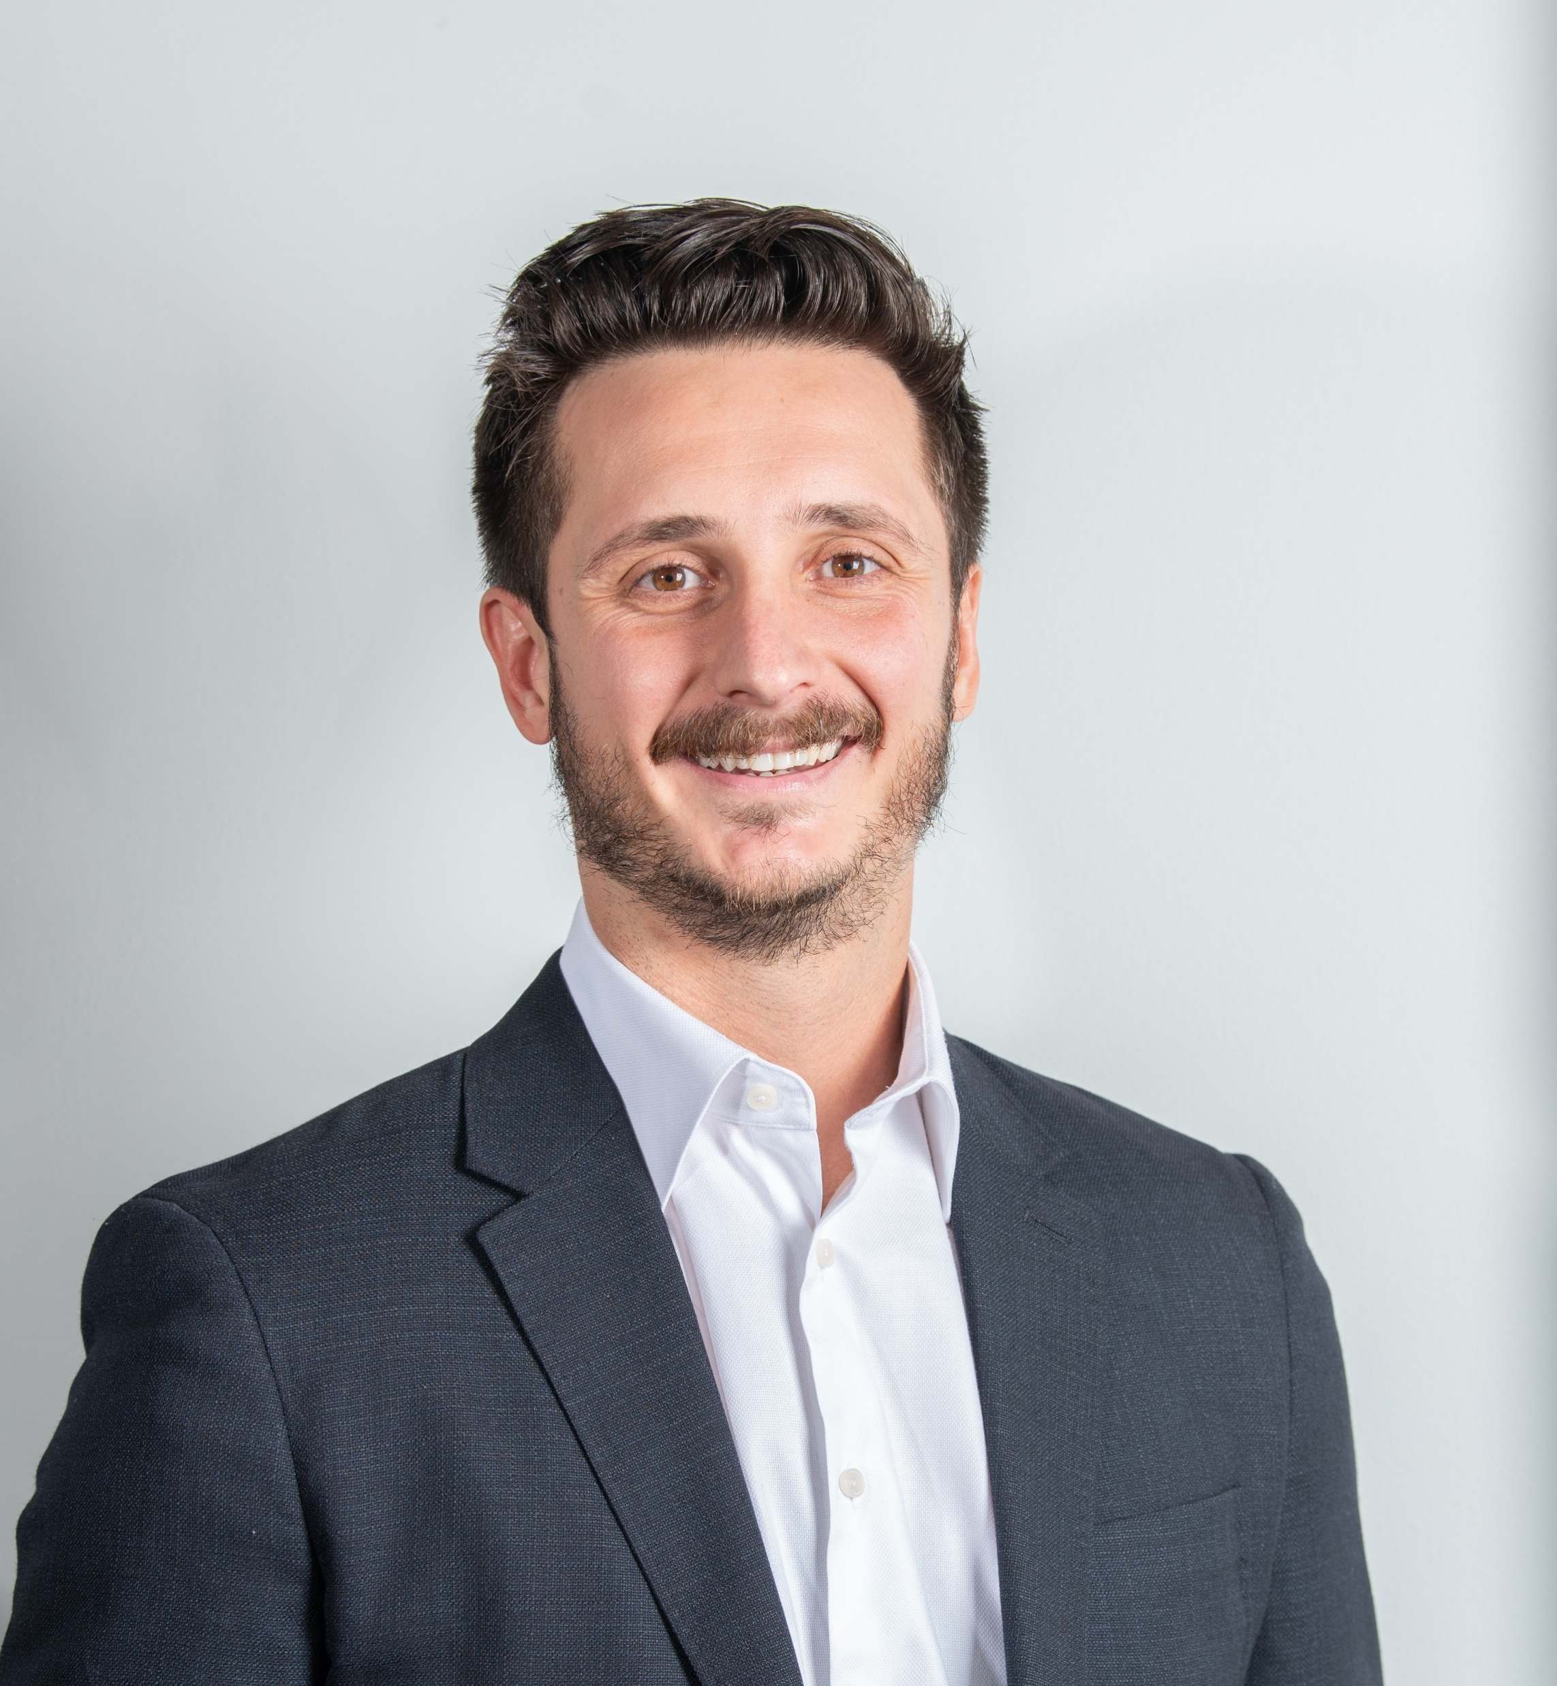
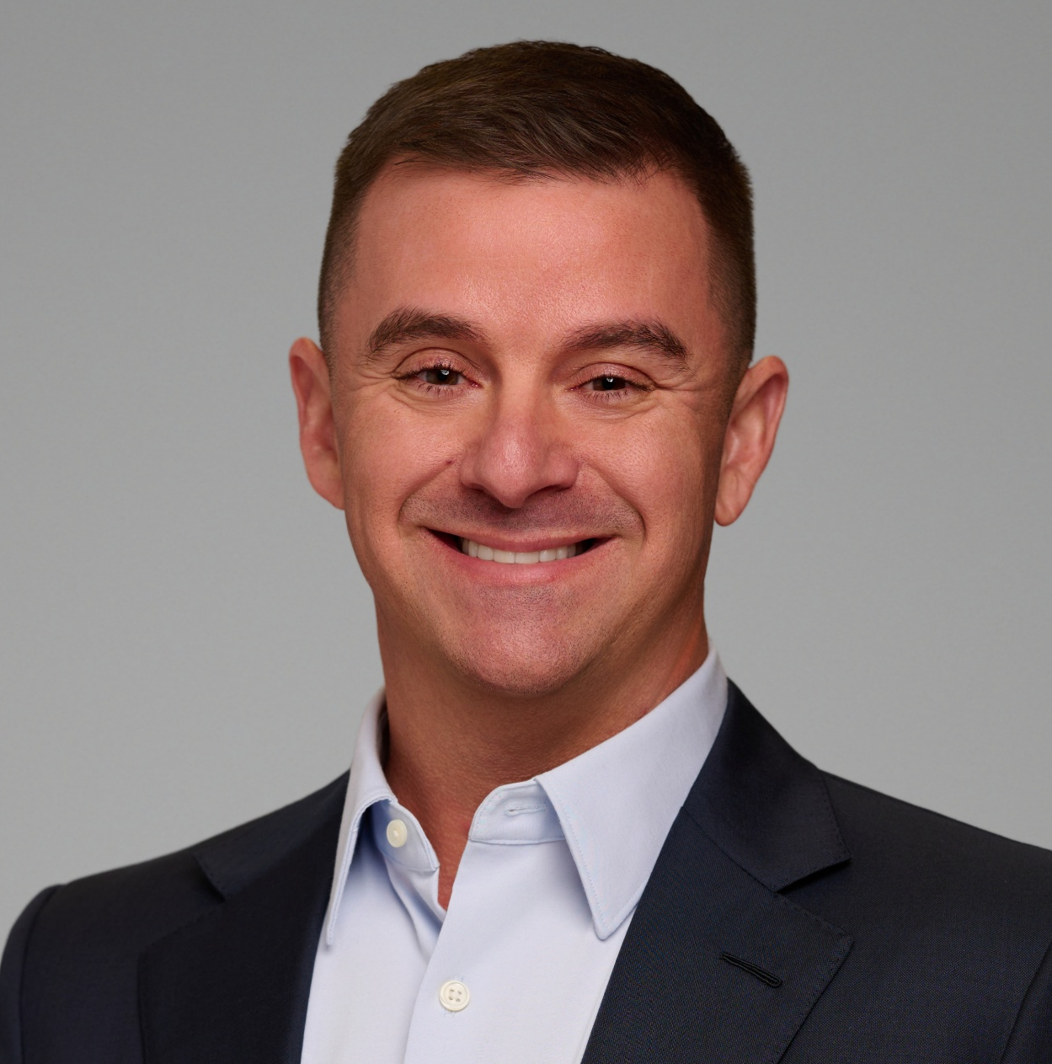
Introductions
Who We Are
JOSEPH MASCALI
JASON STOLTZFUS
Frame Group, LLC
Recovery Management Group, LLC
FERMA Conference | 2026
Program Management Oversight 02

Slide 3
Agenda
Topics to Be Covered
What Is Program Management?
Stakeholder Coordination
1
2
Cost Controls
Project Management
3
4
Accurate Reporting, Compliance, Procurement & Funding Requirements
Documentation & Audit Readiness
5
6
FERMA Conference | 2026
Program Management Oversight 03

Slide 4
Topic 1
What Is Program Management?
DEFINITION
Program Management (PMO) is the coordinated management of capital improvements, renovations, and maintenance activities across multiple departments, facilities, and campuses — to deliver measurable benefits for an organization.
FERMA Conference | 2026
Program Management Oversight 04

Slide 5
Topic 1
Objectives of a PMO
1
Standardize management and delivery of construction, improvements, and maintenance throughout organization
2
Control and reduce costs
3
Deliver projects on time, safely, and on budget
4
Build accountability through transparent reporting
5
Strengthen internal controls and reduce risk
FERMA Conference | 2026
Program Management Oversight 05

Slide 6
Topic 2
Stakeholder Coordination
1
Align Internal Teams
2
Coordinate Vendors
Facilities, finance, procurement, and program leads working from one plan.
Designers, contractors, and construction managers under clear scopes.
3
Keep Grantors & Agencies Informed
4
Document Every Decision
Communicate early and often — avoid compliance surprises.
The who, what, where, and why — captured as it happens.
Coordination is the difference between a program and a collection of projects.
FERMA Conference | 2026
Program Management Oversight 06

Slide 7
Topic 3
Cost Controls — Pre-Construction
1
Establish Procurement Baselines
2
Competitive Procurement
3
Contract & Schedule Controls
• Detailed designs and specifications clearly define scope
• Accurate plans enable consistent, comparable bidding
• Reduce change orders, disputes, and overruns before they begin
• Solicit bids from qualified, pre-vetted contractors
• Ensure competitive pricing and market validation
• Structured RFP packages drive alignment across bidders
• Stringent contractual timelines for mobilization and completion
• Provisions for missed deadlines — liquidated damages
• Escalation controls built into every agreement
Cost control is won before the first shovel hits the ground.
FERMA Conference | 2026
Program Management Oversight 07

Slide 8
Topic 4
Project Management
1
Scheduling & Coordination
2
Daily Oversight
Milestone-driven schedules aligned across all stakeholders; proactive coordination to maintain workflow and avoid delays.
On-site management monitoring daily progress and performance; rapid issue identification and real-time resolution.
3
Site Safety
4
Progress Reporting
Strict enforcement of safety protocols and compliance standards; routine inspections and ongoing safety communication.
Regular updates on schedule, budget, and key milestones; transparent reporting that supports informed decision-making.
FERMA Conference | 2026
Program Management Oversight 08

Slide 9
Topic 5
Accurate Reporting
1
One Source of Truth
2
Fixed Cadence
3
Follow the Money
A consolidated program dashboard — one place every stakeholder looks.
Report scope, budget, schedule, and risk on a regular, predictable schedule.
Tie each project’s status to its funding source and drawdown.
4
Report the Challenges
5
Consistent Metrics
Variances, issues, and decisions — not just green lights.
Give boards comparable measures over time to build trust.
FERMA Conference | 2026
Program Management Oversight 09

Slide 10
Topic 5
Compliance & Funding Requirements
1
Know the strings attached to each funding source
2
Align procurement policies to 2 CFR 200 (Uniform Guidance)
3
Build compliance into workflows — not as an afterthought
4
Verify eligibility and required provisions before award
5
Include required federal contract clauses; check contractor status in SAM.gov (debarment)
FERMA Conference | 2026
Program Management Oversight 10

Slide 11
Topic 5
Procurement Dos and Don’ts
1
Compete & Document
2
Emergency ≠ Exemption
Use full and open competition wherever possible — justify any sole-source or emergency procurement in writing before you award.
Exigent conditions do not waive federal rules — actions must stay cost-reasonable and end once conditions normalize.
3
Contract Forms Matter
4
Document Everything
Avoid cost-plus-percentage, contingency, or open-ended time-and-materials deals — include every required federal and funding-source clause.
Justify procurement method, contract type, and cost reasonableness — retain records 3+ years past final project closeout.
FERMA Conference | 2026
Program Management Oversight 11

Slide 12
Topic 6
Documentation & Audit Readiness
Audit-ready every day — not just at closeout.
1
Standardize Records
2
Clear Trails
Uniform project files and record-keeping across every project and department.
Complete procurement and change-order documentation from solicitation to closeout.
3
Continuous Reconciliation
4
Self-Audits
Reconcile costs to funding sources continuously — never let variances age.
Periodic internal reviews with corrective actions before external auditors arrive.
FERMA Conference | 2026
Program Management Oversight 12

Slide 13
Overall Recommendations
1
Establish a Program Management Office — construction, M&O, finance, legal, and more
2
Standardize processes and procedures across all applicable departments
3
Make compliance and documentation routine, not reactive
4
Optimize for competitive procurements
5
Report accurately to maintain trust and accountability
6
Re-evaluate continuously — programs improve by iteration
FERMA Conference | 2026
Program Management Oversight 13

Slide 14
FERMA CONFERENCE | 2026
Thank You!
Questions & Discussion
FERMA Conference | 2026
Program Management Oversight 14

