Slide 1
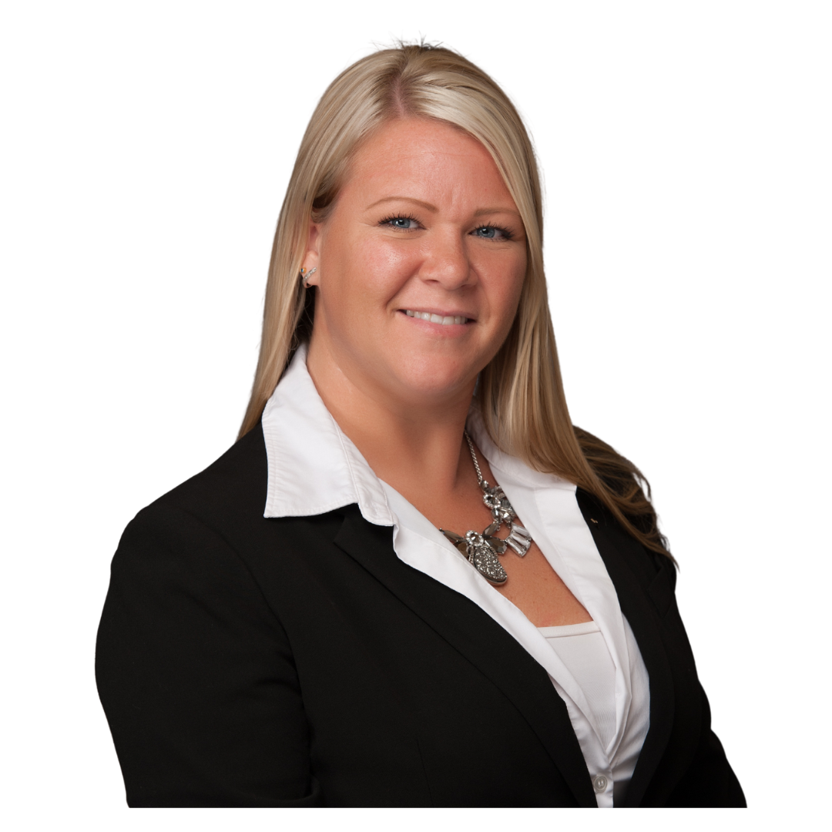
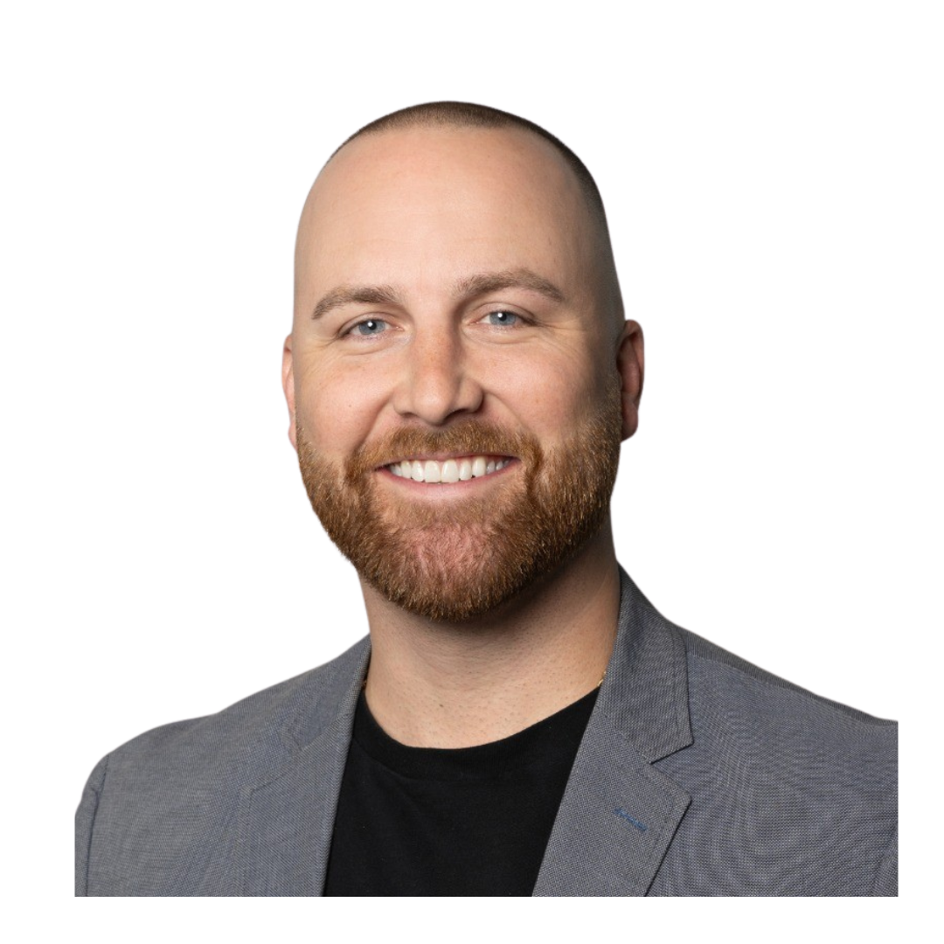
Maximizing Efficiency AND Streamlining Claims Management Processes
Amanda Radcliffe
AVP of Compliance
Davies
Kevin Lederer
SVP, SIU
Davies
Amanda Waltemath
PharmD, MPH
Healthesystems
Greg Nichols
President
SPNet

Slide 2
Claims Management Optimization
Risk Assessment/ Stratification
Data + People + Technology
Low Risk/Low Complexity
Potential High Risk/ High Complexity
Increase Engagement
Streamline Management
Allocate Appropriate Resources
Drive Efficiencies
Mitigate Risk/Complexity
Avoid Future Complexity/Escalation
Apply Clinical Oversight

Slide 3
Claim Lifecycle:
Opportunities, Strategies & Impacts
INJURY
INTAKE
ASSESSMENT & ANALYSIS
MANAGEMENT
CLOSURE

Slide 4
Identifying red flags that insinuate potential fraud
No witnesses to the accident
Conflicting witness statements
Quick legal representation
Inconsistent or vague injury details
Pattern of similar injuries in past claims
Injury doesn't match job duties
History of disciplinary actions or job dissatisfaction
Timing of injury (before/after weekends, holidays, vacations, layoffs)
Secondary employment or side business
Inconsistent social media activity

Slide 5
Understanding what investigative tools to use to expose/confirm fraud is being committed:
Surveillance
Medical canvassing
Social media investigations
Field Investigations

Slide 6
Latest technology related to the investigative tools
Remote surveillance
Social media monitoring
Facial recognition
Vehicle sighting reports
AI within claims systems

Slide 7
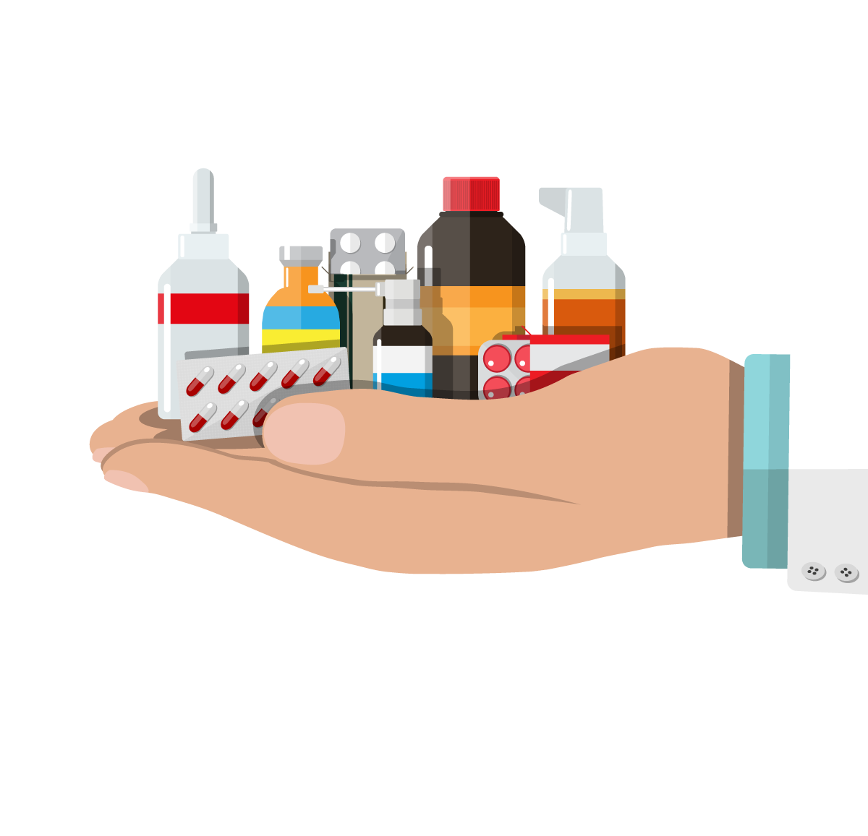
Prescription Drug Complexity & Risk
Opioids / MME
Dangerous drug combinations
Inappropriate polypharmacy
Drug-drug and drug-disease interactions
Specialty Rx management
Prescriber behaviors
Patient behaviors

Slide 8
Pharmacy Management Continuum
COMORBIDITY: DIABETES (NON-ADHERENT)
CHANGE IN PAIN QUALITY
THERAPEUTIC DUPLICATION
EXTREME MED
INCONSISTENT UDS
MULTIPLE PRESCRIBERS
SUBSTANCE ABUSE SUSPECTED
DEPRESSION
HIGH
AI-enhanced IPE+
MODERATE
Pharmacist-IW engagement
Automated Workflow/Review Escalation
Clinical Strategies
LOW
Right-time decision support (MME)
Automated reminders
Prescriber outreach (TALs, LOMN)
SUB-ACUTE PAIN
Pain lasting between 1-3 months
CHRONIC PAIN
Pain lasting greater than 3 months
ACUTE PAIN
Up to 4 weeks post injury
Formulary, Drug Alerts

Slide 9
Summarization
AI to Augment & Streamline Claims Capabilities
Sentiment Analysis
Risk Scoring/Prediction
Recommendations

Slide 10
Social Determinants of Health
Education Access
And Quality
Health Care Access and Quality
Economic
Stability
Neighborhood and Built Environment
Social and Community Context

Slide 11
Insights-Driven Engagement
Claim Process
Injury
PT Referral
Initial Evaluation
Treatment
Discharge
Clinical Oversight
Clinical Oversight
Clinical Oversight
Clinical Oversight
Provider Oversight
Provider Oversight
Provider Oversight
Patient engagement
Patient engagement
Patient engagement
Technology Solutions
Sentiment Analysis
Sentiment Analysis
Sentiment Analysis
Notes Summarization
Notes Summarization
Provider SmartMatch
Notes Summarization
Provider SmartMatch
Provider SmartMatch
Enhanced Communication via 2-way text messaging
Enhanced Communication via 2-way text messaging
Enhanced Communication via 2-way text messaging
PT Risk Score
PT Risk Score
PT Risk Score
Data Collection
Claims data + Referral Script + IE data + PT on-going treatment data + Billing data
Claims data + Referral Script + IE data + PT on-going treatment data + Billing data
Claims data + Referral Script + IE data + PT on-going treatment data + Billing data
Stakeholder Engagement
Flag at risk PT claims + Key insight / recommendations on subset of claims
Flag at risk PT claims + Key insight / recommendations on subset of claims
Provider Dashboard for program success metrics and drilling down to the case level
Provider Dashboard for program success metrics and drilling down to the case level
Client Insights Dashboard for program success metrics and drilling down to the case level
Client Insights Dashboard for program success metrics and drilling down to the case level
AI, Generative AI, ML Solutions
Ongoing Activities
Notes:
Sandip & Brian

Slide 12
Evolution of PT
Claim Process
PT Referral
PT Referral
PT Referral
Initial Evaluation
Initial Evaluation
Injury
Initial Evaluation
Discharge
Injury
Injury
Treatment
Treatment
Discharge
Discharge
Treatment
Risk
Guideline
CRITICAL
HIGH
MEDIUM
LOW
Referral Received
Discharge
Discharge
Referral Received
Discharge
Discharge
Notes:
MR introduced the GL as a major innovation in the comp space 25 yrs ago. The approach for many years was "everything is low risk" until it hits GL then risk increases linearly with utilization.
The next phase represents what we started moving towards 5 years ago. This is generally where most managed care sits. Still start with a baseline of low risk but be skeptical that something could escalate, so check in earlier.
For the past year, we have been evaluating risk upfront and predicting. The critical part here is re-assessing the risk based on the data. Copious data points.
Each PT note contains dozens of data points. Pain, mobility, subjective reports, strength, function, how long wear they there? What did they do? How did they respond?
It would be tough to look at every data point for every patient on every visit. Plausible though. What is not plausible is to triangulate all that data.
When I first came to MedRisk everyone wanted to talk about active and passive treatment. That's easy- every thing a PT can build is active, passive or neither. We can tell you if the treatment is more active than passive and if the therapist is more passive than their peers. That does tell the story. What is important is not whether its active or passive, its whether it is the right thing to do and even more important, "is it working?" An acute grade 3 ankle sprain needs passive care, it just does. Not forever. Perhaps, for as long as its swollen. So I don't want to discourage passive care. I want to look at the volumetric measurements of the ankle and as long as its swollen, it makes sense. It makes more sense on a 60 year old ankle than a 20 year old ankle. It also makes more sense for someone returning to desk work andp sitting all day. So the data points get more meaningful the more you cluster them. This is clinical intuition. I can teach it to a student, now I can I can teach it to a computer. What we are doing here is translating it into risk. What is our level of concern that that recovery will be delayed.
80% of the cases we manage complete care within guidelines. 20% go over. Of that 20% half were for a non-modifiable reason and half someone could have done something about. We are trying to insight into this 20% but we are really trying to find the 10% as early as possible. Monitor them closely and as objectively as possible, use the risk to trigger action, communication and collaboration.
Predicting risk upfront. At every point, our goal is to use whatever is available to us. Upfront tend to have metrics like age, Dx, pre-injury job, surgical status and chronicity. These are all highly predictive of recovery velocity. Upfront, clinical metrics like mobility or function are not available. So lets walk through a case, 56 y/o female s/p RCR as show how insight drive risk assessment and interventions.

Slide 13
Evolution of PT
Risk
CRITICAL
HIGH
MEDIUM
LOW
Referral Received
Discharged
Referral Information
Prescription
Claim feed Details
Scheduling Call
PT Consult
Initial Eval Report
Bill
Note
Bill
Note
Bill
Note
Bill
Note
Continued Authorization
Peer to Peer
Bill
Note
Bill
Note
PT Consult
Provider Outreach
Bill
Note
Bill
Note
Bill
Note
Continued Authorization
Peer to Peer
Bill
Note
Bill
Note
Bill
Note
Bill
Note
Continued Authorization
Peer to Peer
Bill
Note
Bill
Note
Bill
Note
Discharge Summary

Slide 14
An Improved Experience
Patient
Client
More seamless/tech-integrated experience
Optimized claim touchpoints
Matching the right providers to the right injuries
More transparency on recovery drivers
More informed care
Real-time results
Provider
Adjuster &
Case Manager
Leveraging tech for more synergy
Streamlined communication
Access to clinically-driven results
What should you care about?

Slide 15
Questions

