Slide 1
FERMA
2021
Compliance Round-up &
Quick-Fire Q&A
Attorney John M. Drye, Esq.

Slide 2
John M. Drye, Esq.
General Counsel & Chief Risk Strategist – Campus Benefits
Home Office – Atlanta, GA
Work in all 50 US states & Abroad
PPACA , Healthcare Reform & Public School Employee Benefits
In 2013 - 2021, completed training sessions to over 475 + Public School Systems in GA, AL, TN, MS, AR and FL.
Contact: Jdrye@CampusBenefits.com
What will we discuss today:
DOL Updates: COVID-19 & FMLA
1.
FIPA and K-12 Cyber
2.
HIPAA and “Security Rule” HI TECH ACT
3.
Q&A Cross Fire
4.
Presentation Disclaimer:
This Presentation is not intended to be exhaustive nor should any discussion or opinions be construed as legal advice. Listeners should contact school legal counsel for legal advice.
www.CampusBenefits.com

Slide 4
Top Questions School Districts are asking about COVID-19 & when employees return to work in the fall of 2021.

Slide 5
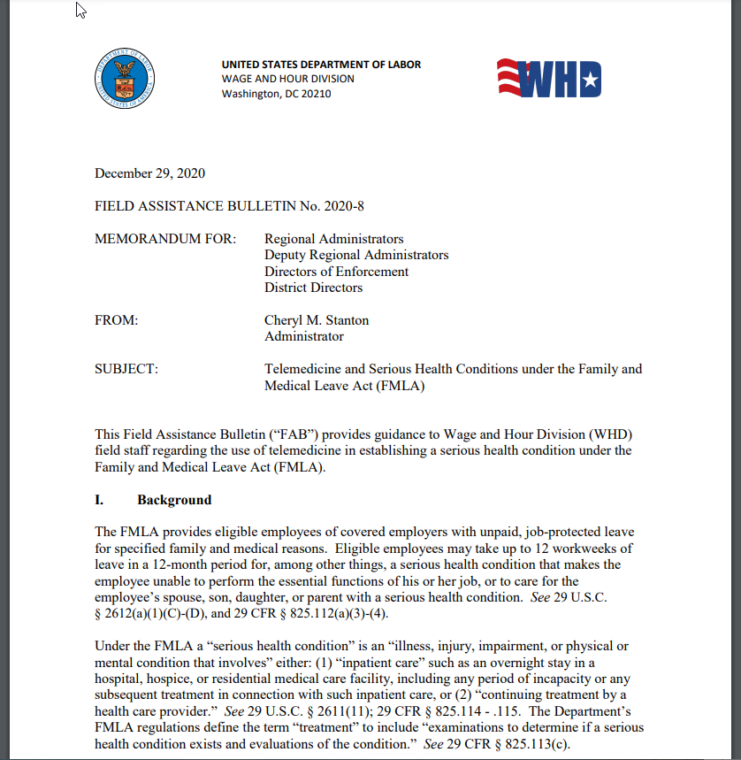
FMLA (Family Medical Leave Act) vs. FFRCA (Families First Coronavirus Response Act)
The DOL just updated its Q&A and issued several “FABs” for Employers on COVID-19 and FMLA
Highlights
“Serious Medical Conditions”
FFCRA Leave Enforcement
Testing Before Returning to Work

Slide 6
Review
(Q) What does the Family and Medical leave act provide?
The Family and Medical Leave Act (FMLA) provides eligible employees up to 12 work weeks of unpaid leave a year, and requires group health benefits to be maintained during the leave as if employees continued to work instead of taking leave. Employees are also entitled to return to their same or an equivalent job at the end of their FMLA leave.
(Q) What types of businesses/employers does the FMLA apply to?
public agencies, including local, State, and Federal employers, and local education agencies (schools); and
private sector employers who employ 50 or more employees for at least 20 workweeks in the current or preceding calendar year – including joint employers and successors of covered employers.
(Q) Who can take FMLA leave?
Employees are eligible to take FMLA leave if they work for a covered employer and:
Have worked for their employer for at least 12 months;
Have at least 1,250 hours of service over the 12-month period before their leave begins; and
Work at a location where at least 50 employees are employed by the employer within 75 miles.

Slide 7
Review
(Q) When can an eligible employee use FMLA leave?
A covered employer must grant an eligible employee up to a total of 12 workweeks of unpaid, job-protected leave in a 12 month period for one or more of the following reasons:
for the birth of a son or daughter, and to bond with the newborn child;
for the placement with the employee of a child for adoption or foster care, and to bond with that child;
to care for an immediate family member (spouse, child, or parent – but not a parent “in-law”) with a serious health condition;
to take medical leave when the employee is unable to work because of a serious health condition; or
for qualifying exigencies arising out of the fact that the employee’s spouse, son, daughter, or parent is on covered active duty or call to covered active duty status as a member of the National Guard, Reserves, or Regular Armed Forces.
The FMLA also allows eligible employees to take up to 26 workweeks of unpaid, job-protected leave in a “single 12-month period” to care for a covered servicemember with a serious injury or illness.

Slide 8
Review
(Q) What is a serious health condition?
The most common serious health conditions that qualify for FMLA leave are:
conditions requiring an overnight stay in a hospital or other medical care facility;
conditions that incapacitate you or your family member (for example, unable to work or attend school) for more than three consecutive days and have ongoing “in-person” medical treatment (either multiple appointments with a health care provider, or a single appointment and follow-up care such as prescription medication);
chronic conditions that cause occasional periods when you or your family member are incapacitated and require in-person treatment by a health care provider at least twice a year; and
pregnancy (including prenatal medical appointments, incapacity due to morning sickness, and medically required bed rest).

Slide 9
Telemedicine makes a big jump towards mainstream
WHD’s experience is that health care providers are now often using telemedicine to deliver examinations, evaluations, and other healthcare services that would previously have been provided only in an office setting.
Given this experience, and continuing the policy adopted in response to the COVID-19 pandemic, WHD will consider a telemedicine visit with a health care provider as an in-person visit under 29 C.F.R. §825.115, provided specified criteria are met.
To be considered an “in-person” visit, the telemedicine visit must include:
an examination, evaluation, or treatment by a health care provider;
be permitted and accepted by state licensing authorities; and,
generally, should be performed by video conference.
Communication methods that do not meet these criteria (e.g., a simple telephone call, letter, email, or text message) are insufficient, by themselves, to satisfy the regulatory requirement of an “in-person” visit.
See 29 U.S.C. § 2611(11); 29 CFR § 825.114 - .115

Slide 10
Telemedicine makes a big jump towards mainstream
Telemedicine has already moved mainstream
There are many variations of “Telemedicine” popping up
Don’t confuse Telemedicine with:
Telehealth
Virtual Care (Disease Management)
Telerehabilitation
Tele-Behavioral Health
Cutting Edge Benefits Departments are looking to the Telemedicine / RX Combo

Slide 11
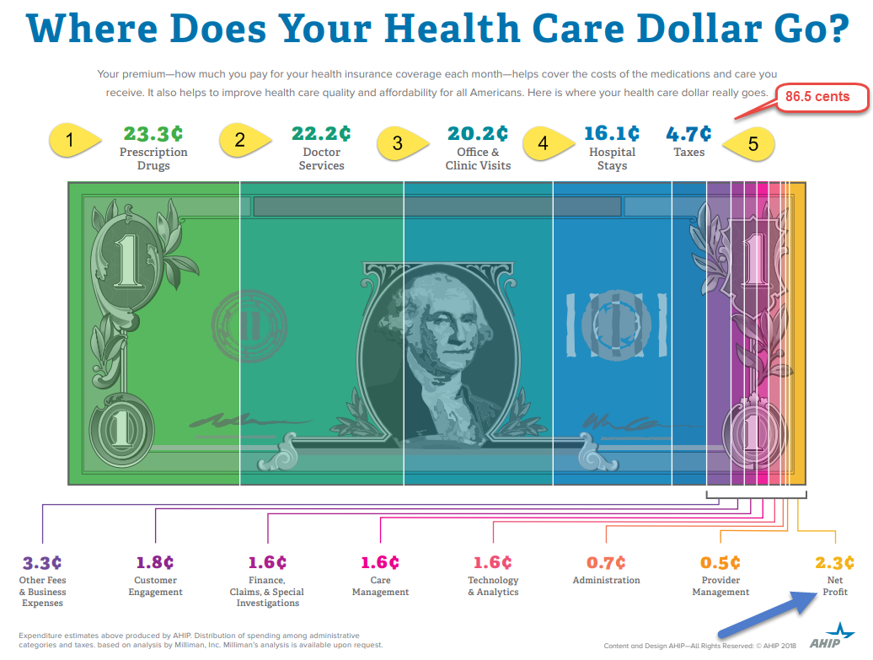

Slide 12
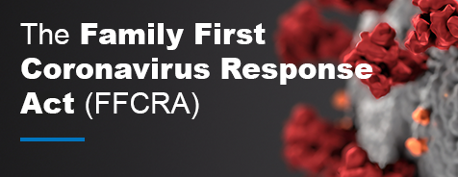
FFCRA Leave Requirements
Expired Dec. 31, 2020
The requirement that employers provide paid sick leave and expanded family and medical leave under the Families First Coronavirus Response Act (FFCRA) expired on Dec. 31, 2020.
However, WHD will enforce the FFCRA for leave taken or requested during the effective period of April 1, 2020, through Dec. 31, 2020, for complaints made within the statute of limitations, which permits complaints to be filed for up to two years from the date of the alleged violation.
A three-year statute of limitations applies in cases involving willful violations.
Confusion with Private Employers in 2021 - Employers are not required to provide employees with FFCRA leave after Dec. 31, 2020, although employers who choose to provide paid sick and family leave for COVID-19 related reasons between Jan. 1, 2021, and Sept. 30, 2021, may be eligible for employer tax credits.

Slide 13
Quiz Time
14. I was out on FMLA leave unrelated to COVID-19. While I was out, my company implemented a new policy requiring everyone to take a COVID-19 test before they come to the office. Under the FMLA, can my employer require me to get a COVID-19 test under this policy?
The FMLA does not prohibit the employer’s testing requirement.
When your FMLA leave is over, your employer must reinstate you to the same job or an equivalent position. However, you are not protected from the employer’s actions that are unrelated to your use of or request for FMLA leave.
For example, if a shift has been eliminated, or overtime has been decreased, you would not be entitled to return to work that shift or the original overtime hours, so long as the employer did not eliminate the shift or decrease overtime because you took or attempted to take FMLA leave.
That principle also applies here, where your employer’s requirement for testing isn’t related to your having been out on FMLA leave but instead, all employees, regardless of whether they have taken any kind of leave, are required to be tested for COVID- 19 before coming to the office.
Other laws may impose restrictions on the circumstances when your employer can require COVID-19 testing and what types of tests are permitted. Click here for more information.

Slide 14
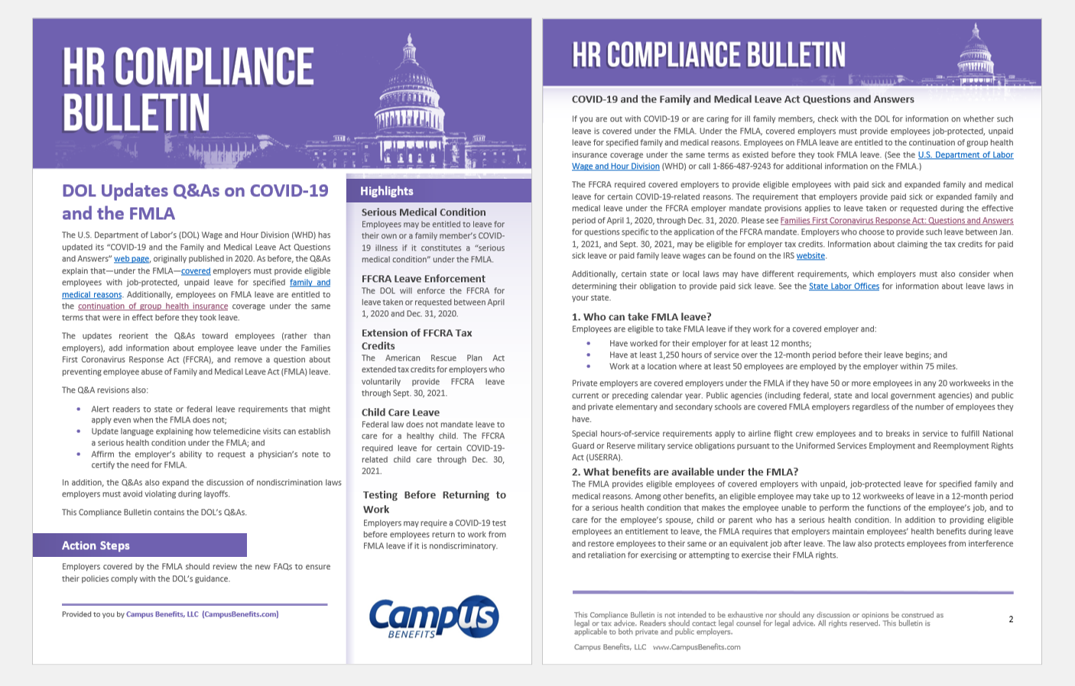
Send an email to JDrye@CampusBenefits.com ask for Compliance Bulletin that corresponds to FERMA Presentation.

Slide 15
Data Privacy
Understanding the (Basics) Questions…..

Slide 16
Florida Data Privacy Laws
Florida Business Doges the Proverbial Bullet:
Florida Privacy Protection Act
(DID NOT PASS by May 2021)
As written the most strict data privacy laws in the United States
Allows a “private right of action” to sue businesses directly
House Bill voted in overwhelmingly.
Senate Bill moved to allow AG to offer business a 30 day period of cure.
Significant burden for “big Tech” and ANY Florida business or entity.
House Bill 969
Senate Bill1734

Slide 17
The Law (Florida) -- Exposure School Districts Have…
State of Florida Law - The Florida Information Protection Act of 2014 repeals section 817.5681 and replaces it with a new statute: section 501.171 Notification required upon breach of security regarding personal information:
The statute requires notice to be provided to affected individuals within 30 days. In addition, notice must now be provided to the Florida Department of Legal Affairs for any breach affecting 500 or more individuals within 30 days of the breach unless good cause is provided to the department in writing for an additional 15-day delay. The new statute authorizes the Florida Office of Attorney General to bring enforcement actions under FDUTPA for any statutory violations, but does not create private rights of action for affected individuals.
The statute expands the definition of personal information to include health insurance policy or subscriber numbers, information regarding an individual’s medical history, financial information, and online user names or email addresses in combination with their associated passwords or security questions and answers to permit account access.
The civil penalties for FDUTPA violations could be up to $1,000 per day for the first 30 days and $50,000 for each subsequent 30-day period, not to exceed a total of $500,000.

Slide 18
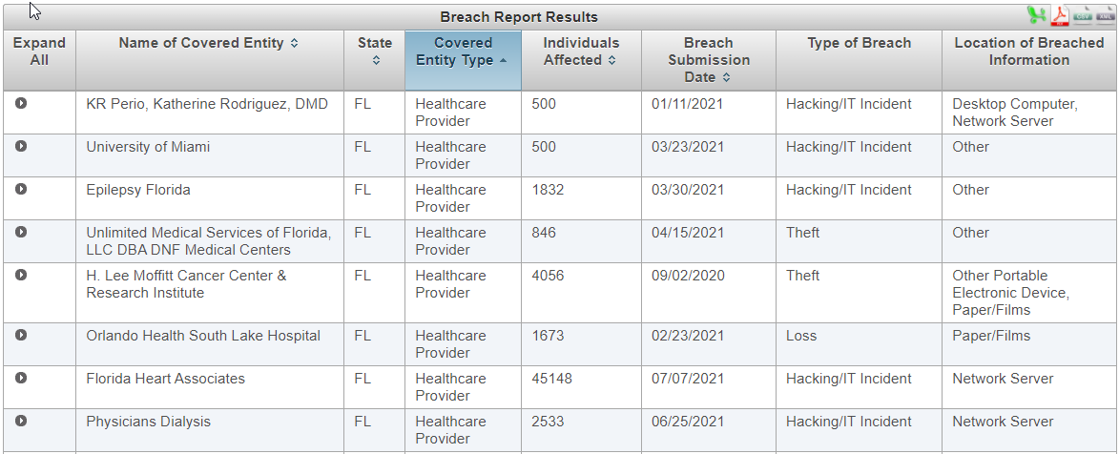
The Law -- Exposure School Districts Have…
Federal Law – There are several areas pertinent to discussion (especially notification requirements), but an important law to understand as an employer or business partner is related to the U.S. Health and Human Services office for Civil Rights. As required by section 13402(e)(4) of the HITECH Act, the Secretary must post a list of breaches of unsecured protected health information affecting 500 or more individuals.
Since 1997, HHS has logged thousands of breaches. This list includes hospitals, doctors, dentist, insurance brokers, universities, state and county governmental entities, and many others.

Slide 19
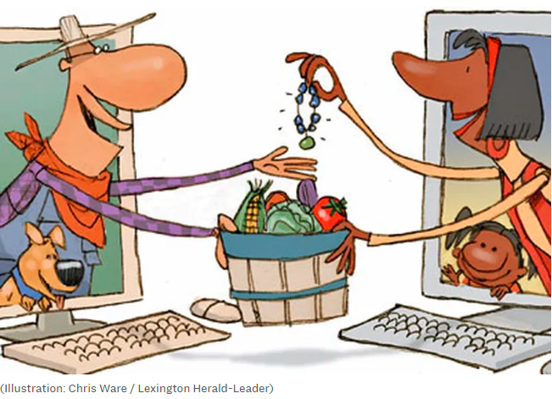
Data has BIG Financial Value
According to a recent TrustWave report….
High Value for Stolen Data:
Credit Cards:
$5.40
Medical Records:
$250
Credit Cards
Medical Records

Slide 20
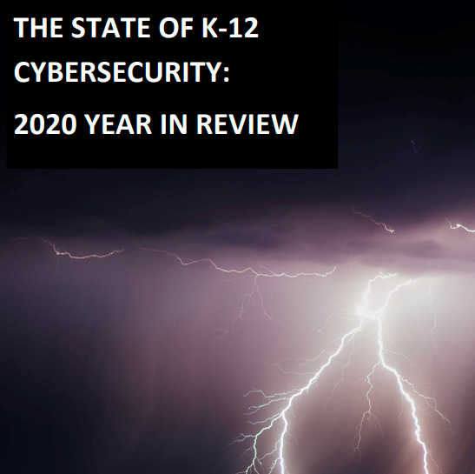
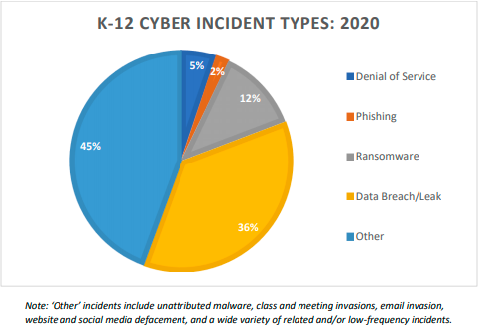
Levin, Douglas A. (2021). “The State of K-12 Cybersecurity: 2020 Year in Review.” EdTech Strategies/K-12 Cybersecurity Resource Center and the K12 Security Information Exchange. Available online at: https://k12cybersecure.com/year-in-review/

Slide 21
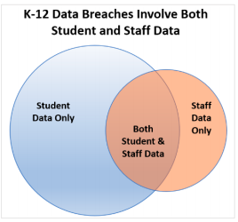
Why are Schools High Target Value
“PHI & ePHI” records
Bullying Reports
Student Transcripts
Social Security Numbers
School IT infrastructure in the age of Zoom and remote learning is significantly ill prepared for the “Online Cartels”

Slide 22
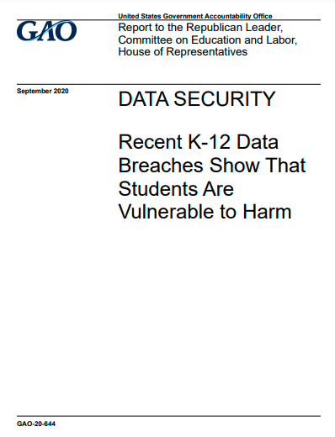
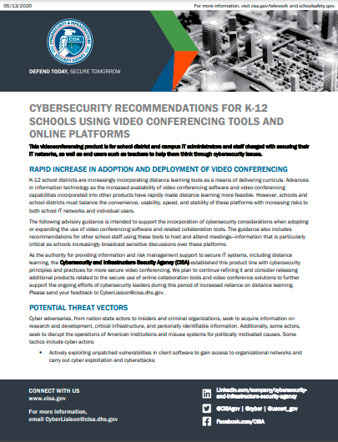

Slide 23
A Cautionary Tale … Toledo (OH) Public Schools
In September 2020, security researchers learned that the Maze ransomware cartel had compromised the data systems of TPS.
Either because the district did not meet the criminal group’s extortion demands or for other reasons of their own, Maze dumped 9GB of compressed TPS data on their site, including sensitive student and employee data.
These data did not appear to involve current records, but those held by the district from at least 2008 to 2017.
By February of 2021—less than six months from the initial incident— news outlets began reporting that parents were receiving notifications of identity theft and credit fraud involving their TPS students:
“[One parent]… learned his son’s information is in the hands of people it shouldn’t be. Here are some of the messages he’s received about his elementary schooler:
The first one was for denial for a credit card.
Another one happened when the child was denied for a car loan because it said the reason was because of his income ratio.
One of the last ones was to have fixed electric rates.
The family got a flier talking about the student’s Toledo Edison account and the gift card he could get by switching suppliers. ‘They’ve got our children’s information and they’re trying to use it,’ said [the parent].” 8

Slide 24
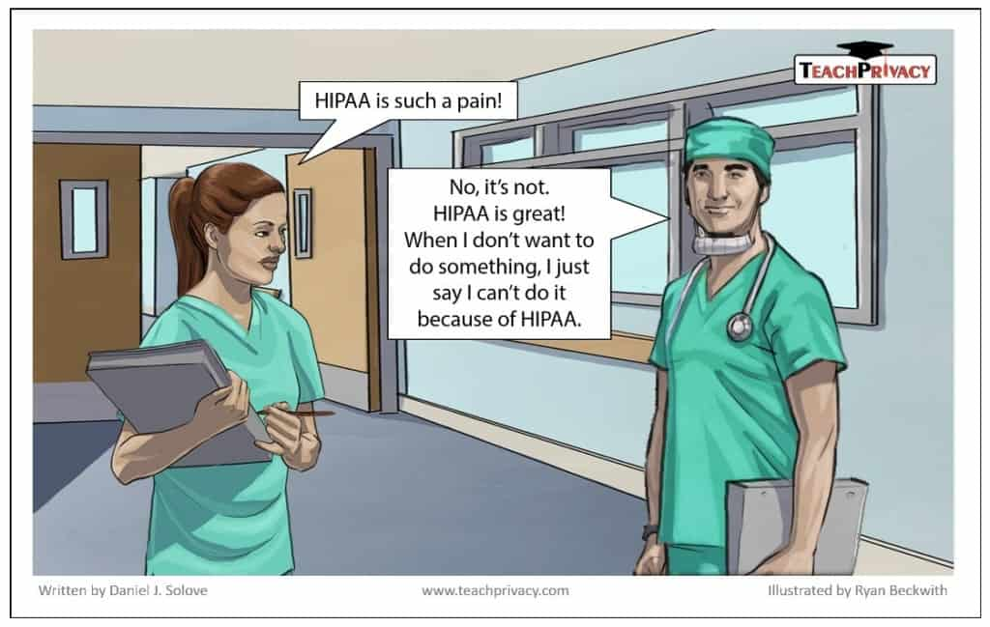

Slide 25
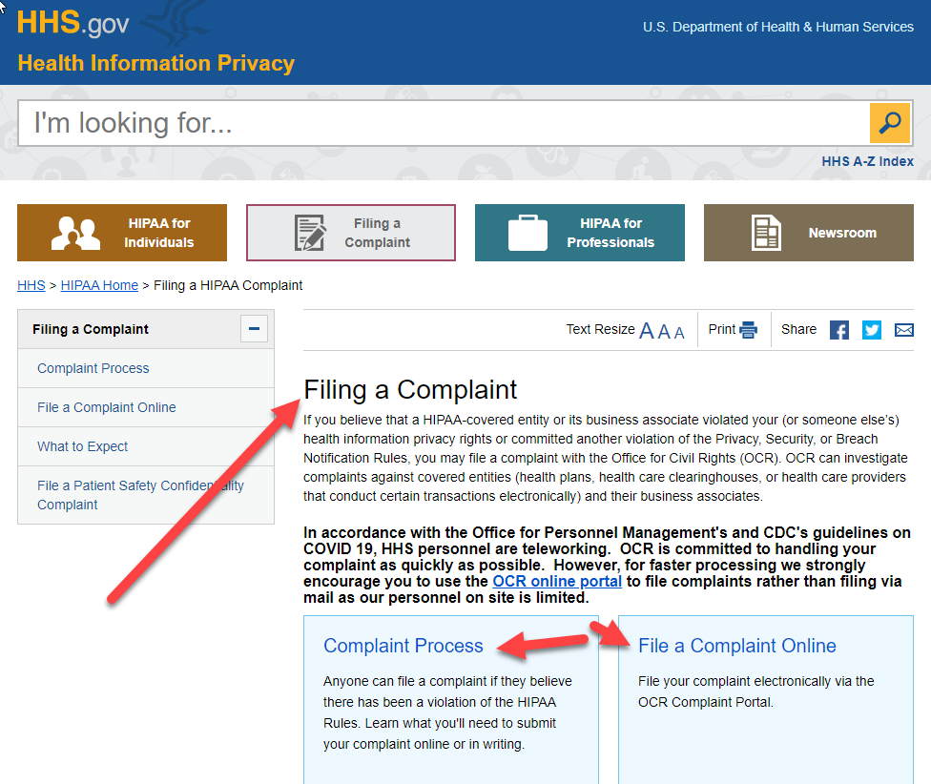
Review
What is HIPAA
The Health Insurance Portability and Accountability Act of 1996 (HIPAA) is a federal law that required:
The creation of national standards
To protect sensitive patient health information from being disclosed without the patient's consent or knowledge.
The Health Insurance Portability and Accountability Act of 1996 was enacted by the 104th United States Congress and signed into law by President Bill Clinton on August 21, 1996.

Slide 26
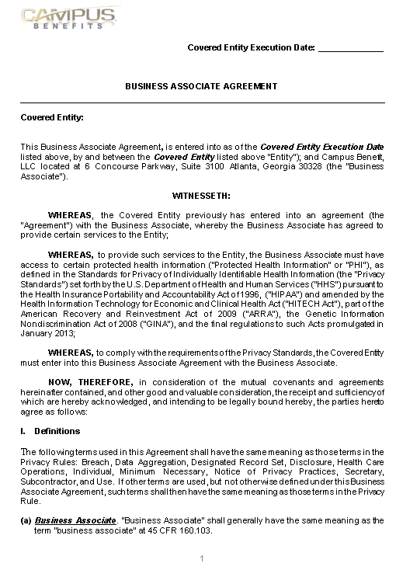
HIPAA = Privacy Rule & Security Rule & Enforcement Rule & Breach Notification Rule
Since HIPAA was passed in 1996 Congress has passed several important updates:
Security Rule in 2004
HiTech Act of 2009
Omnibus Rule of 2013
With the growing reliance of School Districts on vendors and cloud based platforms…. A review of your “executed” BAA (Business Associate Agreements) is timely.
40-70% of data breaches occur through VENDORS

Slide 27
What is the HIPAA Security Rule?
The Security Rule is a set of regulations intended to protect the security of electronic Protected Health Information (ePHI)
The HIPAA Security Rule contains three types of required standards of implementation that all business associates and covered entities must abide by. These standards are:
Administrative Safeguards
Physical Safeguards
Technical safeguards.

Slide 28
What Information is considered PHI?
PHI is any information that can be used to identify an individual
HIPAA has laid out 18 identifiers for PHI.
If a record contains any one of those 18 identifiers, it is considered to be PHI.
If the record has these identifiers removed, it is no longer considered to be Protected Health Information and it is no longer under the restrictions defined by the HIPAA Privacy Rule.
What is ePHI?
When PHI is found in an electronic form, like a computer or a digital file, it is called electronically Protected Health Information or ePHI.
ePHI can be found in a couple of different forms whether it is shared via email or stored on a hard drive, computer, flash drive, disk, cloud hosting platform, or other.
HIPAA Privacy Rule applies to each and every form of PHI that currently exists or will ever exist in the future.
Security Rule only applies to ePHI and does not apply to paper or oral versions of this same information.

Slide 29
18 Identifiers for PHI:
Full names or last name and initial
All geographical identifiers smaller than a state,
Dates (other than year) directly related to an individual such as birthday or treatment dates
Phone Numbers including area code
Fax number/s
Email address/es
Social Security number
Medical record numbers
Health insurance beneficiary numbers
Bank Account numbers
Certificates/drivers license numbers
Vehicle identifiers (including VIN and license plate information)
Device identifiers and serial numbers;
Web Uniform Resource Locators (URLs)
Internet Protocol (IP) address numbers
Biometric identifiers, including fingerprints, retinal, genetic
information, and voice prints
17. Full face photographs and any comparable images that can identify
an individual
18. Any other unique identifying number, characteristic, or code except
the unique code assigned by the investigator to code the data
The rule of thumb is that if any of the information is personally recognizable to the patient or if it was utilized or discovered during the course of a healthcare service, it is considered to be PHI.

Slide 30
Administrative Safeguards
Security Management Process: A covered entity must implement security measures that will help to reduce vulnerabilities in PHI security. A key part of this standard is conducting a thorough HIPAA risk assessment.
Security Personnel: The rule requires that a Privacy Officer is designated who is responsible for developing and implementing security policies and procedures.
Information Access Management: This standard focuses on restricting unnecessary access to ePHI meaning that only the appropriate personnel have access to that data only when it is appropriate.
Workforce Training and Security Awareness: This standard requires that employees complete an annual HIPAA training and also be educated on the organization’s specific security procedures. The organization must also have and apply sanctions against any employee who violates these security procedures.

Slide 31
Physical Safeguards
Access Control: These are procedures that limit access to the facilities that contain information systems like computers and servers.
Workstation use and security: These pertain to the usage of workstations, which can be any computer as well as the information contained within it.
Device and Media controls: These are the policies for how devices containing ePHI can be removed from a facility.

Slide 32
Technical Safeguards
Access Control: A covered entity must put in place policies and procedures that allow only the authorized individuals to access ePHI.
Audit Control: Covered Entities must implement procedures through hardware or software that record and monitor access to systems that contain ePHI.
Integrity Controls: Organizations must have procedures in place to maintain that ePHI is not altered, destroyed, or tampered with.
Transmission Security: A covered entity must implement security measures that protect against unauthorized access to ePHI that is being transmitted over an electronic network.
* Annual Risk Assessments

Slide 33
John M. Drye, Esq. JDrye@CampusBenefits.com
“We are often prepared for the Big Challenges because they are easy to see coming…”
“It is the small things… the admin… the non day-to-day that can bite us… and cause real pain.”
Topics I have trained on recently for clients
Culturally and Linguistically Appropriate
Affordability Percentages
HHS Audits – HIPAA Compliance Gaps
Privacy Rule
Security Rule
Breach Notification Rule
NLRB – New Standard for Employee Handbooks
226J and 227 letters
What does a DOL Health Plan Audit look like?
IRS Proposes Electronic Filing Requirement
FMLA forms … Did you know?
Tax Changes to Fringe Benefits
Call or Email me if you want any of the “Nuggets” from today……

Slide 34
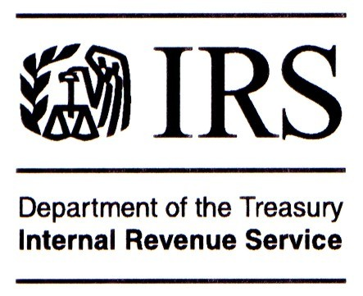
Did you?: Develop a plan that understands how each main regulatory agency works
Part 2: Employers – The Small Things
Pay for PPACA
Regulate and Enforce
Expand Coverage

Slide 35
STOP

Slide 36
Part 2: Employers – The Small Things
1: HIPAA Compliance
In 2016 and 2017, the Department of Health and Human Services (HHS) conducted “desk audits” of 166 covered entities and 41 business associates.
These audits focused on selected requirements of HIPAA’s privacy, security and breach notification requirements.
Of these covered entities, 90 percent were health care providers, approximately 9 percent were health plans and approximately 2 percent were health care clearinghouses.
Based on the information that HHS received, it assigned a score from 1 to 5 for each compliance requirement,
based on the following guidelines:
SCORE | DESCRIPTION
1 | Entity is in full compliance with requirement
2 | Entity substantially meets the requirement
3 | Entity has made attempts to comply with the requirement, but implementation is inadequate
4 | Entity has made negligible efforts to comply with the requirement
5 | Entity has made no serious attempt to comply with the requirement
HIPAA (Health Insurance Portability and Accountability Act of 1996) is United States legislation that provides data privacy and security provisions for safeguarding medical information.

Slide 37
Privacy Rule
The HIPAA privacy rule requires covered entities (that is, health plans, health care clearinghouses and covered health care providers) to comply with national standards for the protection of PHI. The privacy rule includes the following three main protections for PHI:
Use and disclosure rules—The privacy rule limits when an individual’s PHI may be used or disclosed by covered entities;
Individual rights—The privacy rule requires covered entities to provide individuals with certain rights with respect to their PHI, including the right to receive a notice of privacy practices (privacy notice) and inspect and receive copies of their own PHI;
Administrative safeguards—The privacy rule requires covered entities to develop written privacy procedures an implement appropriate safeguards for PHI.
Security Rule
The HIPAA security rule establishes national standards for securing individuals’ ePHI. These standards require a covered entity to perform a risk analysis as a crucial first step of its security process. During the risk analysis, a covered entity examines the risks and vulnerabilities to ePHI it creates, transmits, receives or maintains. This analysis allows a covered entity to implement an appropriate security management process, which involves specific security measures to prevent, detect, contain and correct security problems.
Breach Notification Rule
The breach notification rule require covered entities to notify affected individuals following the discovery of a breach of unsecured PHI. Notification must also be provided to HHS and, in some cases, to the media. The breach notifications must include certain information and be provided by specific deadlines (for example, notice to individuals must be provided within 60 days after the breach is discovered).
Serious HIPAA Compliance Problems
The most serious compliance problems identified by HHS relate to security risk analysis and security risk management. Out of the 63 entities that were reviewed for security compliance:
For security risk analysis, only eight entities scored better than a 3 and approximately 57 percent of the reviewed entities scored a 4 or 5.
For security risk management, only four entities scored better than a 3 and approximately 73 percent of the reviewed entities scored a 4 or 5.
Action Step: Review your BAAs (Business Associate Agreements)

