Slide 1
Biosimilars: Unlocking lower drug costs without compromising care

Slide 2
Objective
Biologics and Biosimilars 101
Why Biosimilars Matter to Payers
Payer’s Role

Slide 3
Objective
“Biosimilars offer a meaningful opportunity for employers to reduce their spending on prescription drugs while maintaining access to high-quality, clinically equivalent treatments for plan participants.”

Slide 4
What is a biological drug?

Slide 5

What is a Biologic Drug?
A drug made from live organisms or contains parts of living organisms, that alters the way a natural biologic function is carried out.
Biologics Medicine: Definition, Uses, Example, and More

Slide 6
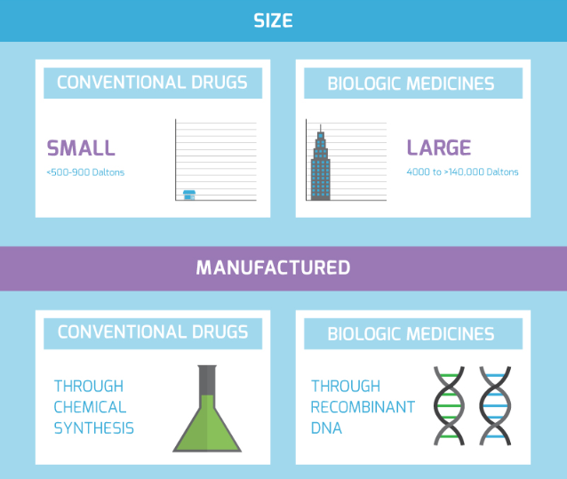
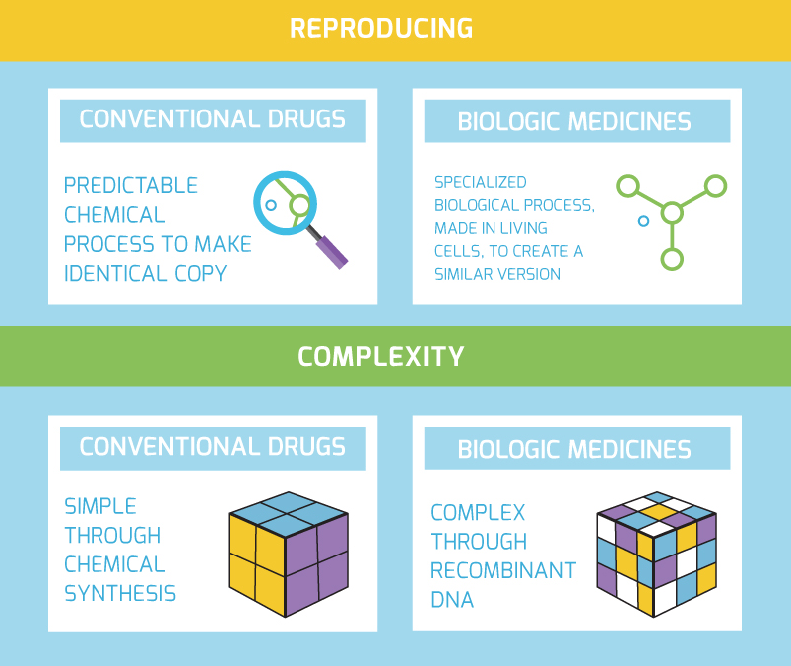
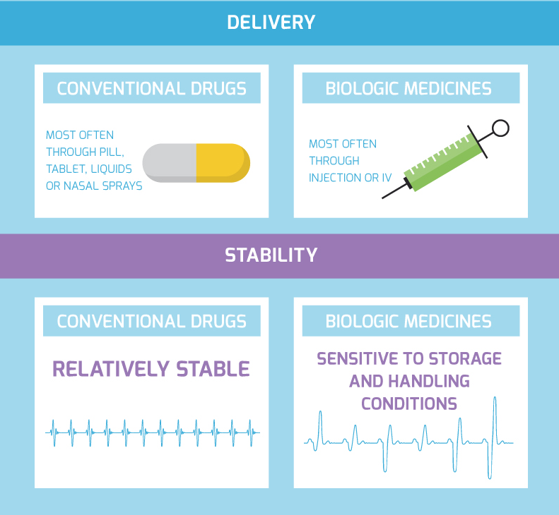
How Biologics differ from other drugs
How are biologic medicines different from other drugs?

Slide 7
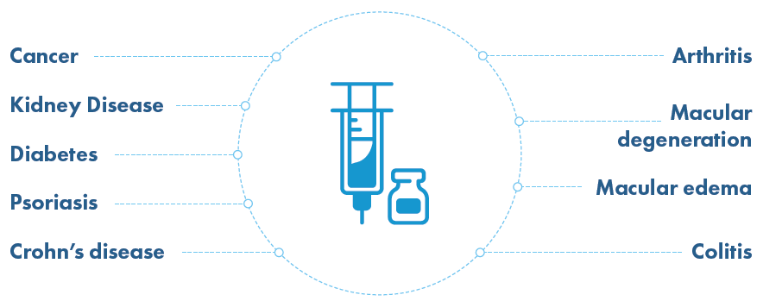
Common uses of Biologics
Biosimilars 101 - Biosimilars Forum

Slide 8
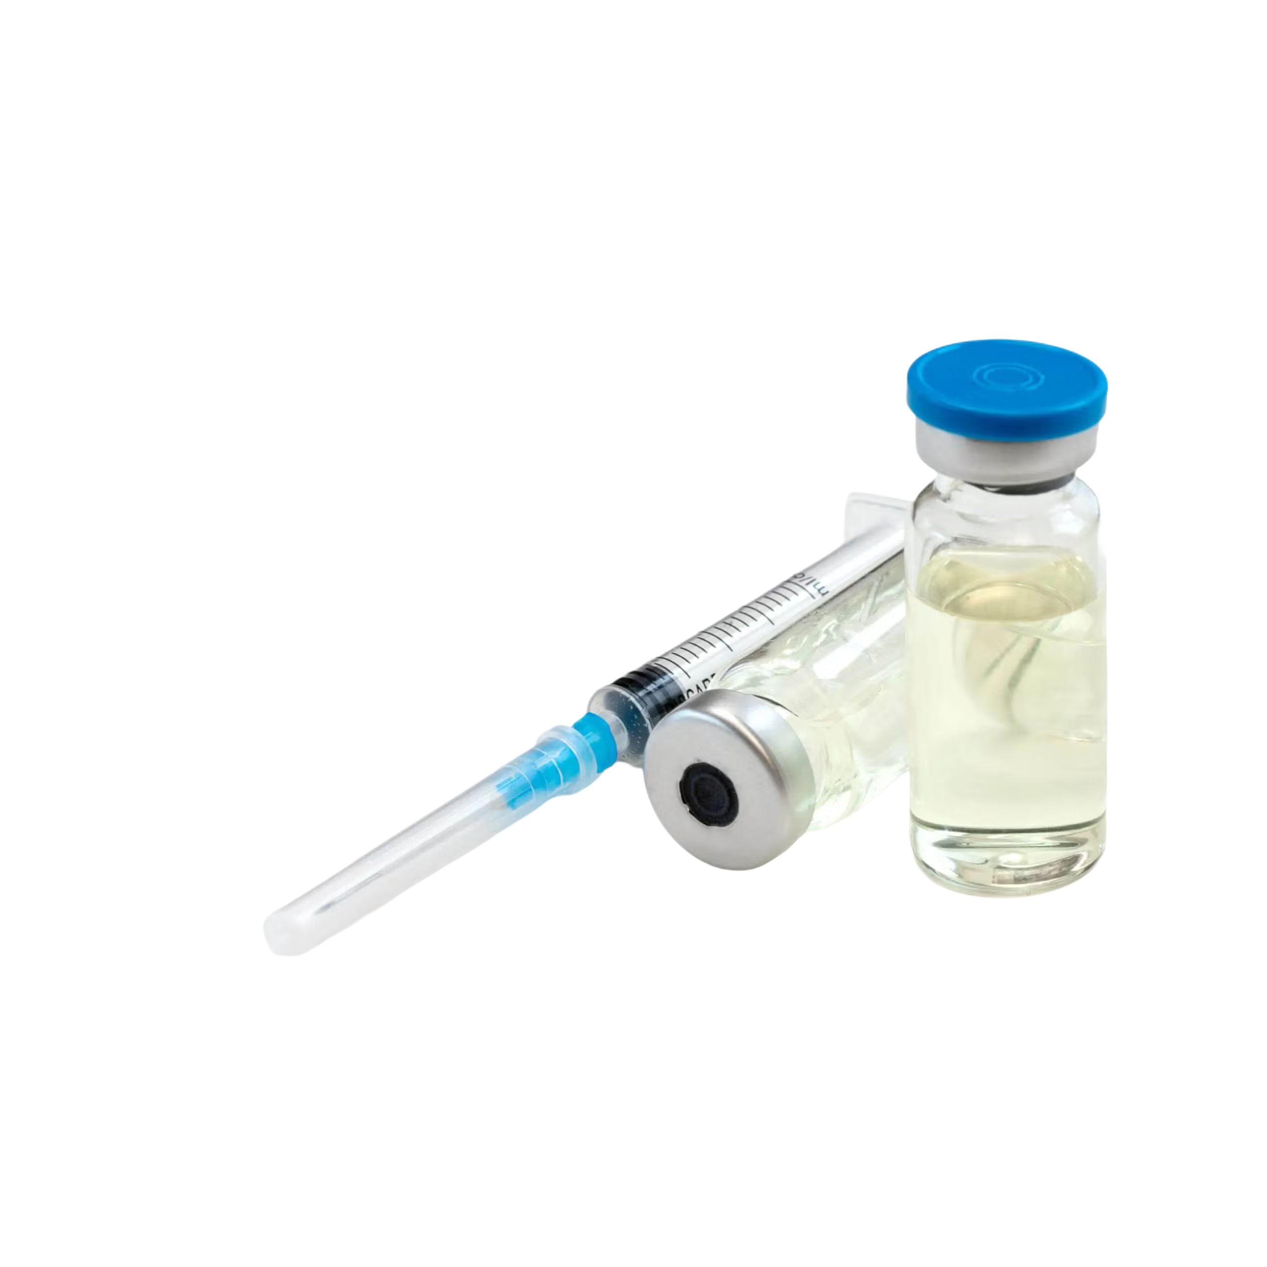
COMMON BIOLOGIC EXAMPLES AND THEIR USE
Biologic
Common Uses
Humira
Rheumatoid arthritis, inflammatory bowel
Remicade
Rheumatoid arthritis, inflammatory bowel
Enbrel
Rheumatoid arthritis, psoriatic arthritis
Rituxan
Rheumatoid arthritis, non-Hodgkin lymphoma
Stelara
Psoriasis, inflammatory bowel

Slide 9
What is a biosimilar drug?

Slide 10
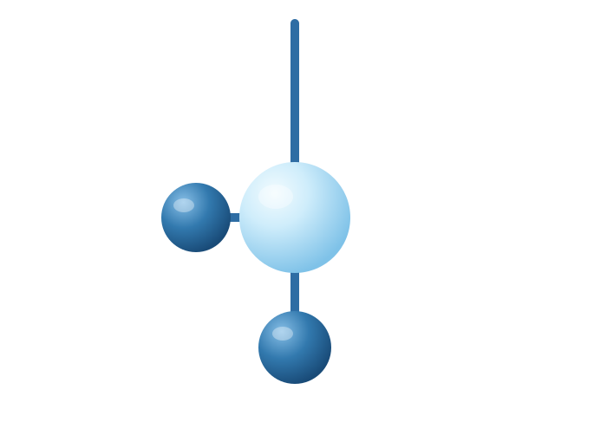
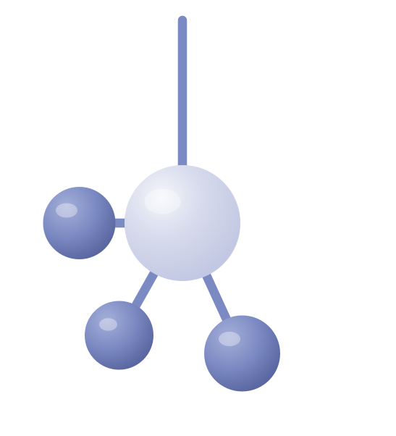
WHAT IS A BIOSIMILAR DRUG?
A biosimilar is like a ‘generic’ for very complex, high-cost drugs—but not identical because the drugs are more complex.
Biologics
Biosimilar
Origin
Made from living cells
Origin
Copies made after patent expiry
Structure
Large, complex
Structure
Similar, not identical
Trial
Full clinical trial
Trial
Approved via comparability

Slide 11
TOP BIOSIMILAR DRUGS ON MARKET TODAY
Biologic
Common Uses
Humira
Rheumatoid arthritis, inflammatory bowel
Remicade
Rheumatoid arthritis, inflammatory bowel
Herceptin
Oncology
Avastin
Oncology
Rituxan
Oncology
Notes:
Note, many of these covered on the medical benefit vs retail pharmacy/specialty

Slide 12
Myths Debunked in biosimilar patient adoption
Good as the original?
They work the same — no meaningful difference in outcomes.
1
Difficult to switch?
In most cases, your pharmacy can switch automatically.
2
Will it save me money?
Yes — 15–30% cheaper, but only if plan and member both benefit.
3

Slide 13
Why biosimilars matter to payers?

Slide 14
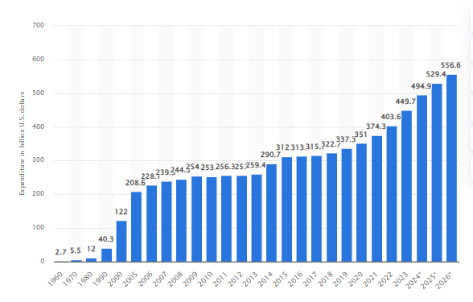
BIOLOGIC DRUG SPEND
557 billion U.S. dollars in 2026
Prescription drug expenditure U.S. 1960-2026| Statista

Slide 15
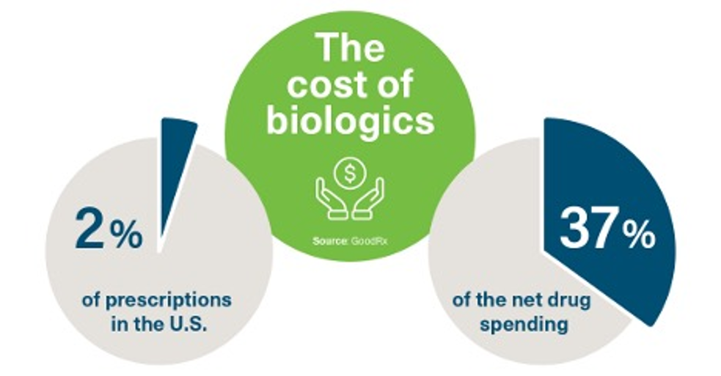
…and the biologic spend is wildly disproportionate to overall drug spend
A Guide to Biosimilars: What you need to know - TheBurg
Notes:
Specialty drugs not considered biologics – oncology, HIV, Hepatitis, MS

Slide 16



Biosimilars create competition
Biosimilars introduce real competition into the market – giving plans leverage to drive down prices on both the biosimilar and the reference brand drug.
ONE SELLER
PRICE
LOWER
PRICE
LOWEST
PRICE
BIOSIMILAR ENTERS
Reference brand biologic
Reference brand biologic
Biosimilar

Slide 17
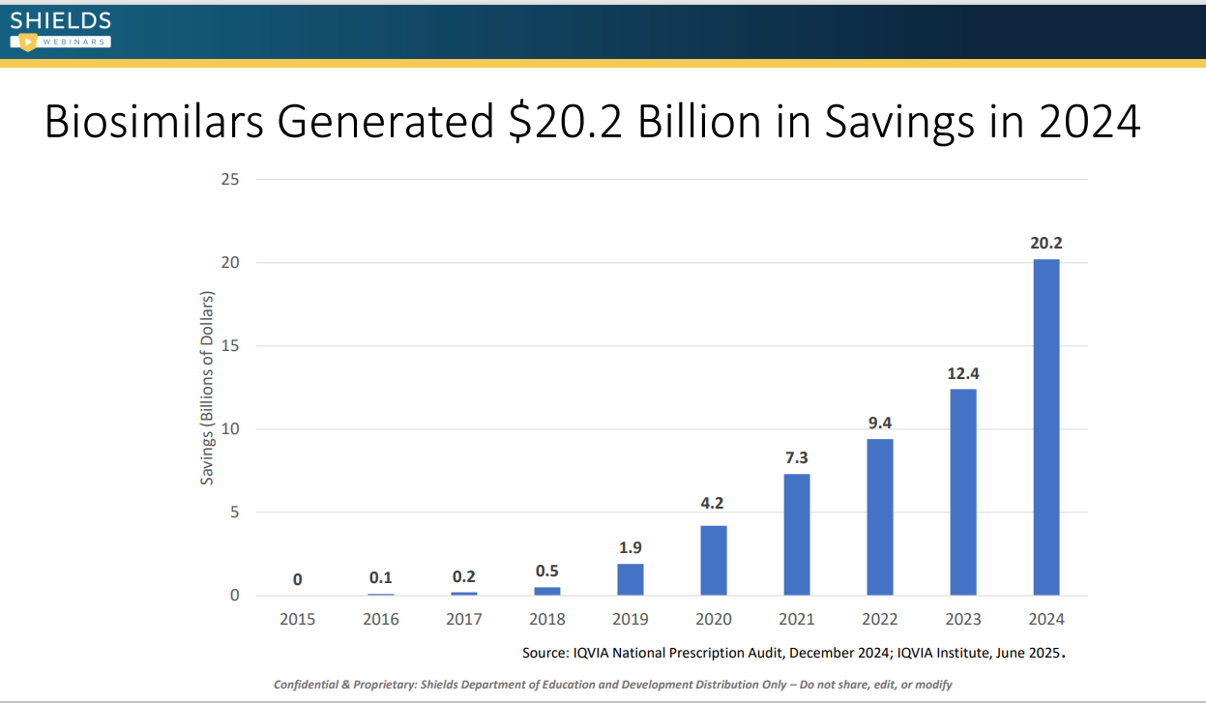
Today biosimilars generate significant savings

Slide 18
Many new biosimilars in the drug pipeline
2025
2026
2027
2029
2030
2030
Nucala®
2025
Stelara®
2025
Xolair®
2026
Orencia®
2027
Entyvio®
2025
NovoLog®
2025
Tysabri®
2026
Perjeta®
2027
Humulin®
2029
Keytruda®
2025
Prolia®/Xgeva®
2025
Simponi®
2029
Opdivo®
2029
Cosentyx®
2025
Soliris®
2029
Enbrel™
2029
Ocrevus®

Slide 19
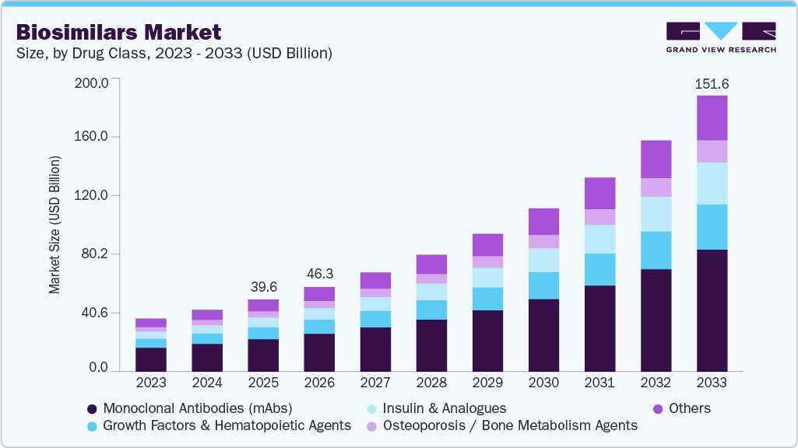
…driving significant future plan savings
Biosimilars Market Size, Share & Trends Report, 2026-2033

Slide 20
What can a plan do to encourage biosimilar use?
Drug spend 101
Notes:
Need to set the stage for the broader conversation

Slide 21
FRAMEWORK FOR 97% PLAN COSTS
Cost of drug is by far the largest expense in the equation.
Amount paid by plan for drug = Cost of drug + pharmacy dispensing fee - member cost share
Cost of drug = ‘Retail price’ – network discount % – rebate (or other)

Slide 22
PBMs highly influence the Cost of Drug variable
Choose which drugs are covered based (partially) on the ‘retail price’
Negotiate network discount %
Negotiate rebates

Slide 23
Humira vs Biosimilar Net Cost Example
Humira (reference brand)
Adalimumab (biosimilar)
Retail Price (AWP)
$7,000
Retail Price (AWP)
$2,000
– Network discount (15%)
–$1,050
– Network discount
–$400
– Rebate
–$3,500
– Rebate
–$200
NET PRICE TO PLAN
NET PRICE TO PLAN
$2,450
$1,400

Slide 24
Plan’s Role in the Amount Paid By Plan For Drug variable
Determine member cost share
Implement other benefit design programs
Ask questions and challenge your PBM regarding all components of biosimilar Cost of Drugs

Slide 25
Low member cost share (tiering/copay)
Do not allow continued use of reference biologic
All new starts begin on biosimilar
Educate your members
Actively transition members
….. and ask questions of your pbm
Plans Call to Action in Encouraging Biosimilars

Slide 26

Most PBM’s Benefit When Plan Costs Go Up
Higher cost of drug =
% rebate retained by PBM
% network discount retained by PBM

Slide 27
Questions To ask of your PBM –
Focus On Low Net Cost
Using a biosimilar first policy?
Are there biosimilars available that we’re not using? Why?
Why are we still covering the expensive brand if there’s a cheaper option?
How much money would we save if fully switched to biosimilars?

Slide 28

KEY TAKEAWAYS
%
Biggest Cost Pressure
Real Savings Opportunity
Partnership Drives Adoption
Biologics are the single largest driver of rising drug spend.
Biosimilars offer plans 15-30%
in savings.
A strong Plan + PBM relationship is what turns opportunity into results.

Slide 29
Questions

