Slide 1
FERMA
2024
John M. Drye, Esq. Campus Benefits

Slide 2
John M. Drye, Esq.
General Counsel & Chief Risk Strategist – Campus Benefits
Home Office – Atlanta, GA
Work in all 50 US states & Abroad
PPACA , Healthcare Reform & Public School Employee Benefits
In 2013 - 2024, completed training sessions to over 600+ Public School System Risk Managers in the Southeast US.
Contact: Jdrye@CampusBenefits.com
What will we discuss today:
1. A Primer on “Mission Risk”
2. HIPAA, Negligence and Fiduciary… oh my
3. What does the word “Fiduciary” mean for you or who?
4. Fiduciary Risk in practice
Presentation Disclaimer:
This Presentation is not intended to be exhaustive nor should any discussion or opinions be construed as legal advice. Listeners should contact school legal counsel for legal advice.
www.CampusBenefits.com

Slide 3
What is the biggest Risk Management Issue you face at your School District?

Slide 4
Topics Since 2013
Employee Benefits and Compliance alone are a significant task
DHS Ends Temporary Covid-19 policy on Form I-9
Machine Readable Files
Educating Staff on PHI
Business Associate Agreements for ALL Vendors
Transparency in Coverage Rule
Hospitals Transparency Rule
Security Rule in 2004
HiTech Act of 2009
Omnibus Rule of 2013
No Surprises Act Section 202(c) of the CAA
Laws involving federal-state preemption
Discrimination
Privacy
Employee leave requirements under FMLA
Federal discrimination statues
ADA (Americans with Disabilities Act)
Title VII
Pregnancy Discrimination Act
Criminal Background checks
Employee confidentiality
Data and privacy laws
Employee free speech concerns
Roe v. Wade & Dobbs Decisions on Abortion
PPACA Rollout 4980 (a) & 4980 (H) offers of coverge
Whistle Blower (42 U.S.C §18001)
Understanding the Exchanges
Participating FL Insurance Carriers in Exchanges
Compliance Plans for
IRS
DOL
HHS
Educating Staff on PHI
Florida Information Protection ACT (2014)
SBS “Culturally & linguistically appropriate”
1094 & 1095 Forms
226-J Notices
HHS Audits – HIPPA Compliance Gaps
Privacy Rule
Security Rule
Breach Notification Rule
GDPR & California Privacy rules in the US/FL
Look Back and Affordability Percentages
FIPA and K-12 Cyber
Telemedicine / virtual care clinics
MEC, EHB, SBC and w-2 reporting requirements
PCORI and Transitional Reinsurance Fees

Slide 5
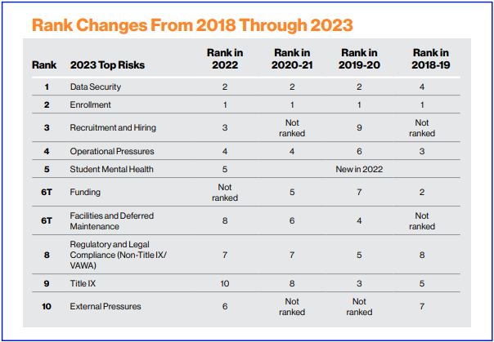
What is on the minds of Risk Managers in Higher Education
UE Survey of 112 Colleges & Universities (2023)

Slide 6
Risk Management “Mission” From a 30-year Public School Practicing Lawyer/Risk Manager
Five Not-So-Simple Steps
Identify the Risk
Analyze the Risk
Prioritize the Risk
Implement a Solution/Mitigation Strategy
Monitor/Manage the Risk
Where Do K-12 Schools Struggle in the Process?

Slide 8
"You keep using that word. I do not think it means what you think it means.“ Inigo Montoya
Fiduciary / Fiduciary Liability / Fiduciary Breach / Fiduciary Responsibility

Slide 9
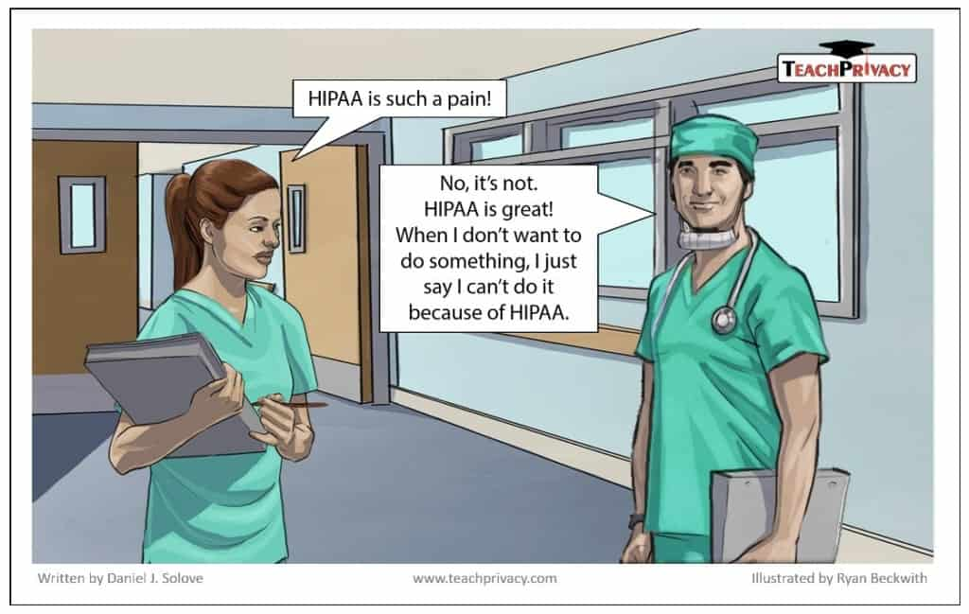
Risk Management: When all else fails… claim HIPAA Fiduciary Duty
Fiduciary Duty
Fiduciary Duty
&

Slide 10
The term fiduciary comes from the Latin term for “faith” or “trust.”
A fiduciary responsibility is an obligation that prevents one party from acting in their own interest rather than in the interest of the organization.
There is an important distinction between (a) Being a Fiduciary and (b) having Fiduciary Responsibility / Liability.
One is a formal designation with typically statue defined responsibilities
One is specific duty (six general types) owed to a protected class
Breach of fiduciary duty lawsuits can proceed in Florida courts as long as the plaintiff can show that one party has accepted the trust and assumed the duty to protect a weaker party
(Quinn v. Phipps, 93 Fla. 805, 113 So. 419, 420-421).

Slide 11
The term “Fiduciary” is used frequently in professional circles in school district settings:
It can apply to multiple positions:
An individual(s) (Finance/Benefits/Superintendent) can be a:
“Plan Sponsor” FIDUCIARY or an “Administrator” FIDUCIARY
Self-funded medical plan Fiduciary
If applicable an insurance “ERISA” fiduciary
An investments (403 b) fiduciary
2. A Board Member can be a district wide Fiduciary
WHO IS NOT A FIDUCIARY?
Attorneys, accountants and actuaries generally are not fiduciaries when acting solely in their professional capacities. Similarly, a third-party administrator (TPA), recordkeeper or utilization reviewer who performs solely ministerial tasks is not a fiduciary; however, that may change if the entity exercises discretion in making decisions regarding a participant’s eligibility for benefits.

Slide 12
Many School District Advisors are also NOT Fiduciaries … because of CONTRCT provisions.
(11) NOT an Administrator or Fiduciary: Client expressly acknowledges that the services and consultation provided by Broker, or any of our affiliates or subcontractors, does in no way make or constitute making Broker an “administrator” within the meaning under applicable law, including the Employee Retirement Income Security Act of 1974, as amended (“ERISA”). Further except as may be specifically agreed upon in any SOW (Statement of Work), neither we nor any of our affiliates or subcontractors is a “fiduciary” within the meaning under applicable law or ERISA, unless provided otherwise herein or required by applicable law. The responsibilities of Administrator and Fiduciary shall remain exclusively with the Client and the Client Benefit Trust Fund.

Slide 13
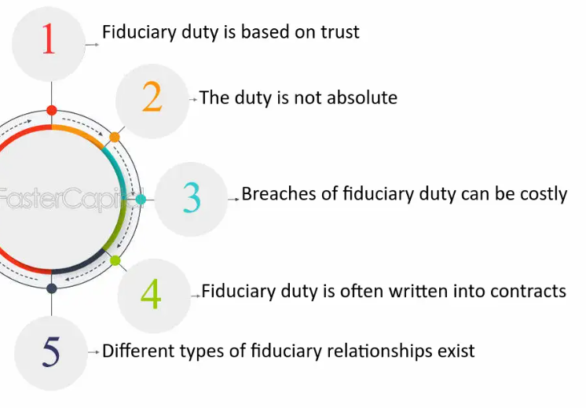
Fiduciary Responsibility
Why Are Fiduciary Responsibilities Important?
Protect a Districts/Employees assets from loss or misuse of power
Prevent conflicts of interest
Provide greater accountability and transparency
Promote professionalism from the Districts' leaders
What Are the Elements of Fiduciary Duties?
Each of the six primary duties fall into one of six categories:
Duty of Care
Duty of Loyalty
Duty of Obedience
Duty of Confidentiality
Duty of Prudence
Duty to Disclose

Slide 14
Elements of Fiduciary Duties
Duty of Care
Board Members must serve with the same care and concern as any prudent and ordinary person would manage their personal affairs or business.
Participating actively in board meetings
Working to advance the District’s directive & goals
Practicing oversight of programs & activities
Monitor budgets & financials
Serving on special committees
Engaging in strategic planning & goal setting
Questioning district spending
Duty of Loyalty
Duty of loyalty means that boards must place the interests of the district ahead of their own interests at all times. Board members are required to publicly disclose any conflicts of interest and not use board service as a means for personal or commercial gain.
Duty of Obedience
Duty of obedience requires board support of all applicable laws and regulations and identification of any illegal or unauthorized activities. The duty of obedience also means that board carry out the district’s mission in conjunction with stated directives and local initiatives

Slide 15
Elements of Fiduciary Duties
Duty of Prudence **
Boards must be aware of risks and exercising caution in decision-making. Board members are expected to handle matters with a high degree of professionalism and be accountable approving expenditures wisely.
Duty to Disclose
Duty to disclose requires board members to be forthright in their speech and behavior. If they have information that would influence their decisions or impact the decisions of other board members, they have a duty to disclose information known.
Duty of Confidentiality
Boards must keep certain types of information confidential and protect the unauthorized disclosure of private or protected data. They must not use the information they see, hear or review in the scope of their position for personal gain.

Slide 16
Are School Districts Subject to ERISA ???
Fiduciary responsibility is contained in Employee Retirement Income Security Act (ERISA), which applies to the responsibility within retirement plans for employers that are not exempt from Title I of ERISA. Public education employers are exempt from ERISA under ERISA Section 3(32). There is no fiduciary exposure for public school districts under ERISA.
The Department of Labor
The Employee Benefits Security Administration (EBSA), which is part of the U.S. Department of Labor (DOL), enforces the Employee Retirement Income Security Act of 1974 (ERISA). EBSA has 15 field offices across the country and a national office in Washington, DC
The Internal Revenue Service
Final 403(b) regulations, effective on January 1, 2009, govern and set forth the compliance responsibilities for all employers sponsoring 403(b) plans. There is no reference to fiduciary responsibilities in those regulations. In fact, the IRS does not have the authority to impose fiduciary responsibilities on any employer.
See sections 3(32) and 4021(b)(2) of the Employee Retirement Income Security Act of 1974 (ERISA) for definitions of the term “governmental plan,” which govern respectively for purposes of title I and title IV of ERISA.

Slide 17
Lets talk about ERISA
The Employee Retirement Income Security Act of 1974 (ERISA) can hold fiduciaries liable for a number of consequences if they breach their fiduciary duties, including:
Legal Remedies
Fiduciaries may be held personally responsible for restoring any losses to the plan and returning any profits made through improper use of plan assets. They may also be liable to participants for lost earnings or improperly received profits. (29 U.S. Code § 1109)
Civil Penalties
The Department of Labor (DOL) can assess a civil penalty of up to 20% of the amount the plan recovers from the fiduciary as a result of a court order or settlement with the DOL.
Removal From Fiduciary Position
Fiduciaries may be removed from their fiduciary position.
Criminal Prosecution
In extreme cases, fiduciaries may face criminal prosecution, including fines of up to $100,000 and imprisonment for up to 10 years.
State Law
Some states outline standards and civil penalties for Breach of Fiduciary Duties
ERISA's goal is to avoid conflicts of interest, so fiduciaries are expected to work for plan participants

Slide 18
A 2020 Bill in the Florida House attempted to outlined six Public Official fiduciary duties:
1. Act in accordance with the laws, ordinances, rules, policies, and terms governing his or her office or employment.
2. Act with the care, competence, and diligence normally exercised by private business professionals in similar corporate and
proprietary circumstances.
3. Act only within the scope of his or her authority.
4. Refrain from conduct that is likely to damage the financial or economic interests of the governmental entity.
5. Use reasonable efforts to maintain documentation in accordance with applicable laws
Maintain reasonable oversight of any delegated authority and discharge his or her duties with the care that a
reasonably prudent person in a like private business position would believe appropriate under the circumstances, & must:
o Become reasonably informed in connection with any decision making function;
o Become reasonably informed when devoting attention to any oversight function;
o Keep reasonably informed concerning the affairs of the governmental entity; and
o Keep reasonably informed concerning the performance of a governmental entity’s executive officers or other officers,
agents, or employees.
Died in Government Operations and Technology Appropriations Subcommittee (on 03/14/2020)

Slide 19
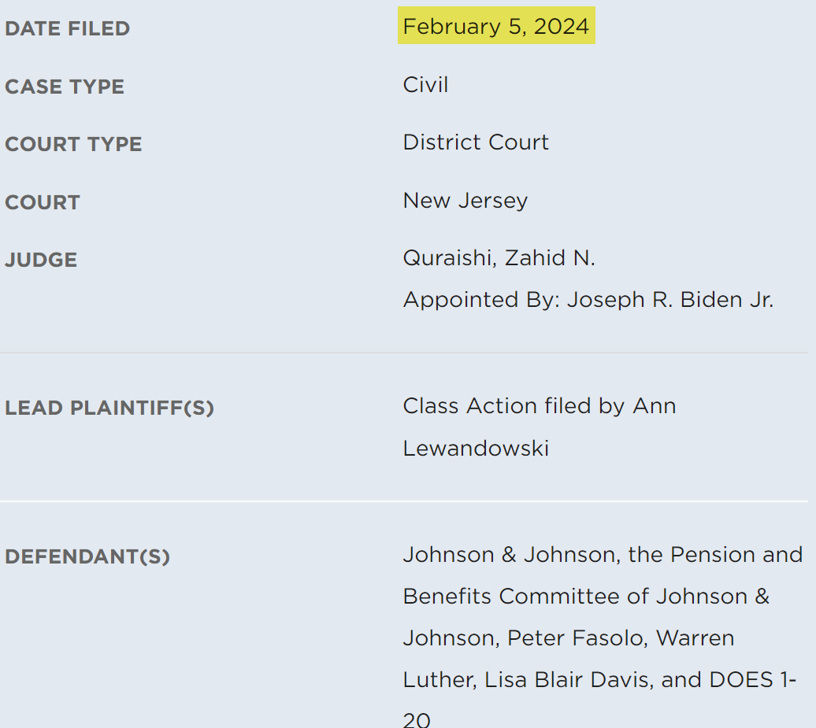
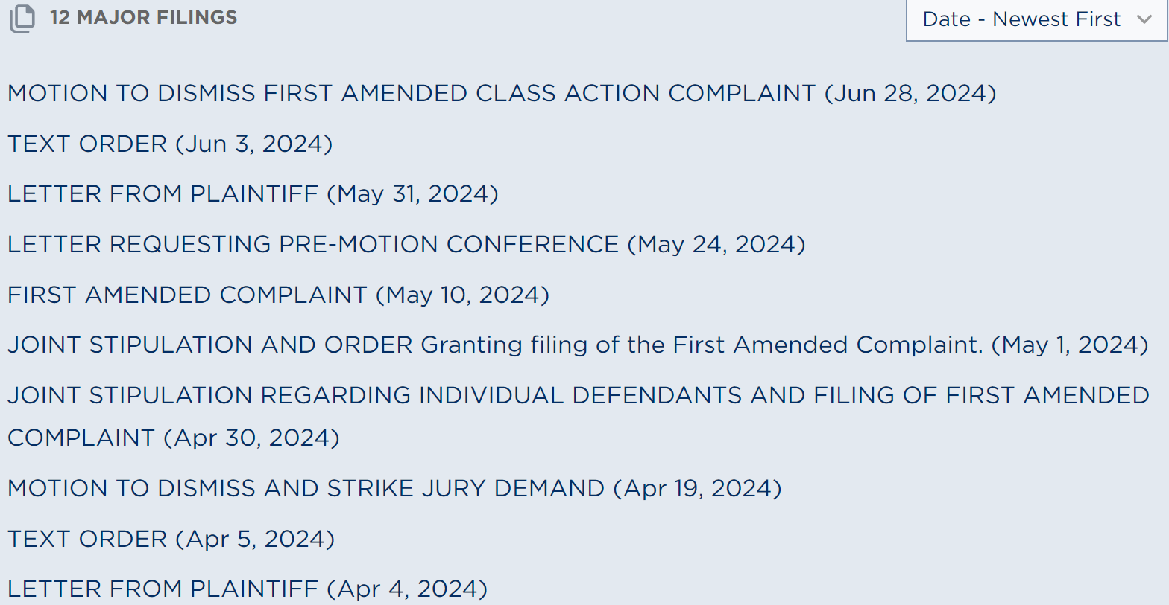
Lewandowski v. Johnson and Johnson et al
Johnson & Johnson Case
Popular with “Google Lawyers”, TPAs, PBM Consultants & Brokers

Slide 20
What does this mean for my School District?
Details of the Case
Across a range of 42 drugs, the complaint alleges that the plan’s negotiated prices were dramatically marked up concluding that “[n]o prudent fiduciary would agree to pay their PBM an average 498% markup above cost.”
$10,000 for a 90-day prescription of generic drug teriflunomide, used to treat multiple sclerosis, that would have cost as little as $28 from online pharmacy Cost Plus Drugs.
Hospitals and health plans are required to make their negotiated prices publicly available, but drug prices and information about how PBMs like Express Scripts price the drugs they manage has not been as open.
Plaintiff claims Defendant’s broker engaged in “spread Pricing” and took exorbitant fees as much as $6.50 per script to the broker.
Plaintiff alleges that the defendants’ conduct violates their fiduciary duty under the Employee Retirement Income Security Act (ERISA) to ensure that prescription drug prices under their health benefit plans (PBMs) are reasonable.
The mismanagement of health benefit plan funds can contribute to:
* increased health care premiums and
* out-of-pocket drugs costs,
* while also constraining employee wage growth.
Duty of Prudence

Slide 21
The Plaintiff’s theory of recovery
The words “fiduciary” and “fiduciaries” are used over 150 times in the J&J complaint.
Employers generally are subject to the ERISA plan administrator fiduciary duties of loyalty (the exclusive benefit rule), prudence, diversification, and to follow the plan terms.
DOL guidance suggests that the duty of prudence is better viewed as a prudent “expert” standard, at least in situations requiring specialized knowledge and expertise.
For example, in the retirement plan investment context, the DOL has stated that the fiduciary should determine whether it possesses the requisite expertise, knowledge, and information to understand and analyze the nature of the risk and potential returns involved in a particular investment. If the employer does not have personnel whose judgement meets that prudent expert standard, it should consult with someone who does have the appropriate level of expertise.
This is the primary basis for the J&J breach of fiduciary duty complaint, which argues that “ERISA's duty of prudence requires plan fiduciaries to make a diligent effort to compare alternative service providers in the marketplace, seek the lowest level of costs for the services to be provided, and continuously monitor plan expenses to ensure that they remain reasonable under the circumstances.”

Slide 22
If a School is not subject to ERISA… are we in the clear?
The Consolidated Appropriations Act, 2021 (CAA) includes provisions that apply to group health plans, including non-ERISA plans:
Prescription Drug and Health Care Spending Data Collection (RxDC)
Requires employer-based health plans and insurance companies to submit information about health care and prescription drug spending to the Departments of Health & Human Services, Labor, and the Treasury
2. Transparency in Coverage
Requires group health plans to report more information about medical and prescription drug costs
3. Pricing information disclosure
Requires group health plans and insurers to disclose pricing information in three phases, including publicly posting machine-readable files for in-network rates, out-of-network allowed amounts, and prescription drug negotiated rates
4. Mental Health Parity and Addiction Equity Act (MHPAEA) compliance
Requires group health plans to comply with the MHPAEA, which prohibits plans from imposing more restrictive financial burdens or treatment limitations for mental health or substance abuse disorders than those applied to comparable medical or surgical benefits
5. Gag clause prohibition
Prohibits health insurance issuers and group health plans from entering into agreements that include gag clauses, which are contractual terms that restrict the ability to share, access, or provide certain information

Slide 23
Under Pressure
Best Practices for Plan Sponsors, Fiduciaries and YOU!
It is in sponsors’ best interest to establish a fiduciary committee for their health plan, if they have not already, because this helps establish a process around gathering information and deeming costs reasonable.
it is important to make sure that fiduciary insurance covers the health care side of the plan, not just retirement, because some polices do and others do not.
Forming a committee is important because with the J&J lawsuit, they didn’t have a committee and by default, they named individuals in the lawsuit…. In this case it was the HR Department along with the C-Suite
Identify, Analyze, Prioritize, Implement & Monitor/Manage….

Slide 24
John M Drye, Esq.
Campus Benefits General Counsel
JDrye@CampusBenefits.com
ETupper@CampusBenefits.com
(Eric Tupper)

