Slide 1
How to Predict & Manage High-Cost Claimants
Prepared for FERMA
July 16, 2025

Slide 2
Topics for Today’s Discussion
1
High-Cost Claimant Trends
Managing High-Cost Claimants
Predictive Analytics for High-Cost Claimants
Acting on the Data for Plan Management
Example Strategy: Leveraging On-site Clinics to Manage HCCs
Cell and Gene Therapy Risk Management Deep-Dive
2
3
4
5
Proprietary and Confidential

Slide 3
1. High-Cost Claimant Trends
Notes:
Nicole – 7 min

Slide 4
On the Path to 10%+ Healthcare Trend
After years of moderating healthcare cost increases (pre-COVID), expect challenges regarding higher healthcare costs driven by:
Healthcare Trend
Chronic Conditions
Prevalence and complexity of chronic conditions are increasing across generations, and evidence that return to care is bringing more first-time diagnoses. Mental health deterioration is compounding the burden.
Inflation
The lagged impact of inflation is starting to be reflected in provider contract negotiations. The full effect won’t be seen for years due to multi-year nature of contracts.
Gene Therapies
Pipeline for new gene therapy products is robust. There could be 66 new therapies by 2032, addressing a growing percentage of the population, with each treatment costing millions of dollars.
M&A Activity
Continued M&A activity in the payor and provider spaces will continue to put upward pressure on trend due to decreased competition. Government intervention muted thus far in this category.
High-Cost Claims
HCCs are increasing in frequency and prevalence — 50% increase in frequency and of $1 million claims between 2020 and 2023
GLP-1s
Never has there been such an in-demand drug to such a large addressable market like obesity, and demand increased rapidly in 2024. 35% of employers cover GLP-1s for both diabetes and weight loss.
Source: Aon Trend Survey
Wild cards: New artificial intelligence applications, continuing federal and state regulation
Notes:
10 min for section - Liz

Slide 5
High-Cost Claimants
Impacting Every Employer
50%
Increase in the frequency of $1M claimants from 2020 to 2023¹
2-5% annual
Projected increase in immunology drug spending through 2028²
38%
Of employers rated “manage healthcare cost and trend” the number one benefit priority in 2024³
$
14-17% annual
Projected increase in spending on cancer drugs through 2028²
28%
Of employers cover Gene and Cell Therapies in their benefit plans³
Sources: 1. Sun Life 2024 High-cost claims and injectable drug trends analysis 2. IQVIA 2024: Outlook to 2028 3. 2024 Aon Health Survey

Slide 6
Distribution of Claims
Increasing frequency of $1M+ claims for those that are 45+
At the $1M layer, most claims are coming from members between the ages 45 to 64 while newborns represent only 19% of claims
At higher thresholds, newborns start representing a larger portion of claims, from ~30% at $2M to ~40% at $3M.
Members between 20 to 44 generally have the lowest frequency of $1M+ claims. A significant portion of these claims are coming from the pharmacy benefit
Source: Aon analysis of Marketscan Commercial Claims Database. Not to be duplicated in whole or in part. Copyright © Merative Marketscan. All Rights Reserved.
6

Slide 7
2017-2023 Top 15 High-Cost Claimants
Some of the largest claims continue to be Neonates
Rank | Year | Total | Condition | Categorization
1 | 2021 | $15.7M | Acute Respiratory Failure with Hypoxia, Sepsis | Respiratory
2 | 2017 | $14.2M | HAE Prescriptions | Endocrine
3 | 2019 | $11.8M | Ventricular fibrillation | Circulatory
4 | 2023 | $9.9M | Antineoplastic chemotherapy | Cancer
5 | 2017 | $9.9M | Malignant neoplasm of breast | Skin
6 | 2020 | $9.3M | Congenital malformations of heart | Neonate/Circulatory
7 | 2020 | $9.2M | Hemophagocytic lymphohistiocytosis - rare genetic disease | Immunological/ Neonate
8 | 2018 | $9.0M | Brain embolism and long hospital stay | Nervous
9 | 2020 | $9.0M | Neonate | Neonate
10 | 2019 | $8.8M | Obstructive hypertrophic cardiomyopathy | Circulatory
11 | 2020 | $8.3M | Infantile Spinal Muscular Atrophy with $8+ in drugs, all OP facility claims | Nervous
12 | 2020 | $8.2M | Perinatal issue - pediatric ICU | Neonate
13 | 2020 | $7.9M | Birth and heart issue - lots of pediatric ICU dollars | Neonate
14 | 2021 | $7.6M | Neonate, Cerebral Edema | Neonate
15 | 2021 | $7.6M | Congenital diaphragmatic hernia, pulmonary hypertension of a newborn | Neonate
When normalized for membership by each age cohort, newborns make up a disproportionate percentage of claims over $1M
Additionally, neonates are overrepresented by the largest claimants
Source: Aon analysis of Marketscan Commercial Claims Database. Not to be duplicated in whole or in part. Copyright © Merative Marketscan. All Rights Reserved.
7

Slide 8
2. Managing High-Cost Claimants
Notes:
Melissa – 5 min

Slide 9
Targeting Clinical Management
A Framework of Prevention – Risk Reduction – Treatment
Prevention
Risk Reduction
Treatment
Notes:
When we consider a framework for clinical management of high cost claimants, we have three key focus areas.
Prevention: reducing risks for developing chronic conditions, cancer or major health care events
Risk Reduction: implementing strategies for early detection of health risks, cancer screenings and strategies to reduce risk of deteriorating health through better management of chronic conditions and promotion of high-quality providers
Treatment: incorporating clinical management, high-quality steerage strategies and targeted solutions to better manage costs while improving outcomes

Slide 10
Roadmap to Targeting Clinical Management
Detail to follow
Analyze Data
Understand the Member Experience
Advance Strategy
Measure Outcomes
Know your Population
Predictive analytics
Gene and Cell Therapy forecasting
HCC assessments
Propensity to engage
Know your Vendor Capabilities
Inventory and gap analysis
Network access & utilization review
Payment integrity audits
Clinical Journey
Assessment of UM and CM programs
Alignment with industry standards
Access to community resources
Member experience audits
Work Journey
RTW policies
Organization culture and climate
Hands-on Oversight
Ongoing detailed review of high-cost claimants & recommendations to improve outcomes
Pharmacy Management
Biosimilar strategies
Outcome-based drug purchasing
Clinical oversight
Program Coordination
Employer-sponsored clinics
Chronic Condition Management
Utilization Management
Expert Opinion
Navigation
Targeted Claims Audit
Detailed review of claims processing
Ensure high-cost claims are paid correctly
Measurement
Process
Impact
Outcomes
Notes:
As you consider a roadmap to targeting clinical management, we think it’s important to start with the data.
You’ll notice we have red stars on the slide indicating that more detail will follow.
Going back to the data, we recommend the use of predictive analytics, gene and cell therapy forecasting, HCC assessments, and the propensity to engage
Before thinking about adding on vendors or services, it’s good to take an inventory of your current vendor capabilities.
You may also consider your network strategy, UM, CM, and payment integrity
From there, you’ll want to understand the member experience both within the healthcare system and at work
Then, you’ll start to consider how to advance your strategy
This may mean deep clinical support on managing HCCs at the member level, exploring pharmacy management, and program coordination. Employers in the education industry have a unique opportunity with employer sponsored clinics due to density of population in a particular area.
Finally, we want to measure outcomes so that we can iterate and have an even greater impact. This is also a good way to hold vendors accountable.

Slide 11
3. Predictive Analytics for High-Cost Claimants
Notes:
Nicole – 7 min

Slide 12
Employers are beginning to adopt sophisticated analytics models to manage high-cost claims
Historical
In past two years
26%
of employers already have predictive analytics as part of their high-cost claims strategy
28%
are interested in adding predictive analytics¹
Primarily used by health plan internal operations (e.g., fully-insured books)
Employers adopting advanced analytics solutions for benefits and risk management
Typically, linear and logistic predictive models
Advanced machine learning techniques
Typically, predictions on a group basis
Precisely-mapped member-level risk distributions
Source: 2025 Aon Health Survey

Slide 13
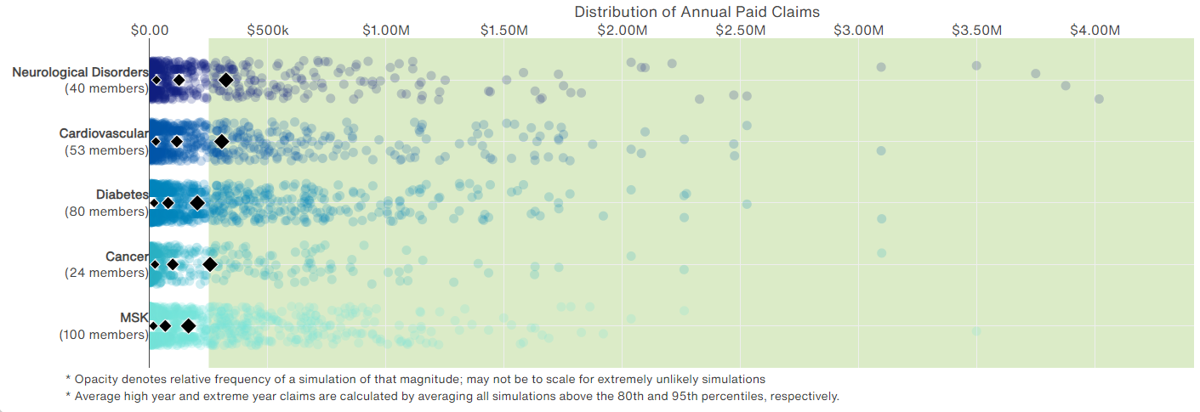
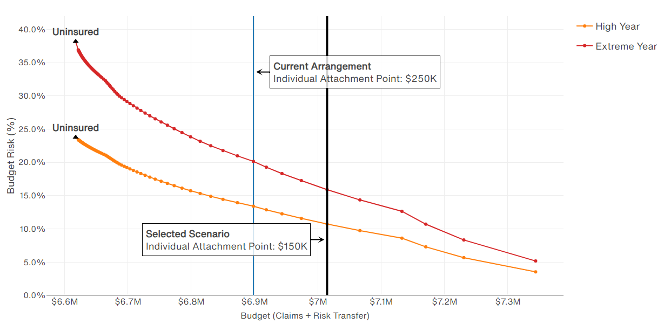
How employers have implemented machine learning to manage high-cost claims
Health Risk Analyzer
Latest-Gen Machine Learning
50%+ of high-cost claims predicted
Member-level risk & cost predictions
Precision budgeting
Regularly refreshed
20M+ Lives of Commercial data; Refreshed Regularly
Individual plan claims, demographics
Millions of simulations
Data scientist, actuarial, and clinician expertise

Slide 14
How are employers using machine learning in benefits and risk management?
Budget and forecast costs with increased precision
Protect Budget with reinsurance, captive, and financing strategy
Optimize Care Management to prevent & mitigate high-cost claims
Monitor emerging risks and novel therapies with robust reporting

Slide 15
4. Acting on the Data for Plan Management
Notes:
Nicole/Melissa to split section: 5 min

Slide 16
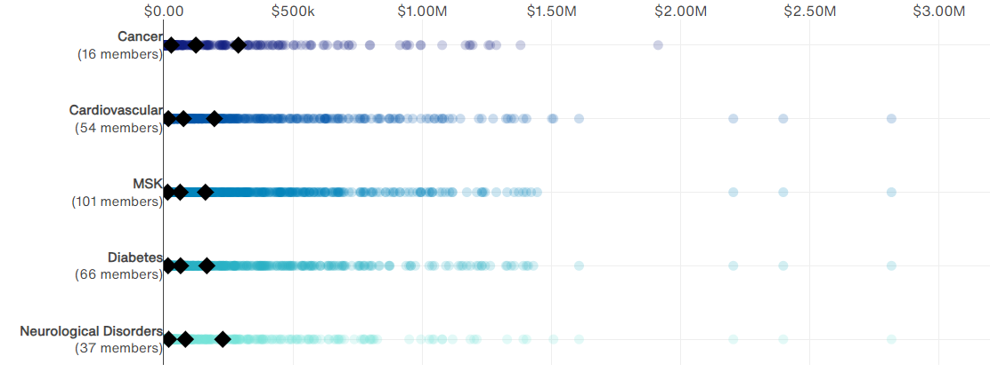
Managing Risk for a High Turnover Population
Case Study
Employer Background
Skilled nursing provider experiencing high turnover (40% in 2023)
Operating below annual budget and unsure if they should lower premiums
Considering eliminating aggregate stop loss
Interested in expanding programs beyond MSK program
Results
The client leveraged machine learning model projections to:
Eliminate aggregate stop loss, maintain budget, and achieve modeling ROI with premium savings
Support for the polychronic population (e.g., promotion of carrier programs, on-site screenings, prevention activities)
Continually monitor risk with reporting

Slide 17
Case Study: Large Retail Employer
Medical Carrier Cancer Strategies
 | Strategies in Place vs Available | Vendor | Comments / Opportunities
Plan Design/ Networks | Cancer Centers of Excellence (NCI?) Institute of Excellence® (IOE) for CAR-T and stem cell transplants; steerage High Performance Networks Oncology Support Incentive Designs |  | A Transplant Differential is in place (bone marrow and stem cell transplants) The Blue Distinction COE is not turned on No NCI Steerage
Utilization Management | Chemotherapy/Immunotherapy Prior Authorization NCCN guidelines and requirements SOC Steerage Precision Medicine Components and Requirements Diagnostic Imaging Prior Authorization Genetic Screening and Counseling Peer to Peer Decision Support |  | BCBS has precertification of chemotherapy turned on and they utilize NCCN Pathways Site of Care Steerage is not tuned on Radiation Therapy Management is not turned on Genetic Testing Support and Management is not turned
Clinical Member Support | Oncology Case Management (Population targeted) Comprehensive Oncology Care Management – Oncology RN, BH, Nutritional, Social Worker Support Timing of Identification and Engagement Treatment Decision Support Promotion of Clinical Trials |  | The BCBS Oncology Case Management program evolved from triggering 6 cancers and now targets 28 cancer types Holistic member support is in place Reporting needs to be provided to assess effectiveness of engagement and management Clinical Trials are not promoted
Preventive Care | GIC for Preventive Opportunities Member and Provider Interventions ACO/PCMH incentives for Physicians |  | BCBS does have targeted member communication materials on the recommended screening services
Notes:
This is an example of clinical score card where we focused on cancer
This particular client scored well on preventive care with the medical carrier targeted member communication materials based upon recommended screening services
However, there were no COEs activated except for bone marrow and stem cell transplants. There also wasn’t any steerage to NCI designated cancer facilities. We know that there are cancer diagnosis and treatment disparities that happen with community oncologists given the complexity of cancer.
Regarding UM, the client had precertification for chemotherapy turned on and they were using NCCN pathways. However, there was opportunity for site of care steerage, radiation therapy management, and genetic testing support.
Lastly, from a clinical member support, the case management was targeting 28 cancer types and supporting members holistically. We pushed the vendor on reporting around effectiveness of engagement and management. There was a gap in not promoting clinical trials.

Slide 18
4a. Example Strategy: Leveraging On-site Clinics to Manage HCCs
Notes:
Melissa – 10 min

Slide 19
Cultivating and Evolving Clinic Strategy
A Future of Advanced Care, Value-Based, and Accessible
Yesterday
Today
Tomorrow
Clinics
Reactive focus on acute needs or treatment
Lack of attention for prevention or holistic care
Must have large population of employees in one area
Very limited performance guarantees
Either occupational health or primary care
Tied to overall wellbeing strategy/goals
Primary and acute in-person care, some wrap around virtual services
Disconnected primary care and occupational medicine
Expansion to onsite specialty care but lack of integration
Evolving performance guarantees and well-established ROI
Virtual wrap-around for employees without clinic access
Focus on health equity and hybrid solutions in development for smaller populations
Data driven strategy and evolution
Holistic care for prevention, risk reduction, and treatment
Access to high quality, low cost, proactive advanced primary care
Informed referrals and integration into benefit ecosystems
High-quality, low-cost steerage
Stretch Performance guarantees for outcomes
Continually expanding hybrid solutions for smaller populations
Expanded national near-site shared networks
Aon Proprietary and Confidential

Slide 20
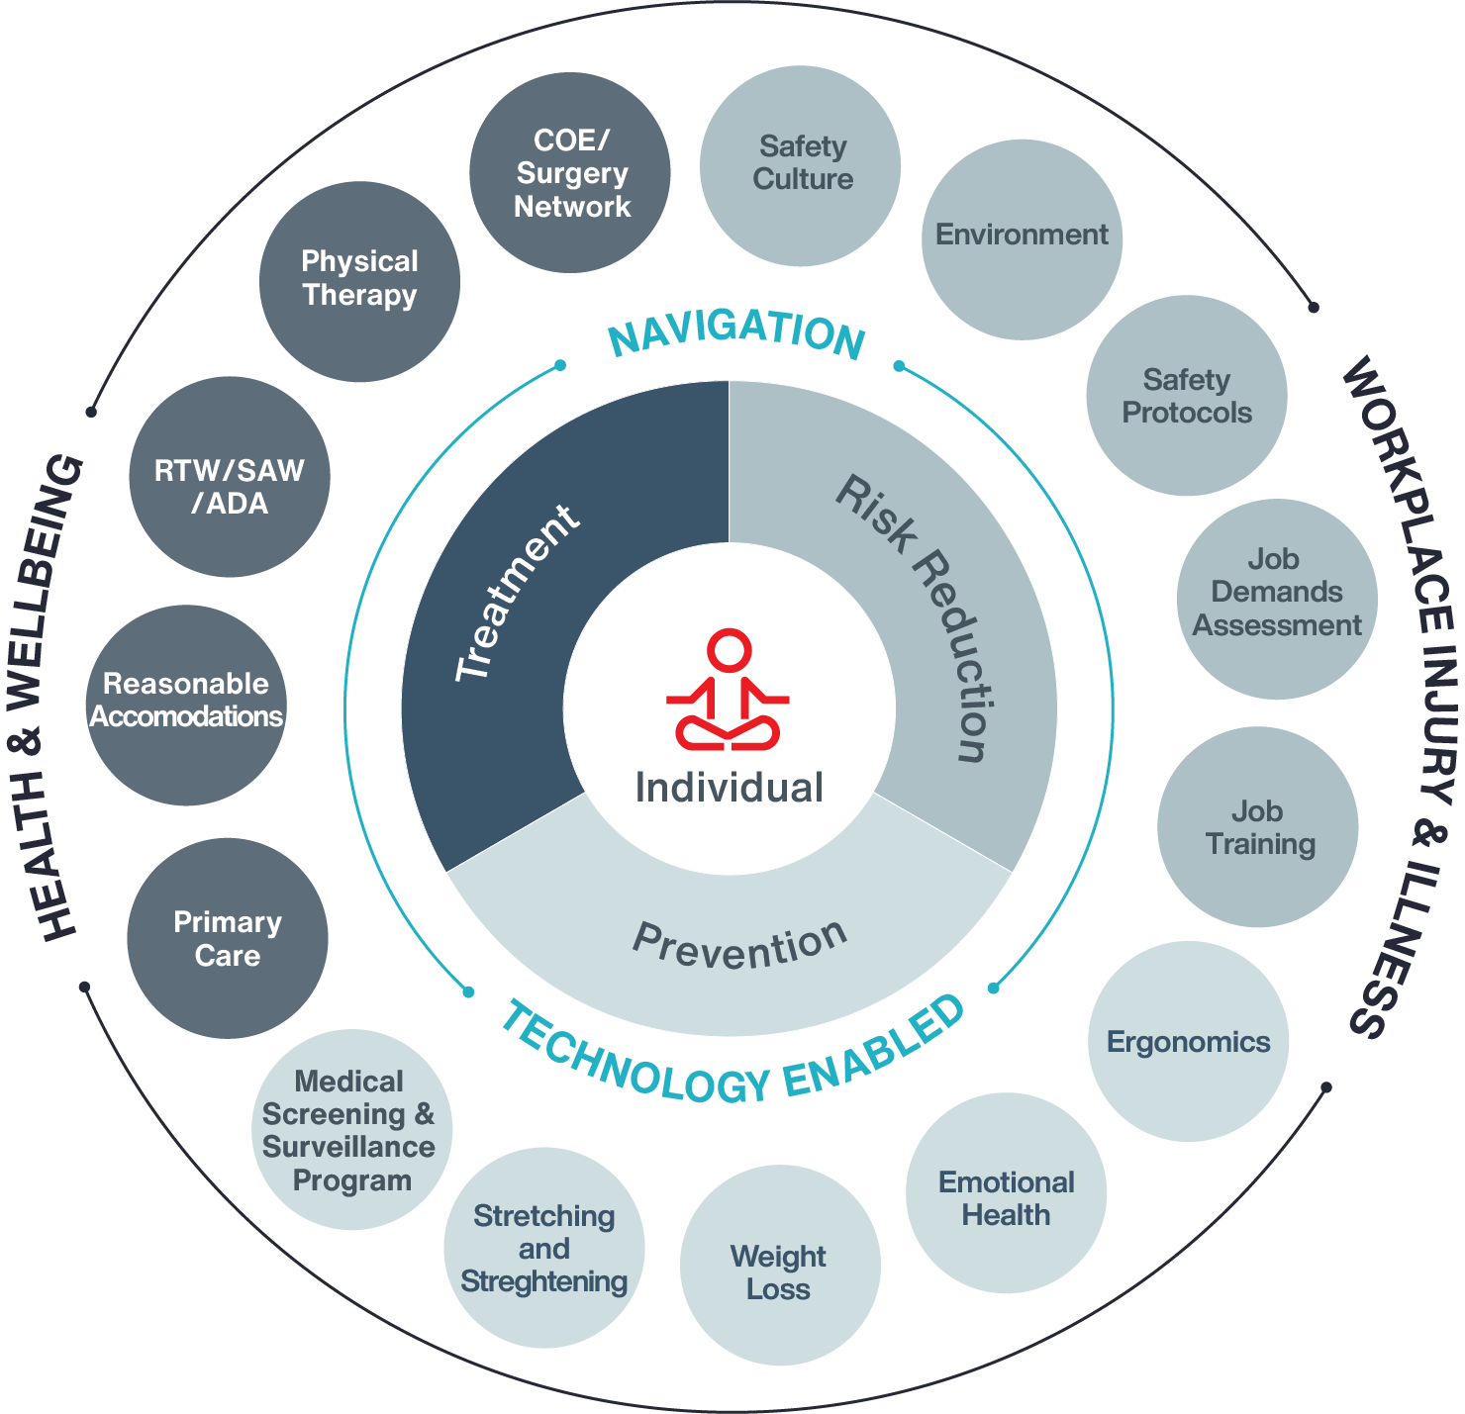
Bridging Risk, Safety, Absence and Health
Aon Proprietary and Confidential
Notes:
Occupational medicine is an ecosystem with its own internal logic.
There is a PRIMARY care level (where demand for basic services such as preplacement evaluations is primarily met by physicians not board certified in occupational medicine), a specialized consultation SECONDARY level (primarily met by providers specializing in occupational medicine), and a TERTIARY level requiring advanced expertise for medical evaluations and such.
These three levels are obvious for clinical care and case management, but they also exist for population health management (health monitoring, health promotion, program management). Primary care physicians who do not understand this ecosystem, and who assume that occupational medicine is all about injury care with some onerous paperwork attached, do not get the best outcomes.
Considerations:
Separate:
Occupational health providers are similar to specialists—trained in their unique field
Having a separate occ. model is usually the most expensive approach
You cannot create a firewall within one individual; therefore, the only way to keep information truly separate is to have multiple providers
Separation can cause fragmented care and silos
Trust issues with employees can occur when using the same provider for both services
Access to medical records can be better controlled and monitored with these services are kept separate
Combined:
With proper training and expertise, any provider is capable of doing a great job with occupational medicine
Understanding patients’ history outside of occ. can be invaluable
Resources don’t always allow for separation, and many clinicians are great at managing both
Communication issues can occur when having separate providers or vendors
Resource sharing and savings can occur when combining services providers (e.g., staffing, supply costs, salaries)
Occupational services should be an entry point to driving utilization of primary care services. Separating them can affect this opportunity

Slide 21
Integrating Occupational and Primary Care Services
EMR and Data Management
54% use single EMR across primary and occ health
45% use two separate EMRs and of those, 17% integrate both systems within data warehouse
Access to Records
Access to Primary Care provider: 85% of primary care records
Access to Occ Health provider: 85% of occ health records
Cross Training
82% of Primary Care providers receive training for recognizing work-related issues
31% of Occ Health providers receive training on primary care issues
38% available behavioral health records
46% available primary care records
15% available behavioral health records
54% available occ health records
31% receive training on how to improve work conditions and health at work
31% receive training on preserving and restoring working capacity
54% receive Return to Work (RTW) training
38% have a structured communication system to share information between providers
Helpful Tips:
Keep records segregated
Communicate and educate members that information is not shared bidirectionally unless approved by patient.
Recommend to offer both primary care and occ health in one space to streamline access to care and patient experience
Source: Integrating Occupational Health and Primary Care Services in a Worksite Center, NAWHC-Alliant, 2024

Slide 22
Best Practice Approach to Employer-Sponsored Clinics
Discover
Develop
Deliver
Determine
Captures what we need to know to identify opportunities, gaps and overall direction of offering a health center
Build the framework for short and longer-term strategy:
The methods and tactics through which the strategy will come alive by selecting the right vendor
Innovative techniques to measure the impact of the strategy and to identify needed evolution
Aon Proprietary and Confidential
22
Notes:
Within Aon’s Health Transformation Team (HTT), we have built a team designated to working with employer-sponsored clinics. This team guides clients through financial feasibility, vendor selection, implementation and governance, auditing, and redesign of their health centers.
Discover:
Captures what we need to know to identify opportunities, gaps and overall direction of offering a health center:
Goals and needs
Data collection/data review to determine population specifics and needed services
Program inventory for integration/navigation
Understanding member and leadership need and preference:
Stakeholder interviews
Employee focus groups/surveys
Feasibility analysis to determine financial value of clinic (ROI) over 5 years looking at multiple utilization rates
Business case
Develop
Build the framework for short and longer-term strategy:
Health Center strategy design based on feasibility analysis and goals, including scope of services, staffing, compliance, management model, build-out or remodel
Location specific strategy, if multiple sites
Integrated wellbeing and navigation
Multi-year framework
Measurement strategy
Deliver
The methods and tactics through which the strategy will come alive by selecting the right vendor
Vendor/partner selection
National vendor or local partner
Implementation and built-out or remodel
Construction
Plan design and compliance
Marketing and communications
Vendor Summit to ensure benefit program integration
Vendor governance oversight and management
Determine
Innovative techniques to measure the impact of the strategy and to identify needed evolution:
Audits and assessments which can include an Operational Assessment, Clinical PCMH Assessment and Quality Assessment with Value on Investment
Refine and evolve strategy and PGs, review data to understand potential expansion or needed changes, as appropriate

Slide 23
Feasibility Study
Cost Savings
Direct Savings
Expenses
Start-up Cost
Indirect Savings
Operating Cost
Benefits of conducting a feasibility study:
=
Unbiased third-party analysis to support Go/No-Go decisions
Educate stakeholders to onsite health center services, benefits, and risks
Estimate start-up and annual operating costs for 5 years along with net present value of savings
Data Collection
Assumptions
Analysis
Location
Demographics
Cost of services in the community
Existing health center utilization
Construction vs. renovation
Eligibility
Scope of services
Staffing
Utilization/penetration rate; 3 scenarios
Hours of operation
Direct and indirect savings
Staffing and space requirements
Implementation and ongoing costs
5-year benefit-to-cost ratio
Aon Proprietary and Confidential

Slide 24
5. Cell and Gene Therapy Risk Management Deep Dive
Notes:
Nicole – 5 min

Slide 25
Cell and Gene Therapy: What is it?
Gene Therapy
Cell Therapy
The use of genetic material in the treatment or prevention of disease
Cell and Gene Therapies
The transfer of intact, live cells into a patient to help lessen or cure a disease
Defining Characteristics
Intended to be curative, one-time Treatments
Medical Benefit
Regulated under FDA
High-cost Claims
Robust pipeline

Slide 26
Managing Cell & Gene Therapy Risk
Know your risk
Know your coverage
Know your options
Identify all FDA-approved cell & gene therapies as well as those in the near-term pipeline
Understand whether your existing stop loss coverage covers cell & gene therapies under current terms
Consider cell & gene therapy coverage options given their high costs, limited scope and uncertain efficacy
Forecast the potential exposure presented by each therapy based on population data and clinical information
Identify any gaps in coverage such as lasers and exclusions for members with known conditions
Assess how much risk you can retain based on business objectives and access to capital
Perform a clinical review of your health plan population to identify high-risk members who may qualify for therapy
Determine whether your current level of coverage is sufficient or if gaps need to be addressed
Select from the full spectrum of risk management strategies to address any residual cell & gene therapy risk

Slide 27
CGT Risk Management Spectrum
Traditional Methods | Captives | Licensed (re)insurance company owned by a self-insured organization; enables larger employers to reduce catastrophic claims volatility and stabilize financing costs while retaining profits and gaining direct access to the reinsurance market.
 | Group Captives | (Re)insurance structure established and controlled by multiple small and midsize self-insureds; enables employers that do not have the scale to self-fund on their own to spreads the risk of catastrophic claims over all members and collectively reduce volatility
 | Stop-Loss | Insurance policy that provides reimbursement to self-funded employers if their employee claims reach above the predetermined limit – can be designed at the individual claimant level or the aggregate portfolio level
Transfer the Risk | CGT Stop Loss / Carve-out | Stop-loss policy (individual or aggregate) that separately covers certain high-risk components of a larger insurance policy that have possibly been carved out
Spread the Cost | CGT Specific Loan | Financing option that allows employers to smooth volatility of claims by receiving a loan to pay for a high-cost GCT & making staged repayments; structures may vary (e.g., loan can be paid directly to pharma in full/installments with payments made to lender)
 | Access to Credit | Financial agreement in which credit is available to cover for non-budgeted, high-cost drug claims via a PEPM fee
Guarantee ROI | Warrantee Guarantee | Reimbursement option that is based on a guaranteed therapeutic outcomes; enables risk sharing between employer and manufacturer as manufacturer is financially liable if therapy does not product expected results
 | Outcome based payment | Financial agreement in which payments to a pharmaceutical manufacturer or provider is structured around seeing the expected outcome of a therapy (e.g., partial payment made at time therapy is administers and final payout once results are seen)
 | Employee Mobility | Clinical tracking of patients and their medical status as required for warrantees or outcomes-based solutions; this solutions/market need is presented with challenges around responsibility, data quality, logistics, funding and research/feedback loop

Slide 28
Thank You Contact Us! Nicole Netsov, nicole.netsov@aon.com Ryan Brown, ryan.brown3@aon.com
Aon - Proprietary & Confidential

